Slide 2

Ministerial roundtable I – Strengthening Trust in Science:
Promoting Effective Science-Policy-Society Nexus and Values in Science

Slide 3
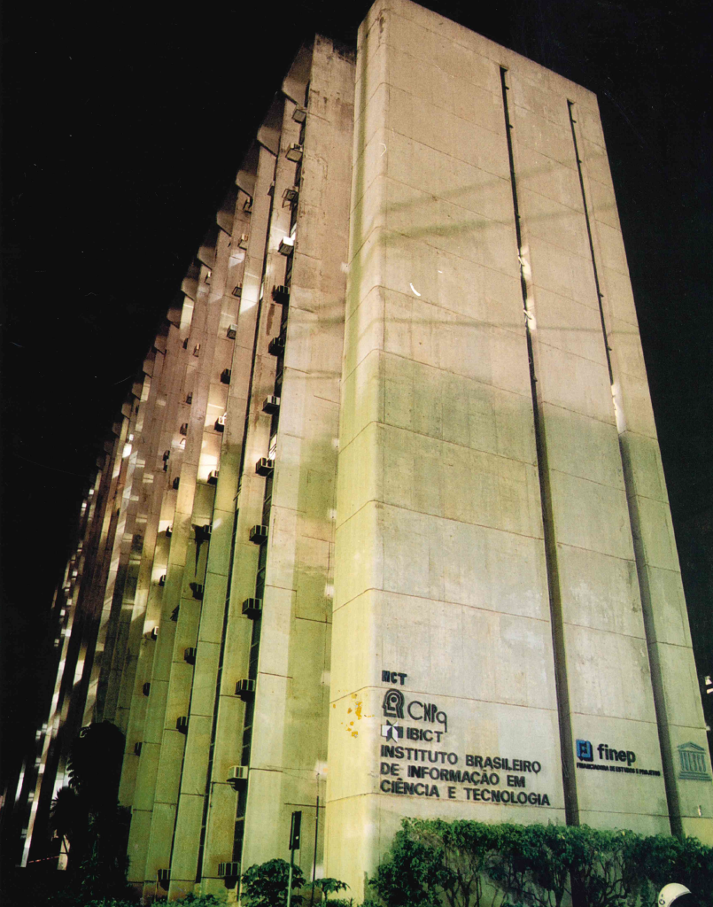
Brazilian Institute of Information in Science and Technology
Promote competence, the development of resources, and information infrastructure in science and technology for the production, socialization, and integration of scientific and technological knowledge.

Slide 4
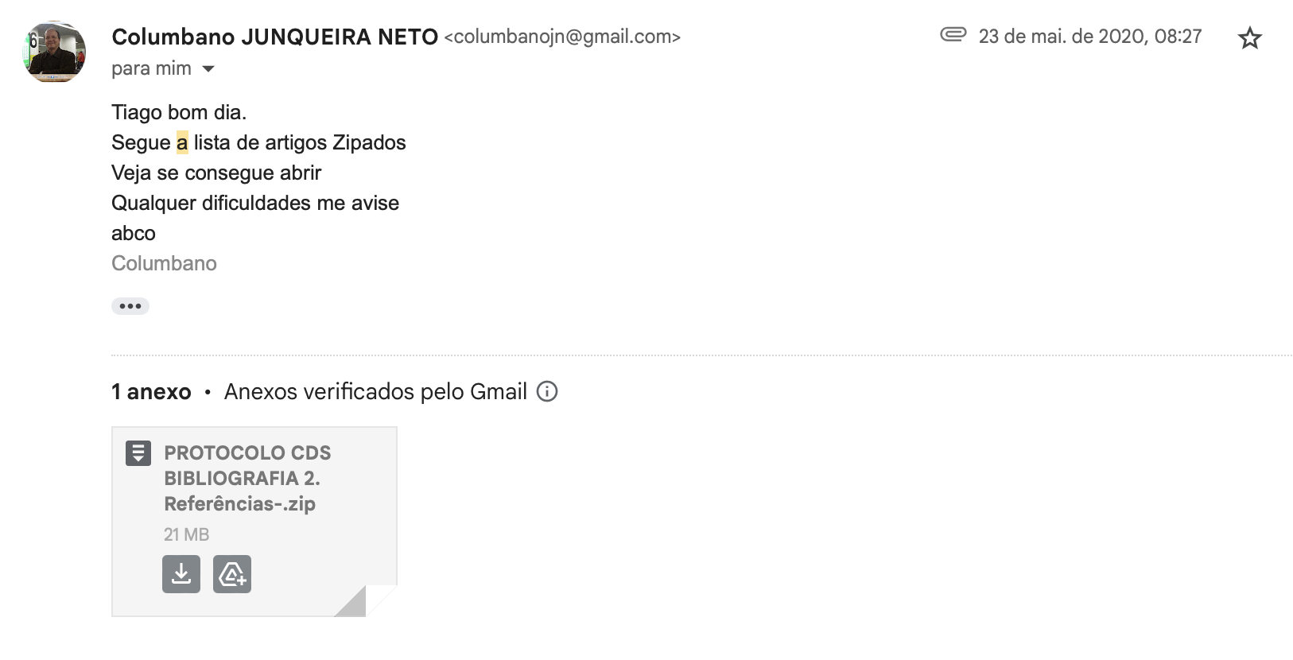

Slide 5
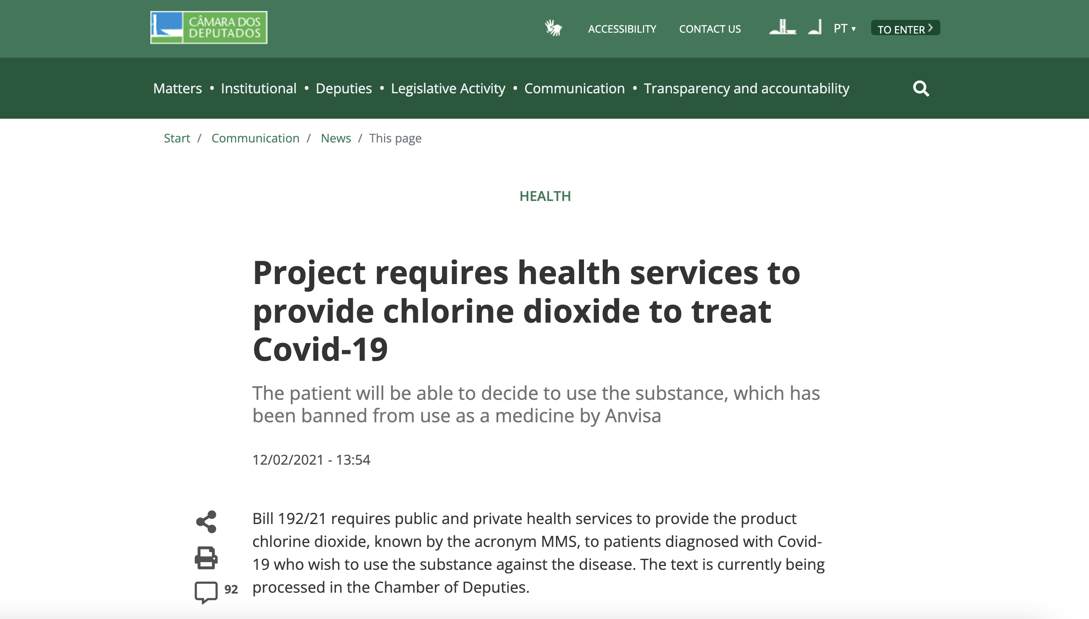

Slide 6
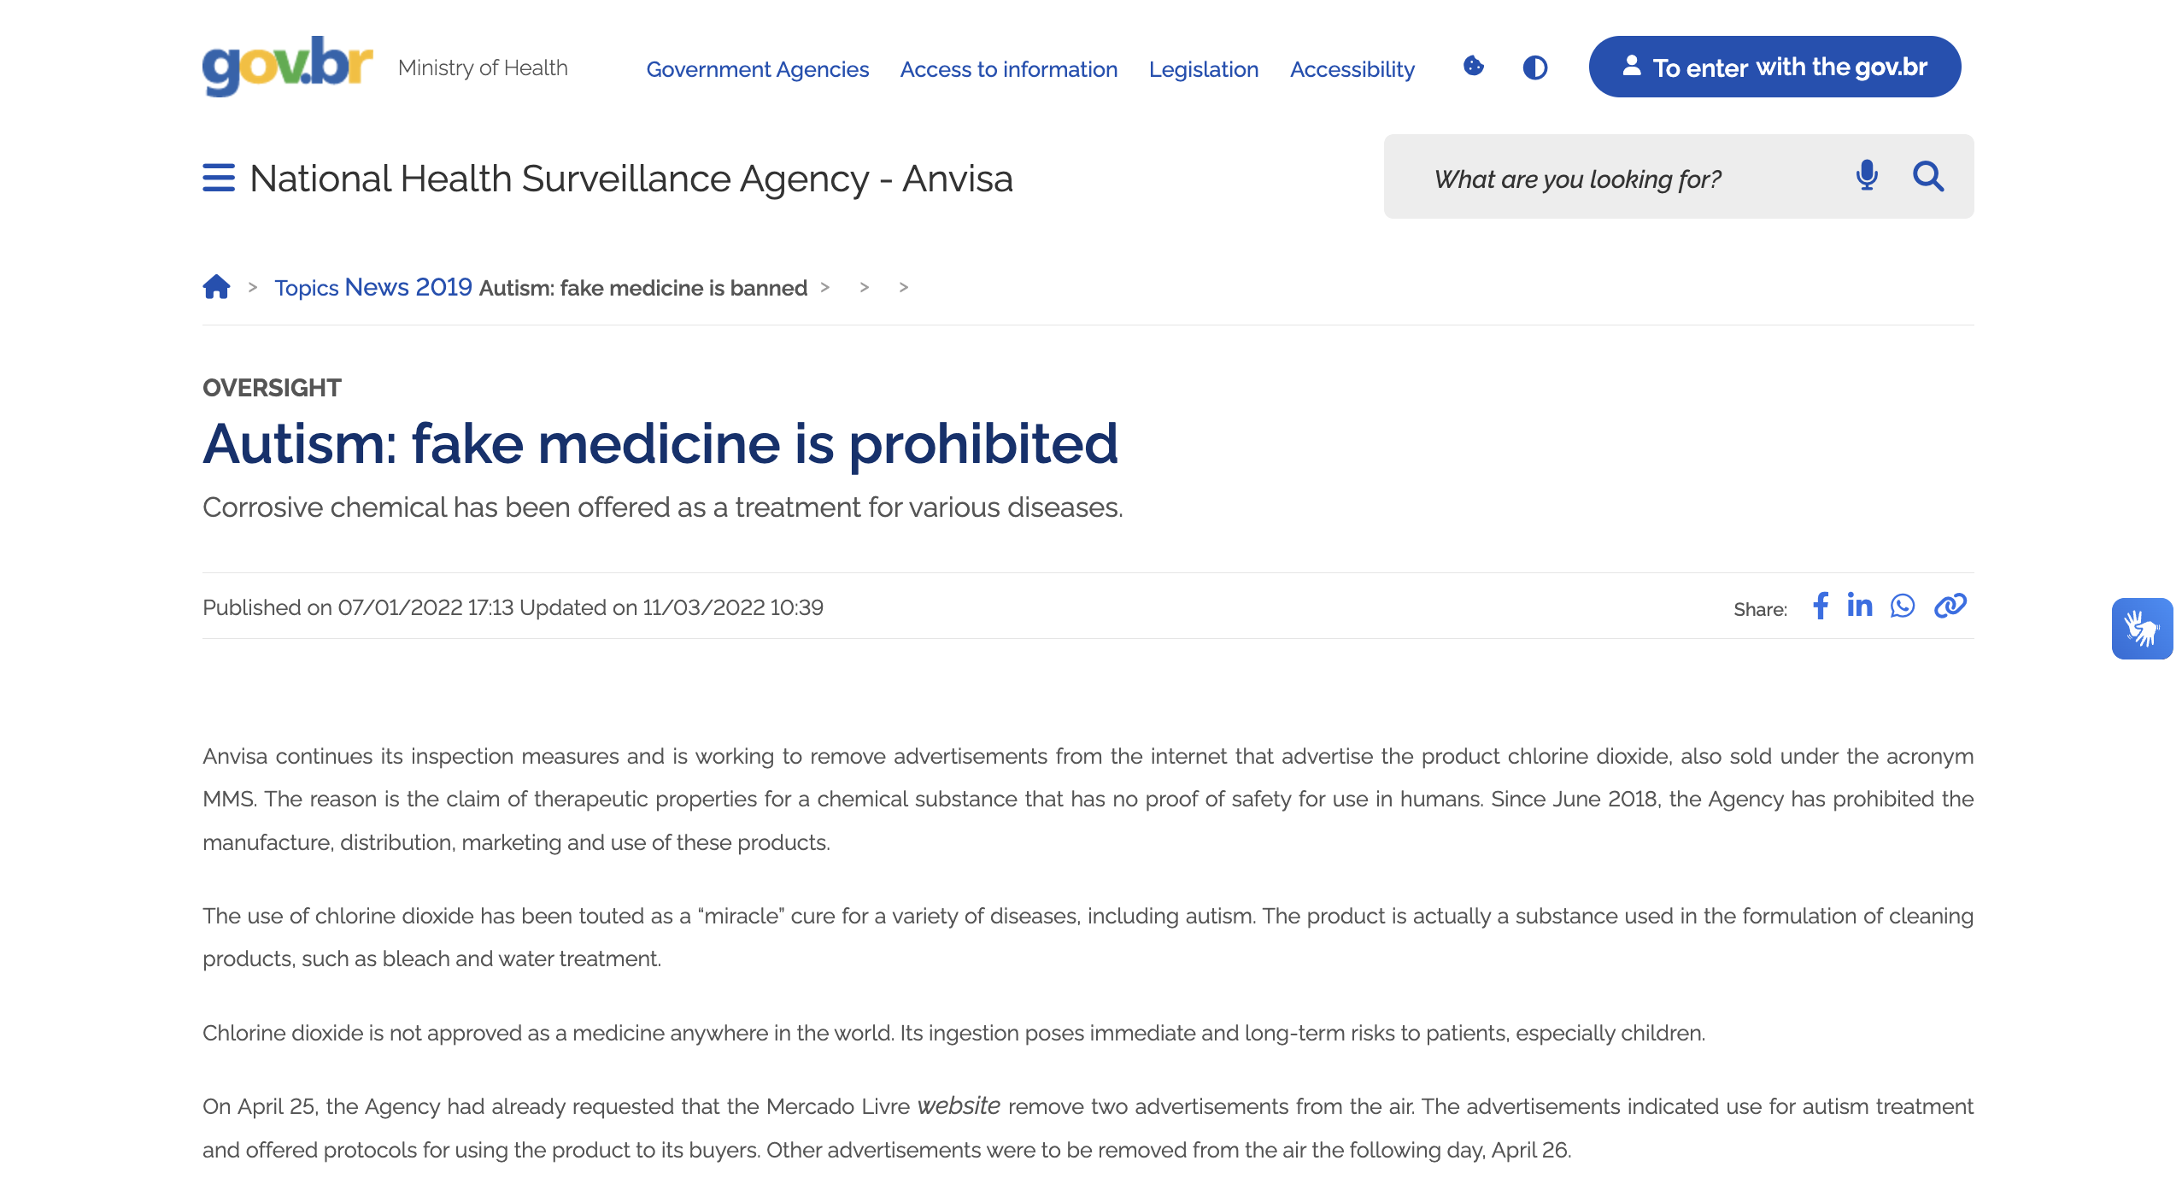

Slide 7



Slide 8
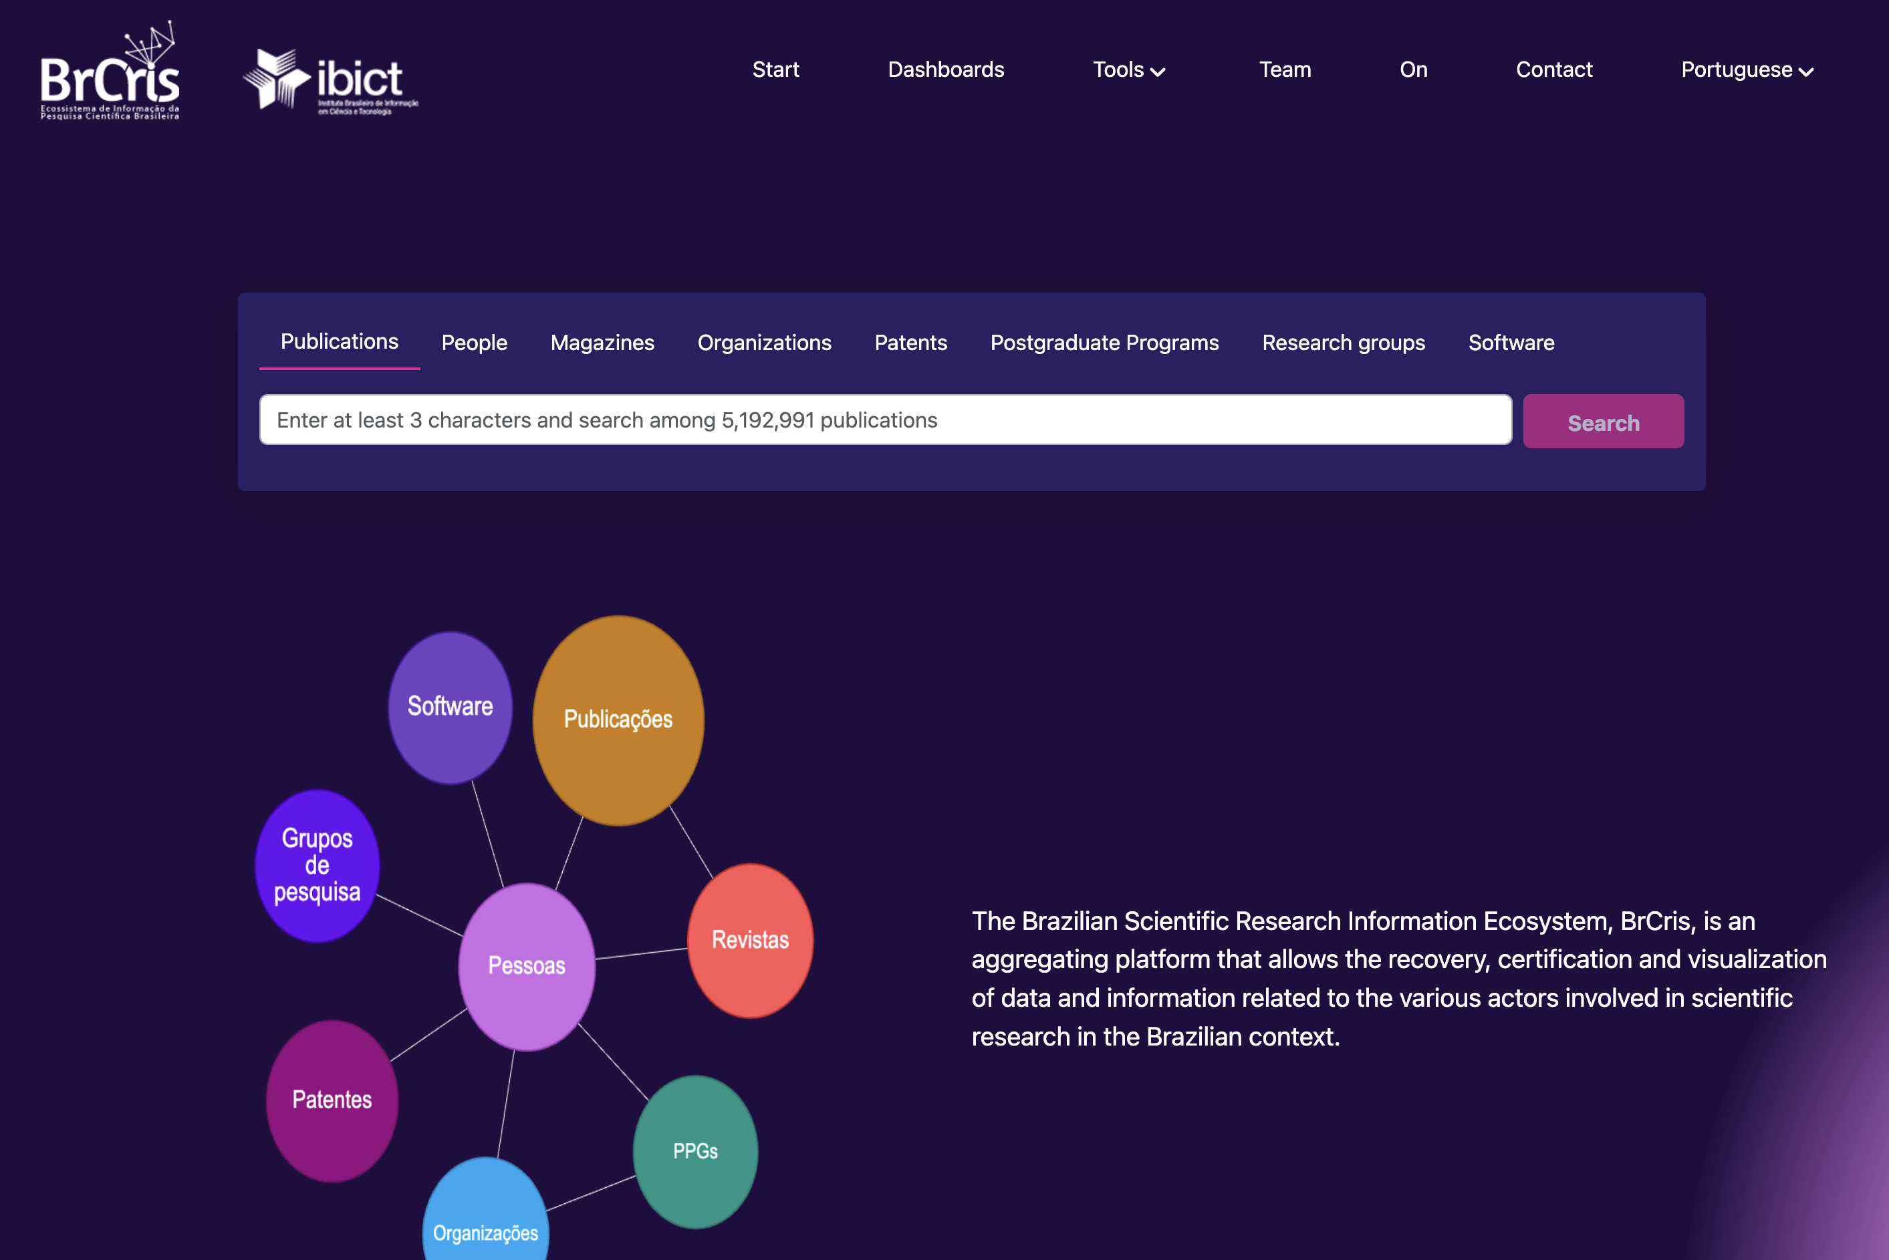

Slide 9
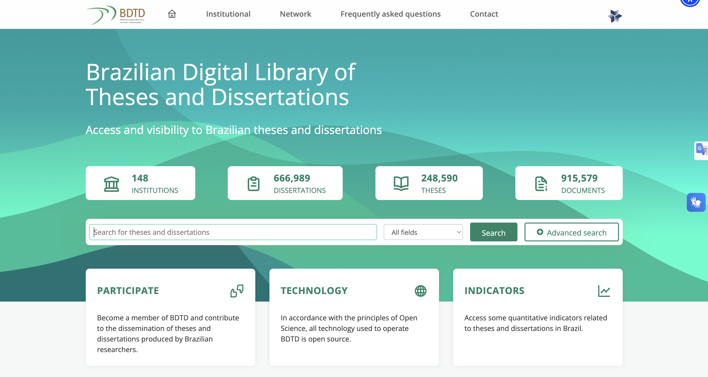

Slide 10
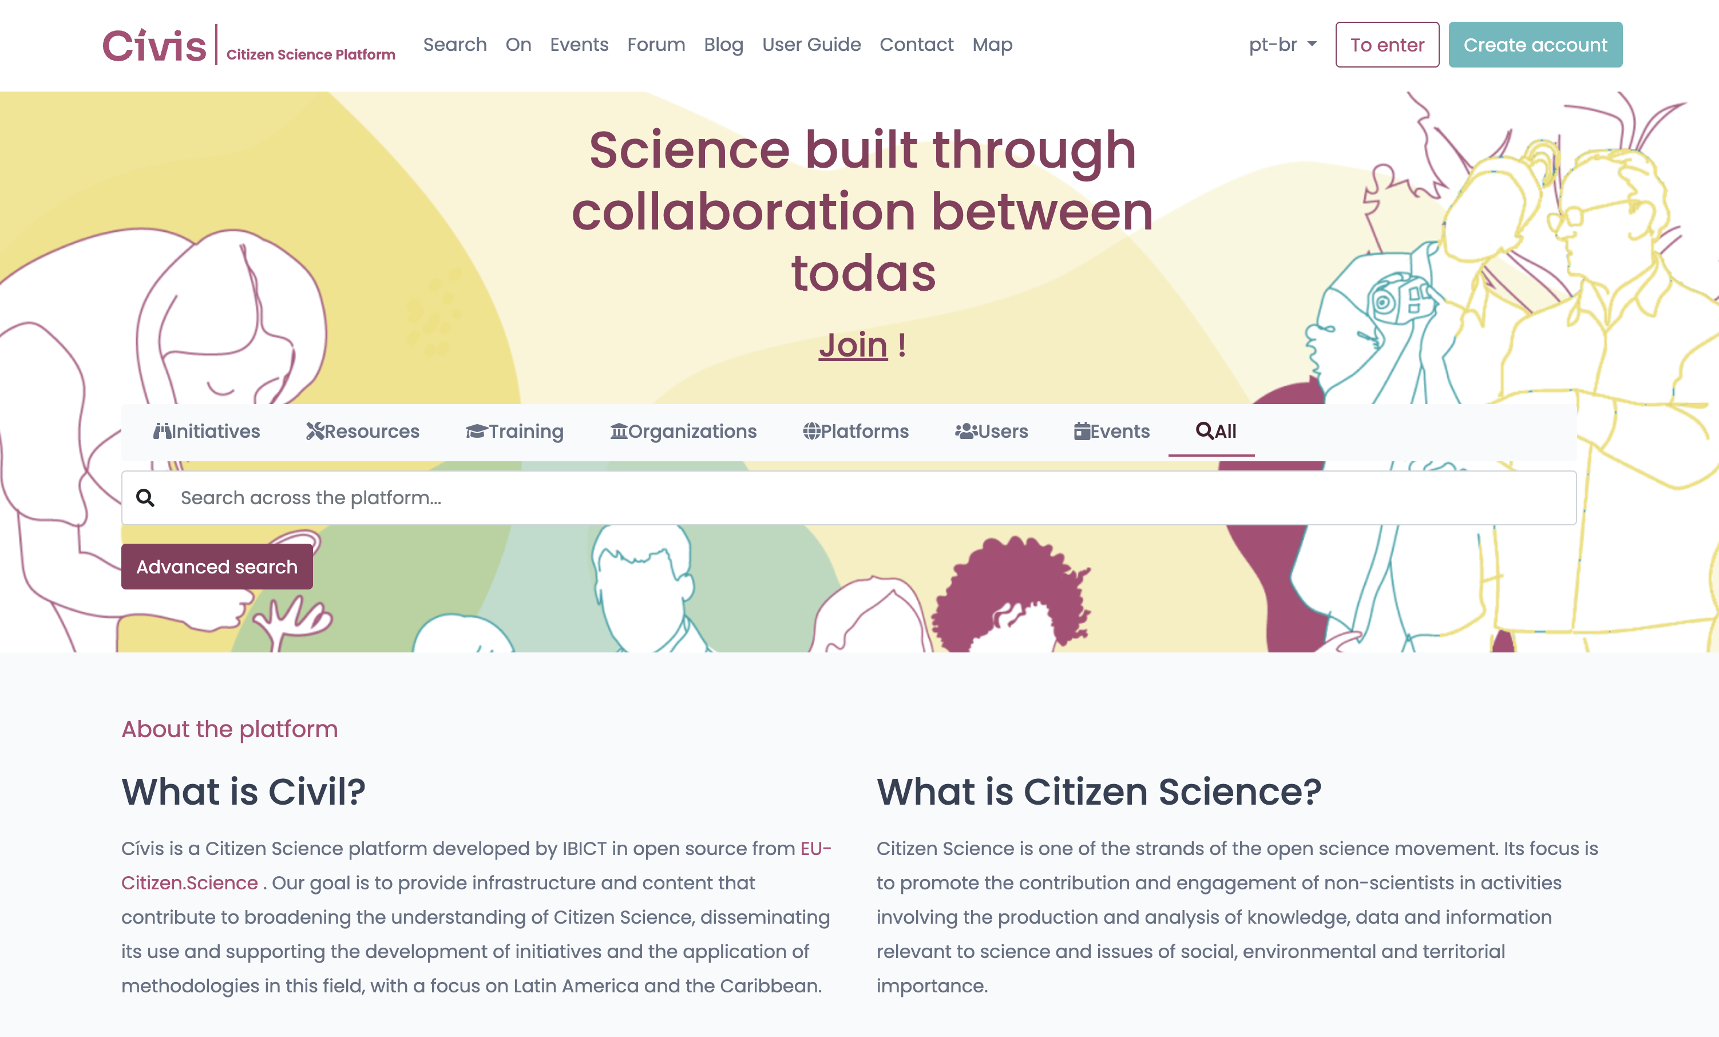

Slide 11
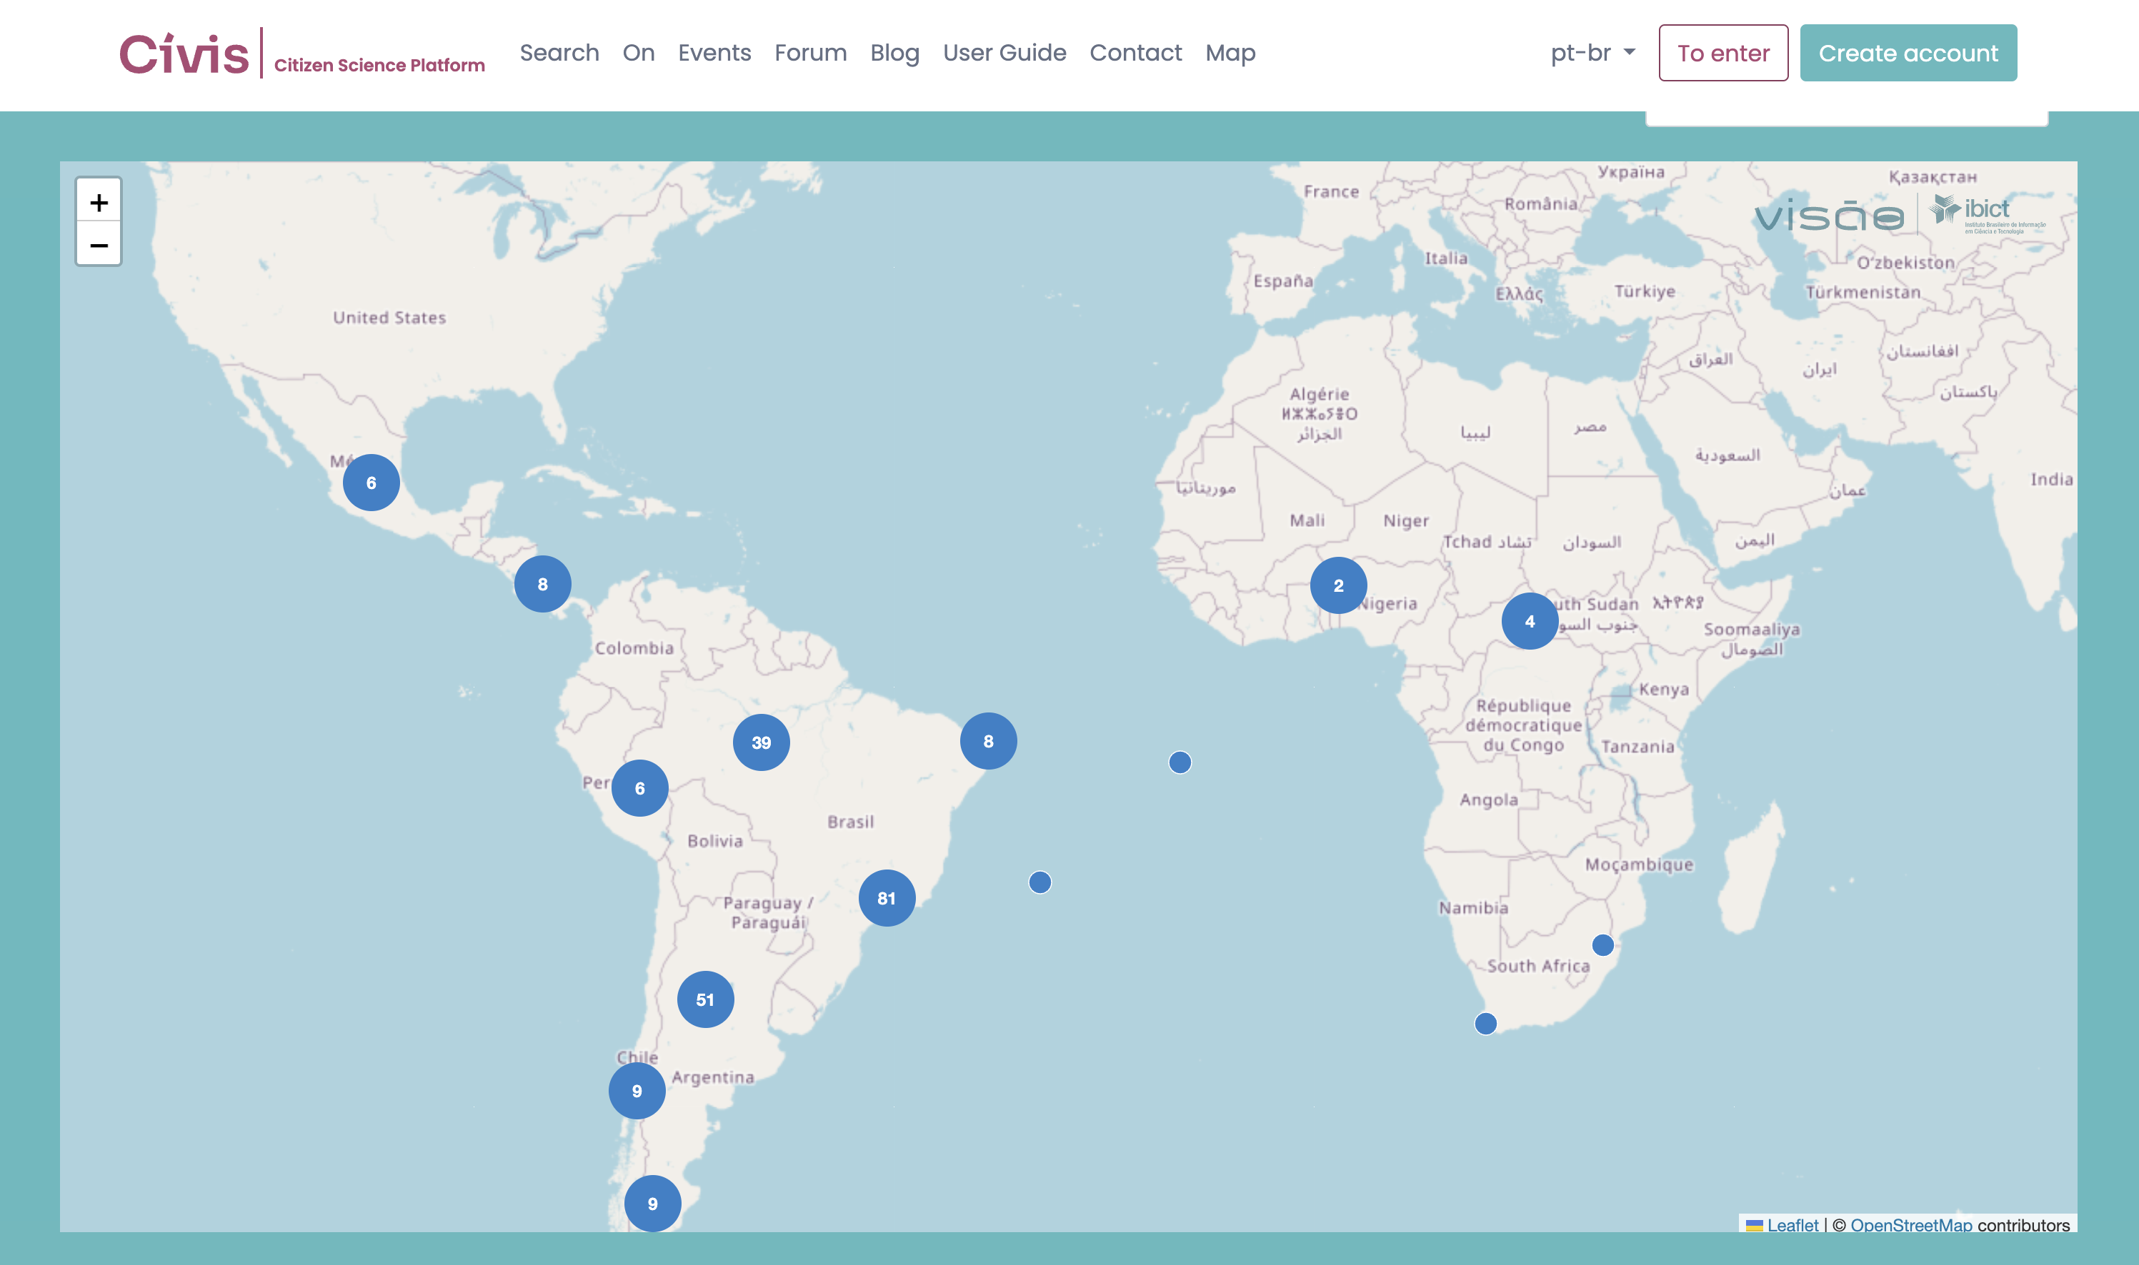

Slide 12


Slide 13
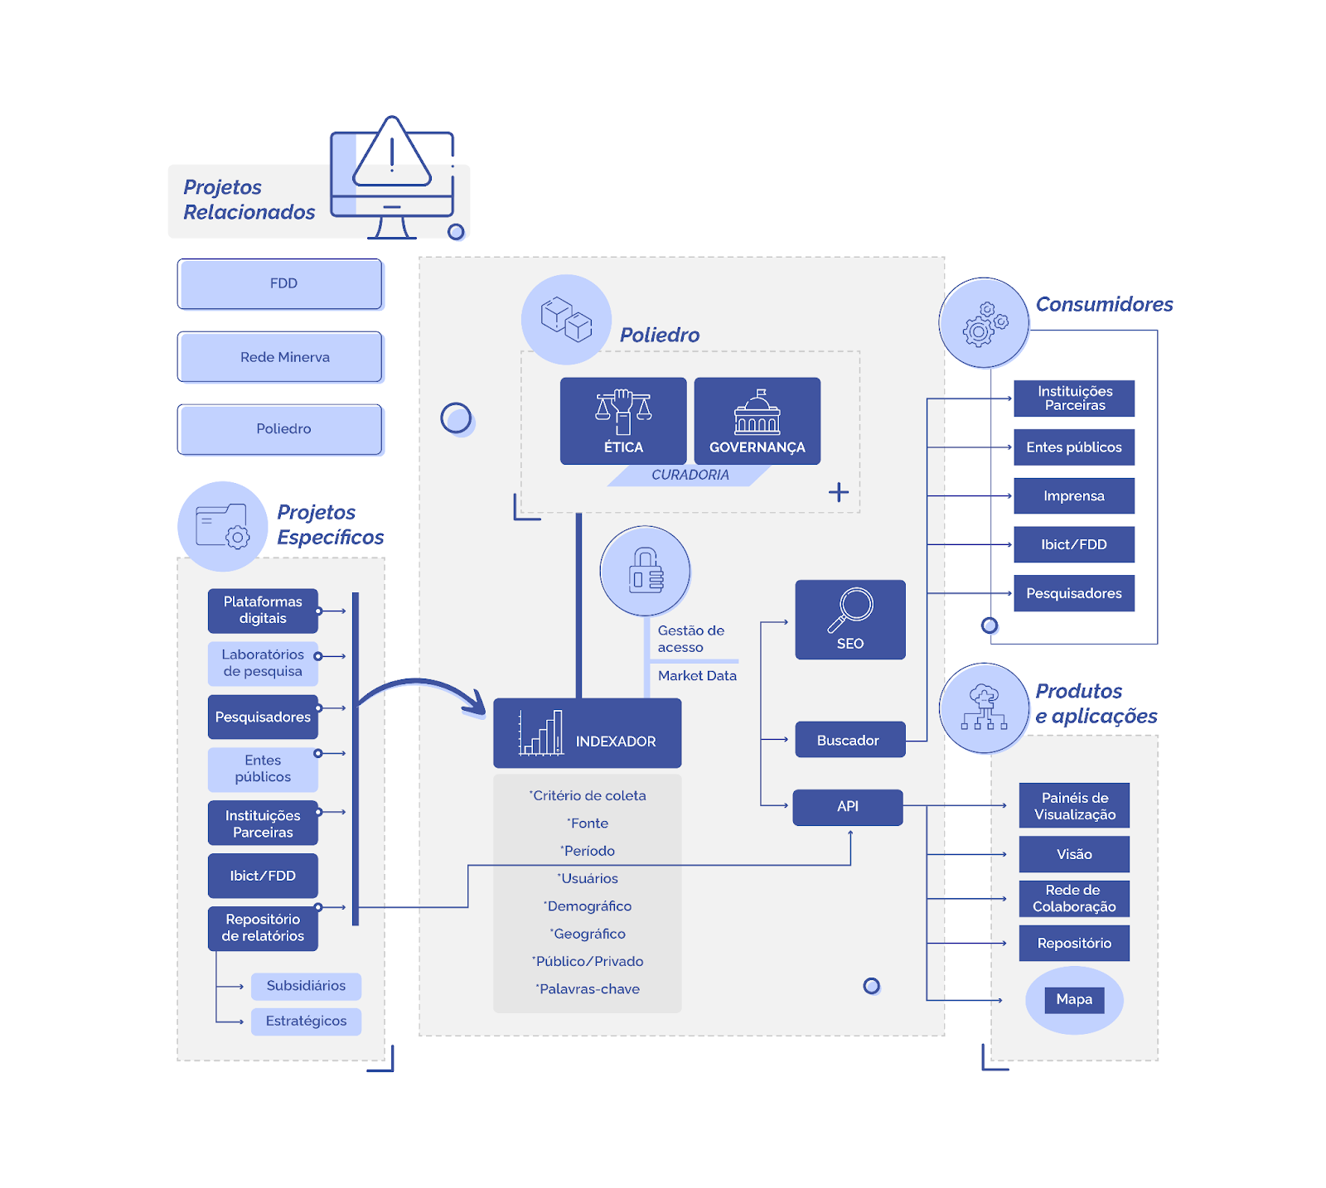

Slide 14
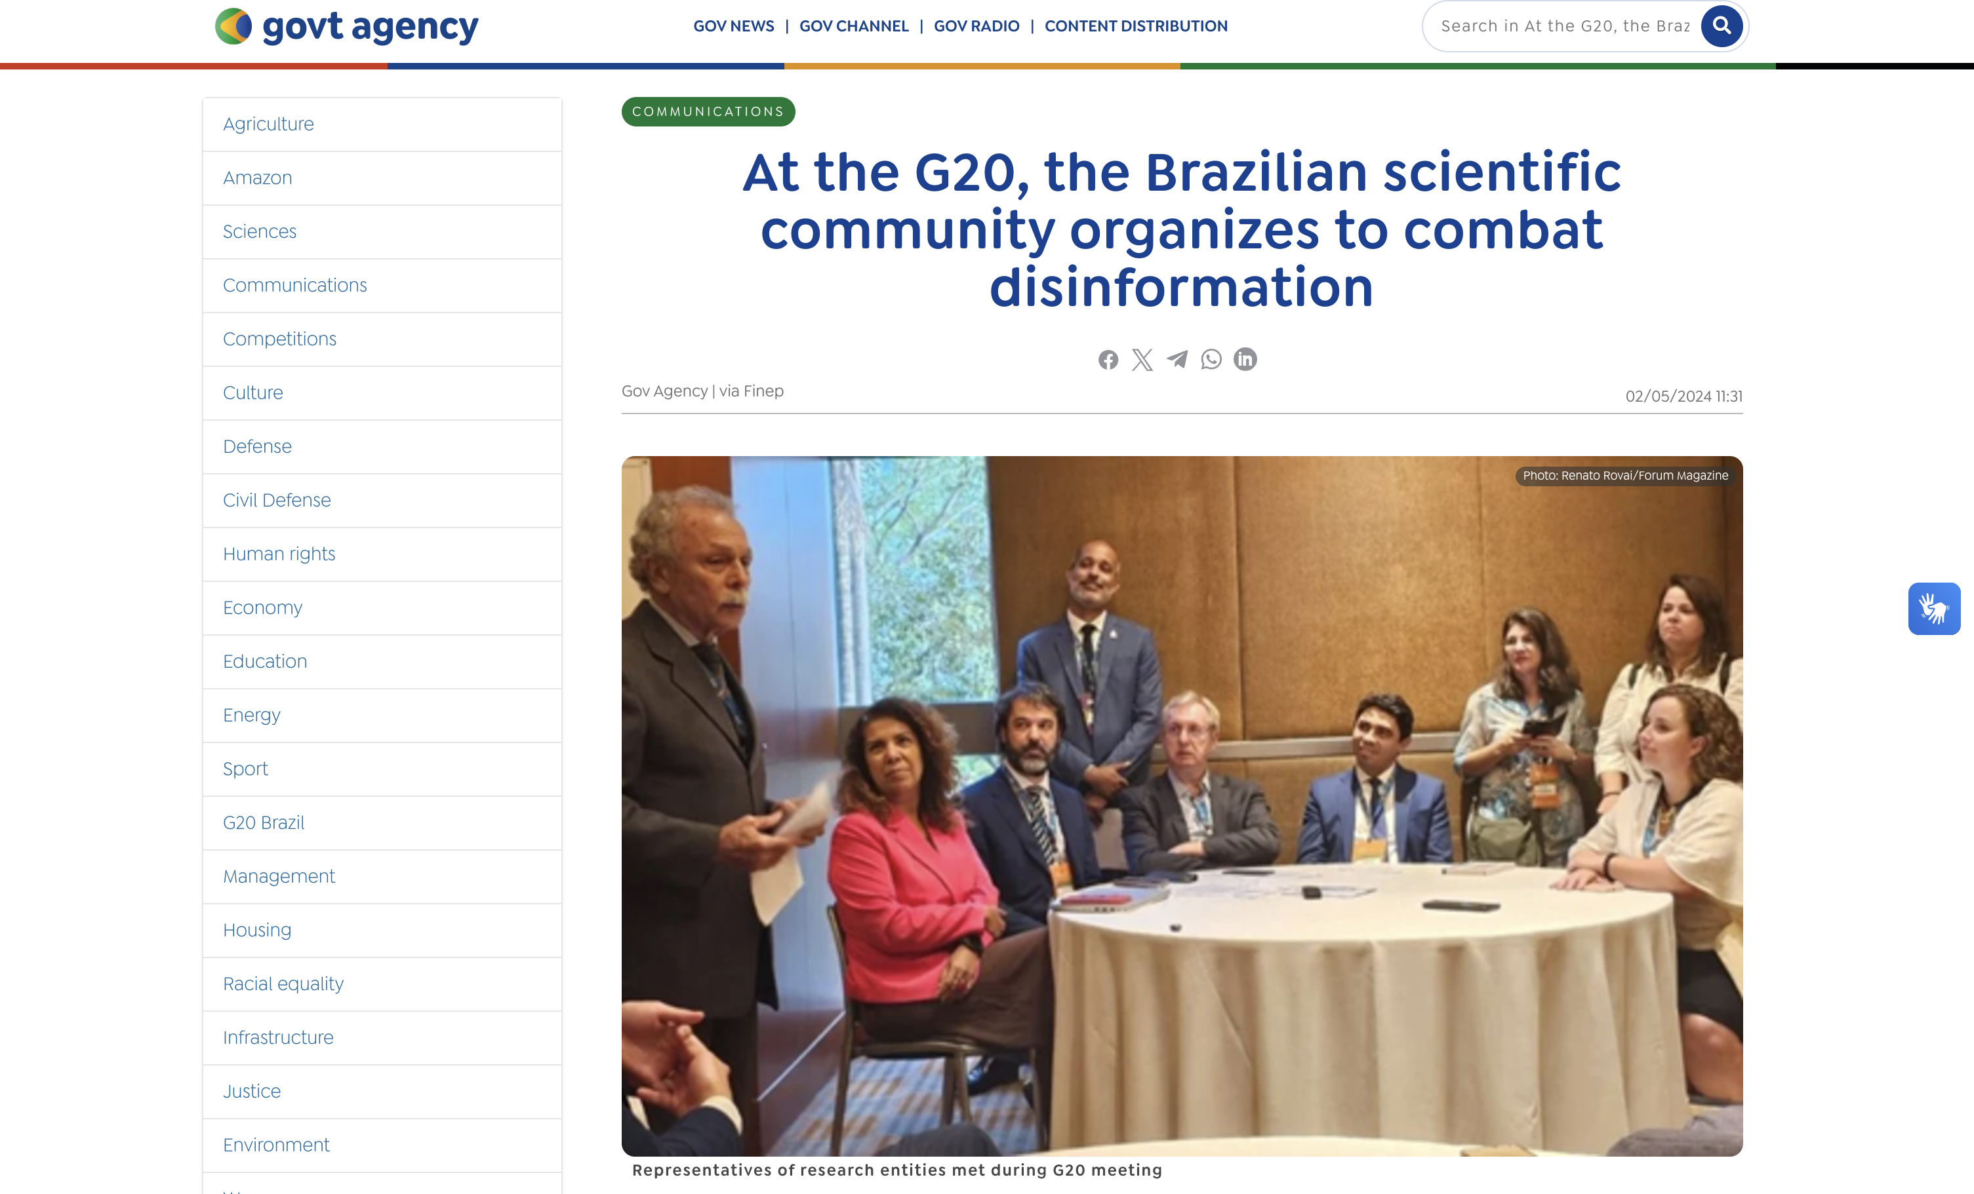

Slide 15
Thank you!
Tiago Braga
tiagobraga@ibict.br
Brazilian Institute of Information in Science and Technology
www.ibict.br

