Slide 1
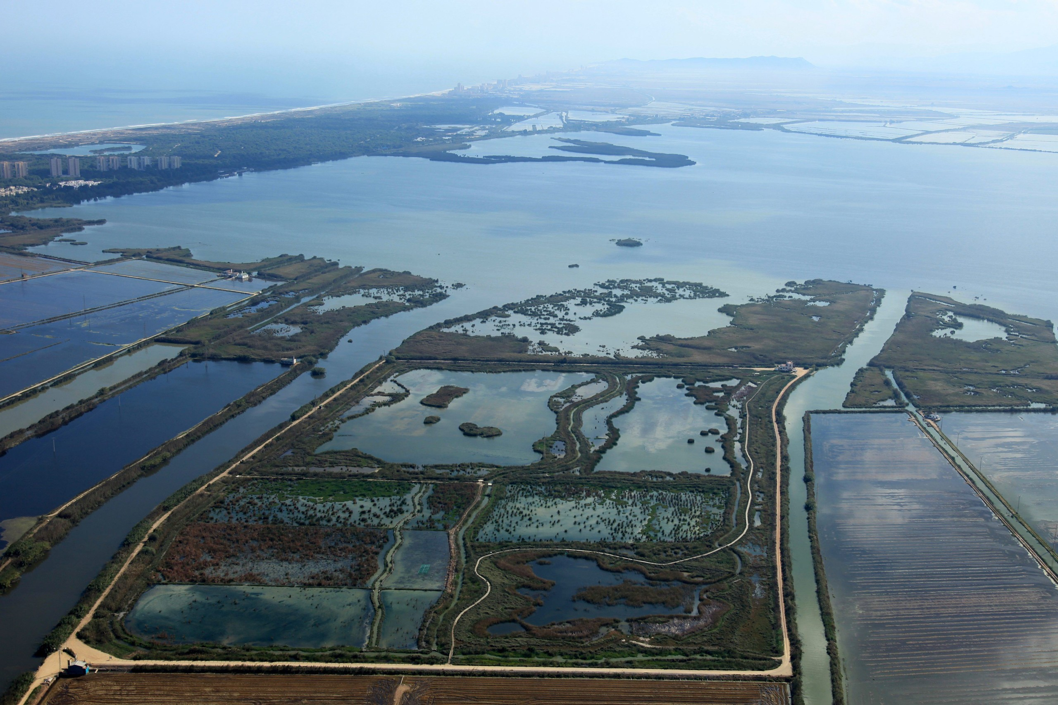



Water quality modelling of Free Water Surface Tancat de la Pipa Wetland for urban runoff mitigation optimization
Martínez-Biosca, A¹. *, Hernández-Crespo, C.¹, Andrés-Doménech, I.¹, Rodrigo-Santamalia, M.E.² , García-Haba, E. ¹, Calzadilla-Cabrera, D. ¹, Martín M¹
¹ Instituto de Ingeniería del Agua y Medio Ambiente - UPV, Valencia, Spain,
² Instituto Agroforestal Mediterráneo - UPV, Valencia, Spain

Slide 2
INTRODUCTION
MATERIAL AND METHODS
RESULTS
  MONITORING PERIOD
  WATER QUALITY
  WATER QUALITY MODELLING
  FUTURE LINES
CONCLUSIONS

Slide 3
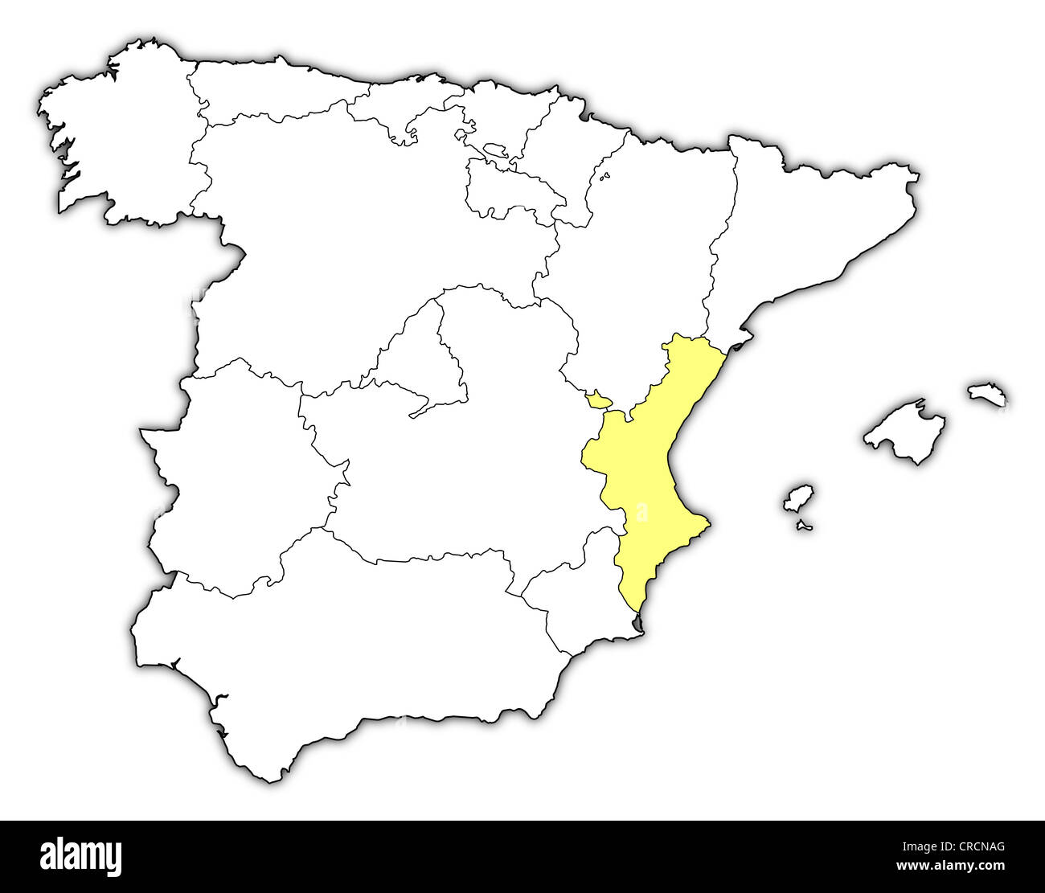

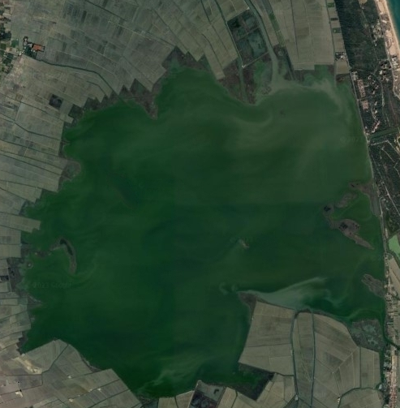


1. INTRODUCTION
The urban, agricultural, and industrial growth of Valencia and nearby towns since the 1970s.
Albufera Lake has suffered significant anthropic pressures, including urban and industrial wastewater discharges, as well as agricultural and urban runoff
VALENCIA
Tancat de la Pipa
HYPEREUTROPHIC STATE
ALBUFERA
LAKE
Wastewater discharges were eliminated
The CURRENT CHALLENGE is focused on combined sewer overflows (CSOs), especially with the new version of EU treatment Directive
Location in the north of the Albufera Natural Park

Slide 4

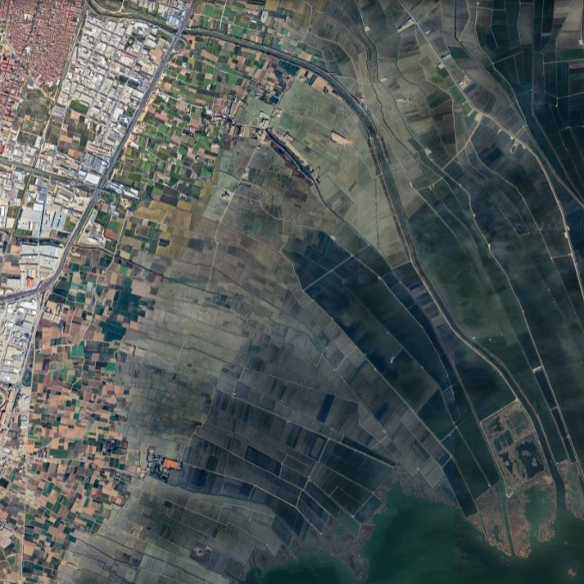
1. INTRODUCTION
Catarroja
Overflow points
5.5 km
ALBUFERA LAKE
Albal
Commercial and industry areas
Barranco del
Poyo (BP)
WEST COLLECTOR
Reserve Lagoon
Educative
Lagoon
Acequia del puerto
de Catarroja (PC)
BP
FG3
fp3
F4-SM
F4-SL
F4-SC
FG2
fp2
Silla
Sinkhole
PC
RICE
PADDIES
FG1
fp1
Sector B: FWSCW: Divided into 3 independent sub-sectors (FP, FG, and F4)
Sector C: Educative and Reserve Lagoons
Sector D: Sinkhole (artificial spring)
Tancat de la Pipa
2 km
ALBUFERA LAKE

Slide 5
OBJECTIVES:
Quantify the impact of combined sewer overflows (CSOs) on Albufera lake in terms of pollutant concentrations, using samples taken at TPCW inflow points.
Evaluate the role of large constructed wetlands, not specifically designed for this, in mitigating urban and agriculture runoff.
Develop and calibrate a water quality model to optimize the operation and design of constructed and restored wetlands.

Slide 6
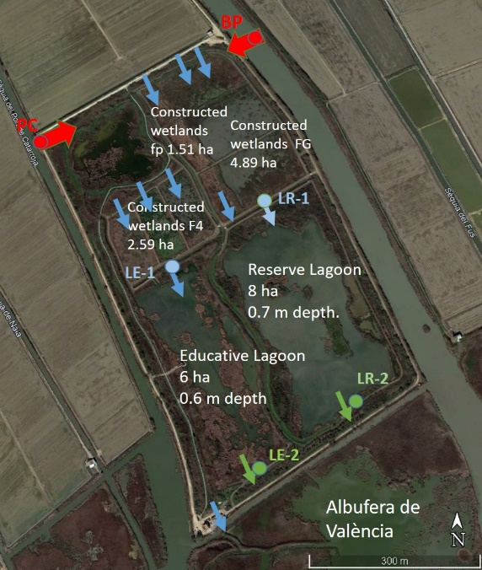
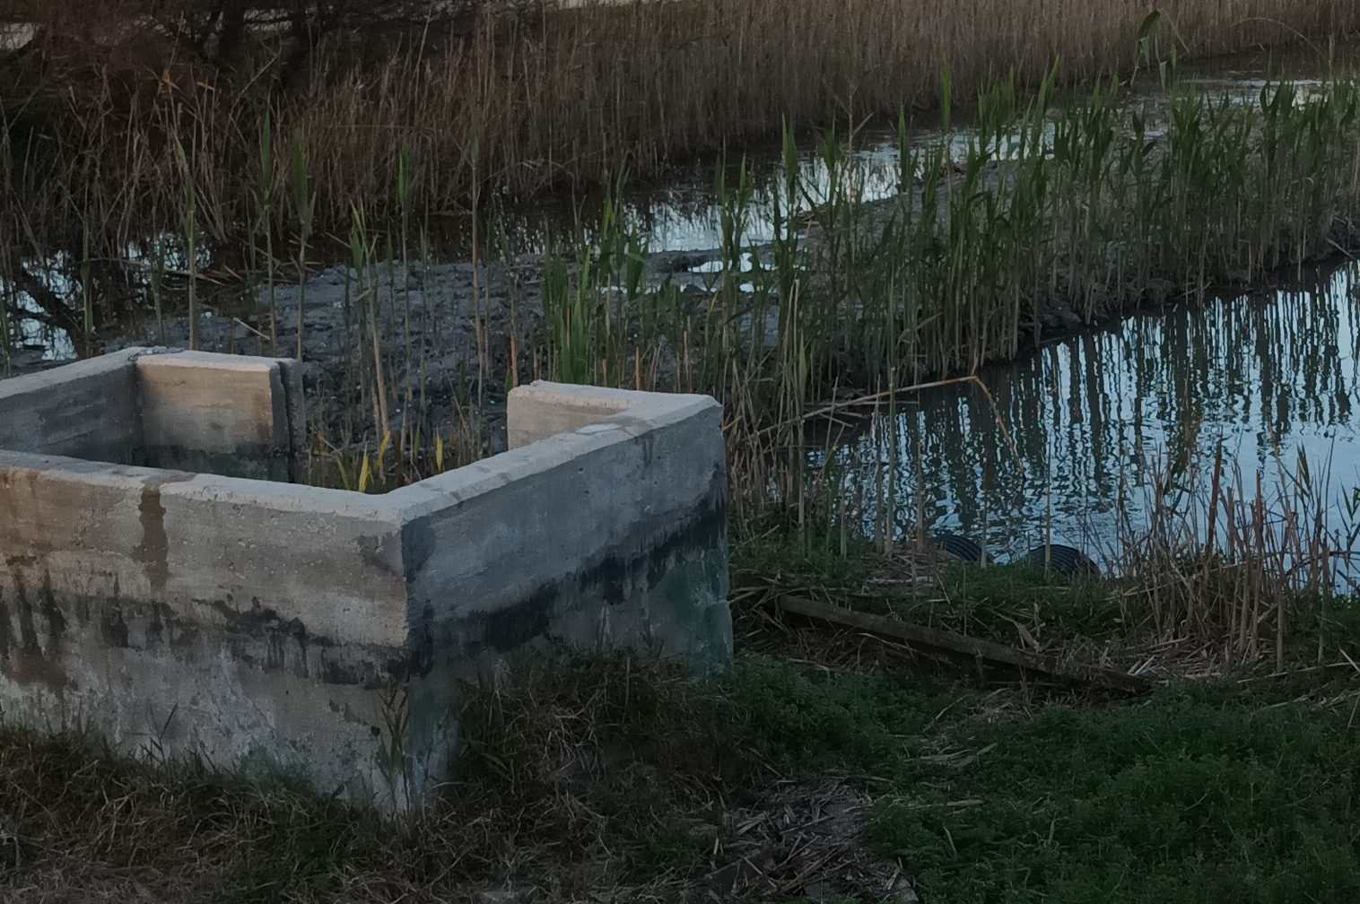
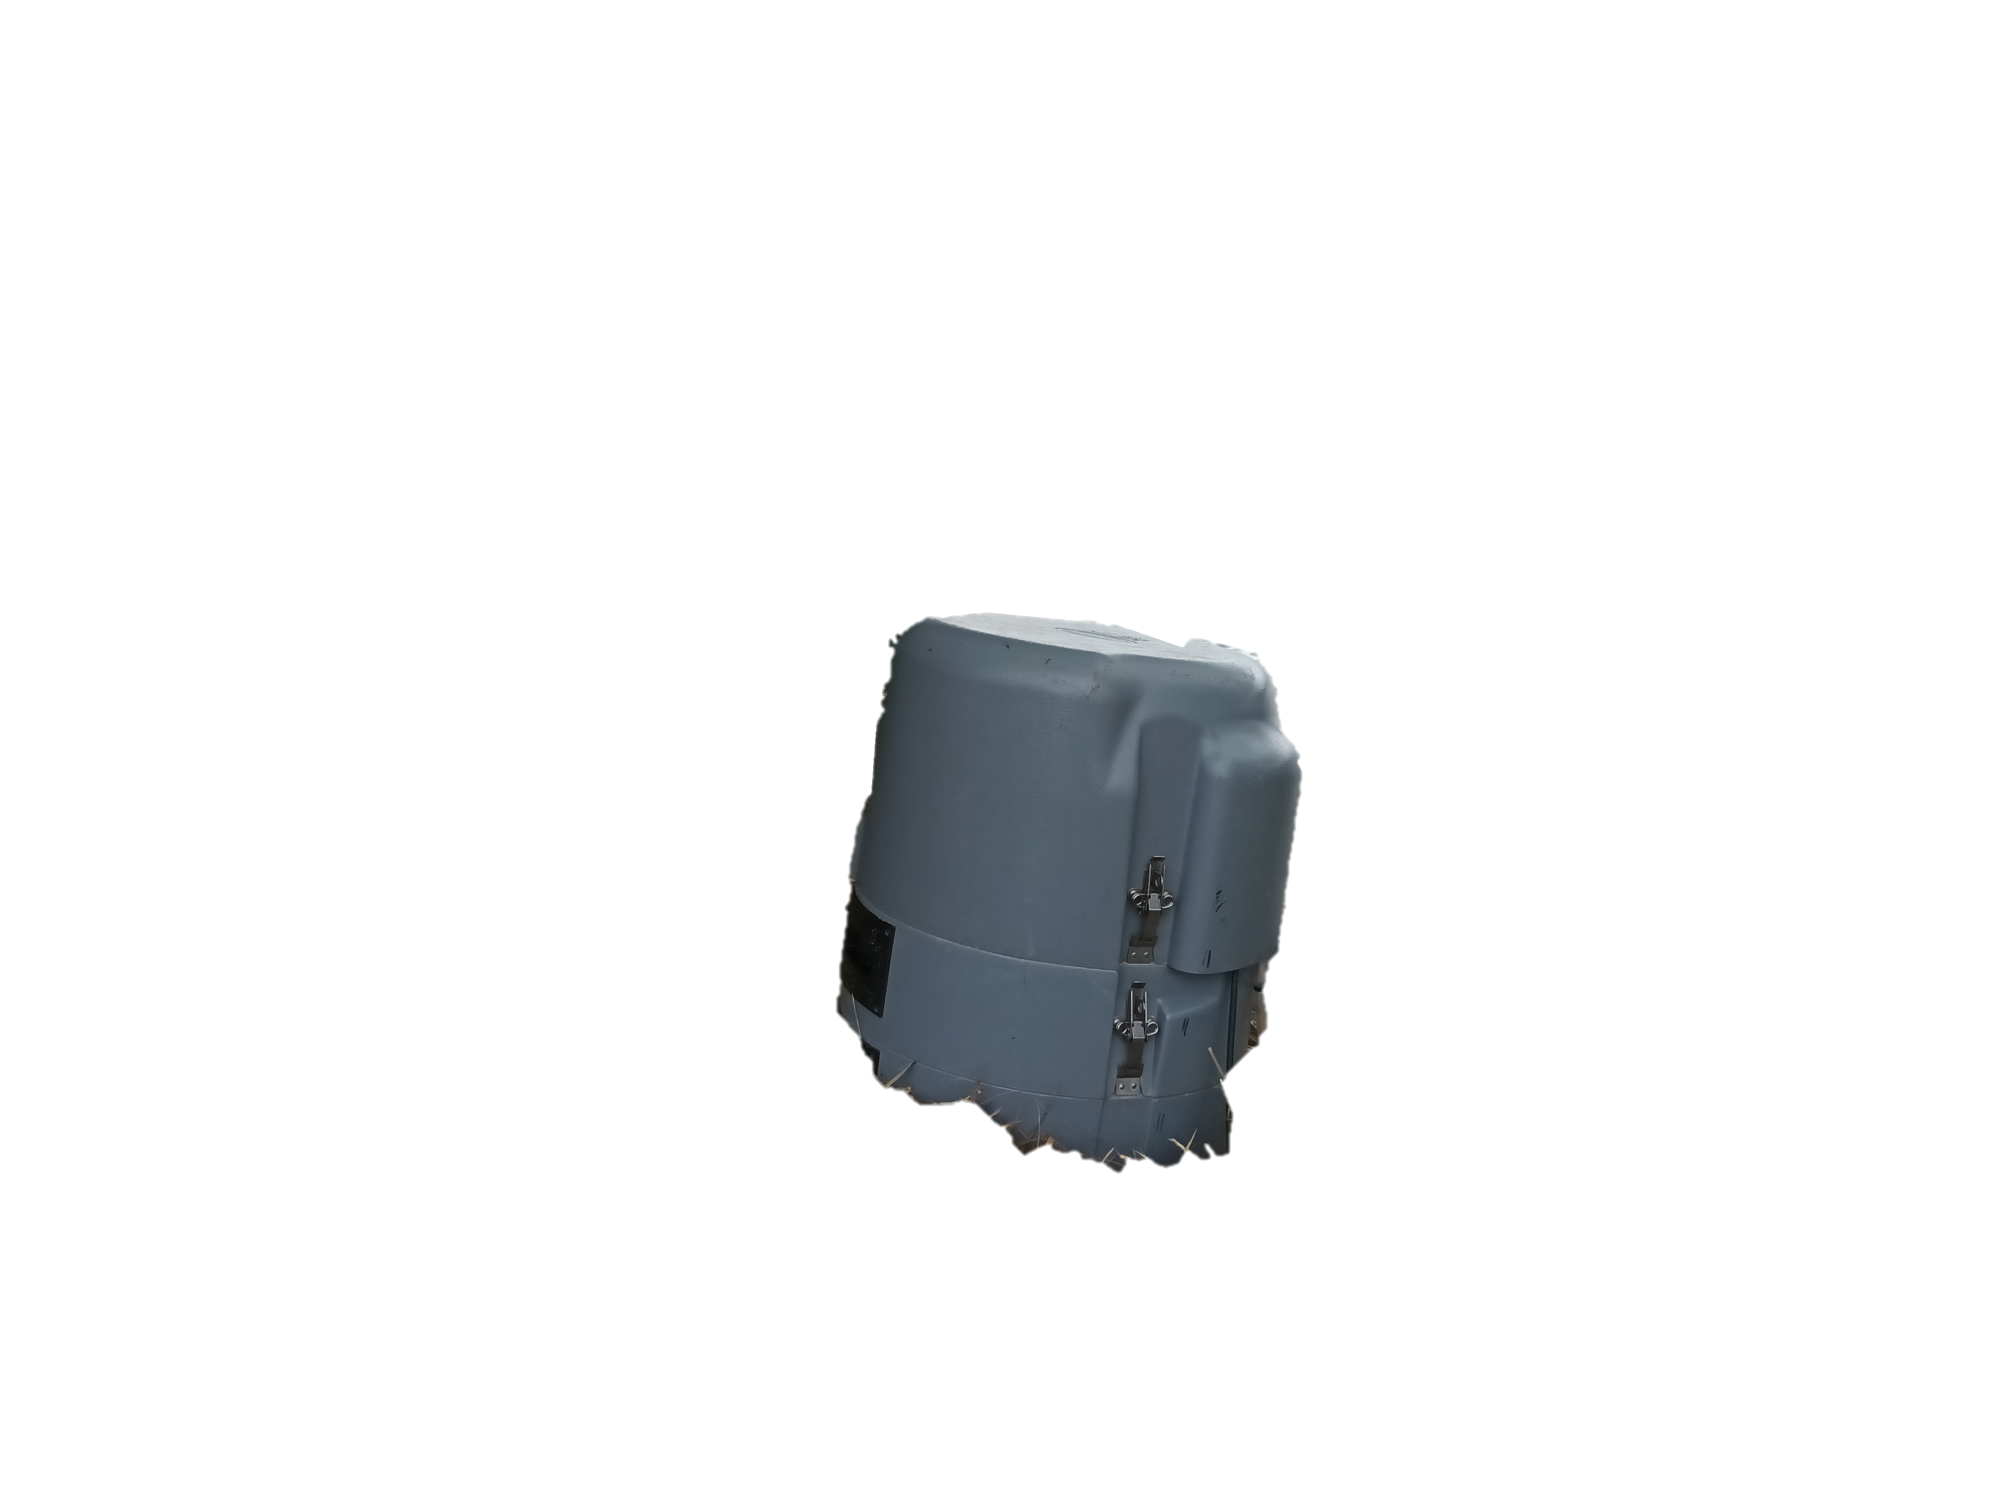
2. MATERIAL AND METHODS
Sampling methods:
Autosamplers (Hach, 24-bottle capacity) + Grab samples collected at 6 points within TPCW, twice a day, for up to one week post-event.
BP
PC
LR-1
Measured Variables:
Physicochemical: COD, nitrogen species (TN, N-NH₄⁺, N-NO₂⁻, N-NO₃⁻), TP and P-PO₄³⁻, OD, turbidity and conductivity.
Selected pollutants: Pesticides and emerging contaminants (e.g., Ibuprofen, Paracetamol, Tebuconazole).
LE-1
LR-2
LE-2
Modelling approach:
Initial phase: simple CSTRs for each wetland/lagoon in spreadsheets
Second phase: develop a full FWSCW model in COMSOL Multiphysics® software.
ALBUFERA
LAKE
Monitoring points at TPCW

Slide 7
3. RESULTS - MONITORING PERIOD
Monitoring period | Nº of Rainfalls | Total Depth (mm) | i-max (mm/h)
1 | 2 | 48.6 | 20.0
2 | 8 | 117.4 | 37.0
3 | 2 | 123.0 | 68.8
4 | 1 | 14.4 | 2.8
5 | 1 | 14.2 | 6.0
6 | 1 | 4.4 | 2.2
7 | 2 | 24.8 | 9.4
8 | 1 | 18.6 | 4.5
9 | 2 | 45.0 | 11.8
10 | 3 | 72.2 | 10.6
The monitoring period: February 2023 – November 2024 (keep working)
Total rainfalls: 23
Valencia has an average of 27.2 rainfalls per year

Slide 8
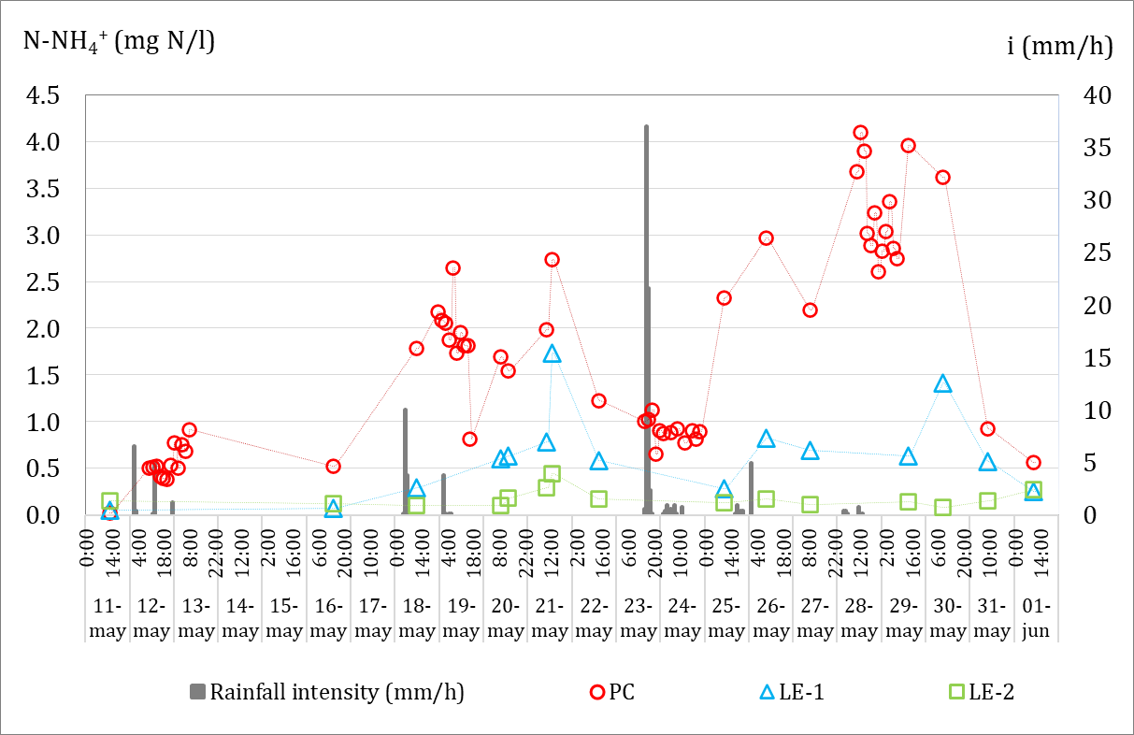
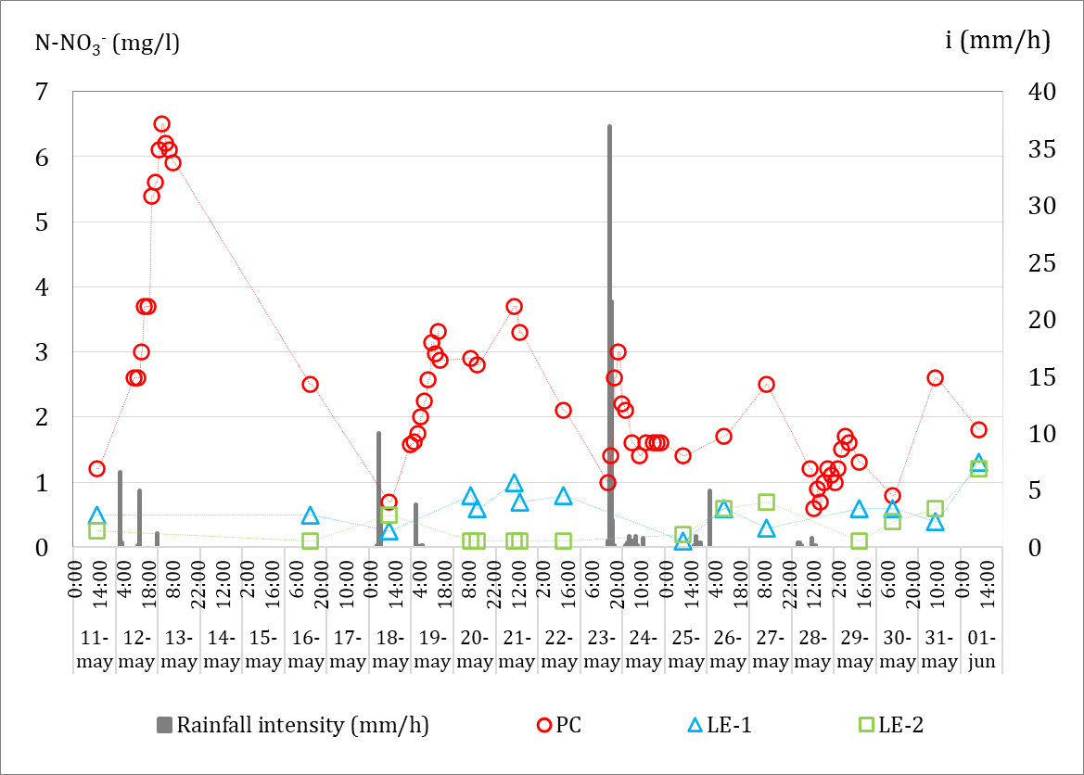
3. RESULTS – WATER QUALITY
Event Monitored: 2nd (May 2023), Monitoring Duration: 21 days, Total Rainfalls: 8, Total Depth: 117.4 mm, (i-max): 37 mm/h
3.01 mg N-NO₃⁻/l
0.65 mg N-NH₄⁺/l
Ammonia and nitrites concentrations in TPCW during the rain event in May 2023. Dashed line indicates historical average inflow concentration at PC 2009-23 (n=211).
With each rainfall, the concentration increases, reaching peaks of 6.3 and 2.5 times.
At the wetland’s outlet → The peaks are reduced by almost 80% as the water flows through the Tancat.
The EMC at the Educational Lagoon is close to their historical average → TPCW manages the runoff effectively.

Slide 9
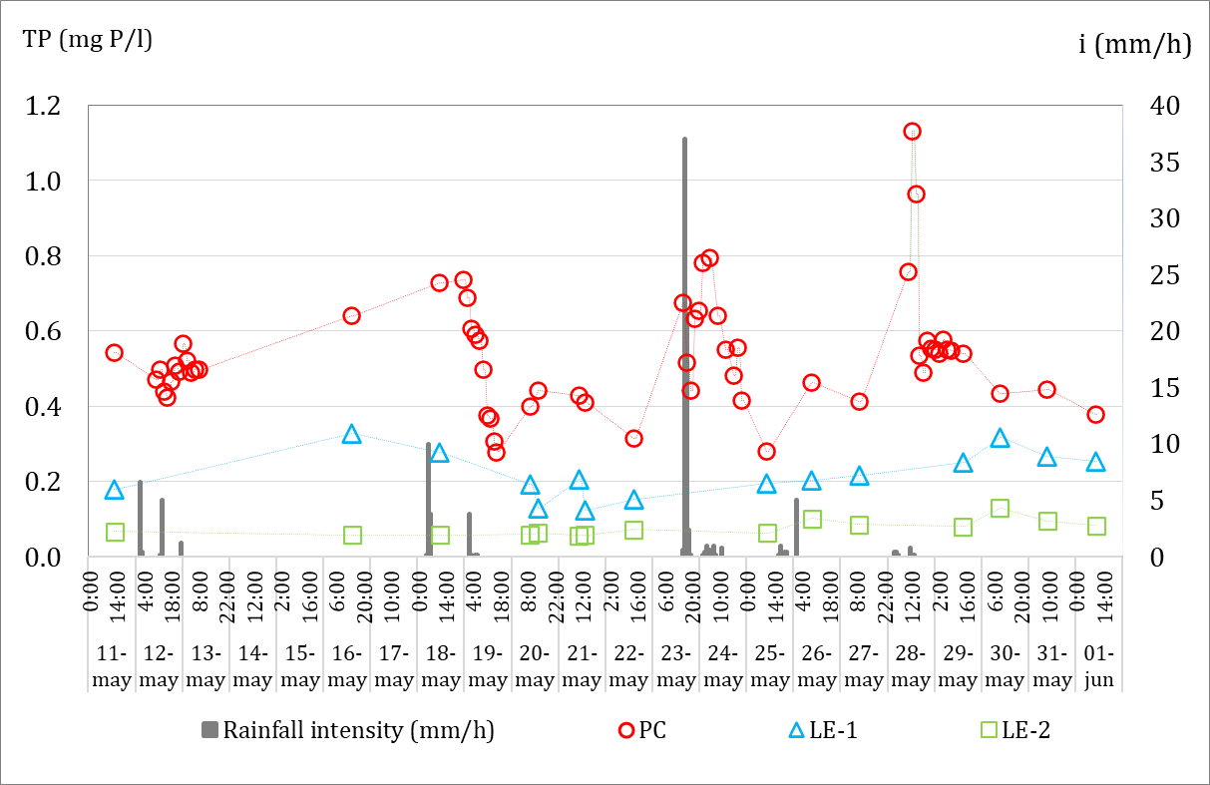
3. RESULTS – WATER QUALITY
Event Monitored: 2nd (May 2023), Monitoring Duration: 21 days, Total Rainfalls: 8, Total Depth: 117.4 mm, (i-max): 37 mm/h
Black dashed line represents the updated value of the European Directive for the TP discharge limit 0.5 mg P/l (>150.000 p.e.).
0.5 mg P/l
0.35 mg P/l
The same trend is observed: after each rainfall, the concentration increases → 3 times their historical average.
At the wetland outflows, the TP concentration is below 0.5 mg P/l.
At the Educational Lagoon outflow, the TP concentration decreases even further.
TP concentrations in TPCW during the rain event in May 2023. Dashed line indicates mean PC inflow concentration 2009-23 (n=211).

Slide 10
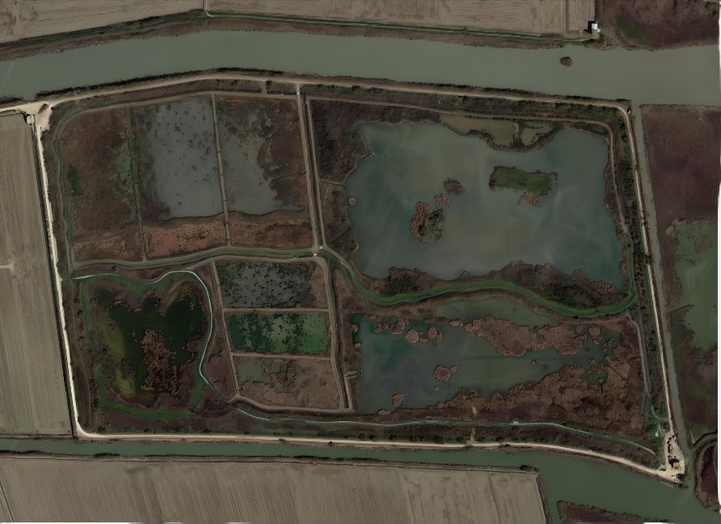
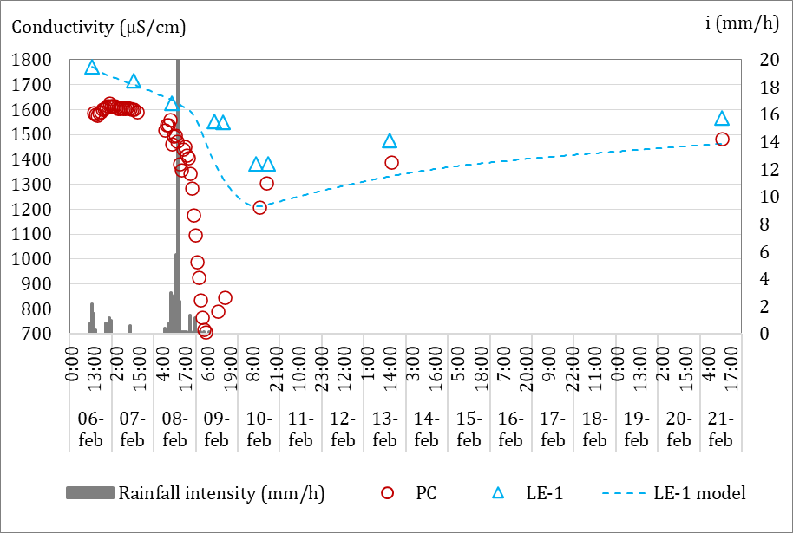
3. RESULTS – WATER QUALITY MODELLING
Basic model (1 reactor) → Understand the wetland and identify key points for a future model
No tracer experiments in TPCW (NATURAL PARK): CONDUCTIVITY → Learn about hydraulics
System balance: EVAPORATION is an output and RAINFALL is an input
Vegetation has not been considered in the model at this stage
PC
Spreadsheets
F4
Q_{in}:30 l/s
LE-1
h: 0.2 - 0.3 m
S: 2.59 ha
CSTR (1 reactor)
HRT:1.5 d
Q_{out}:30 l/s
1st event February, 2023

Slide 11
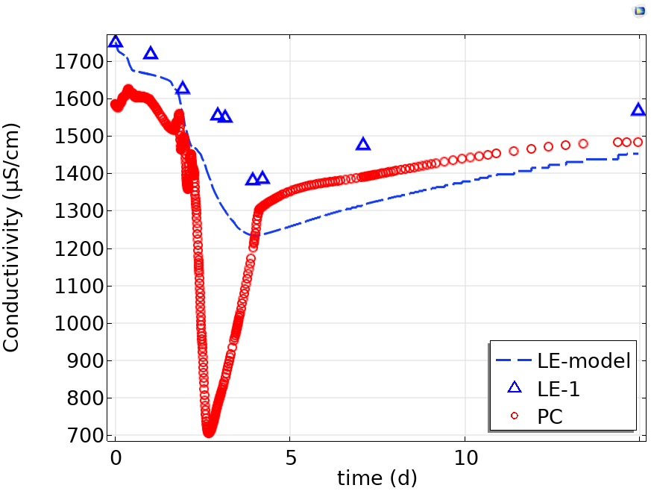





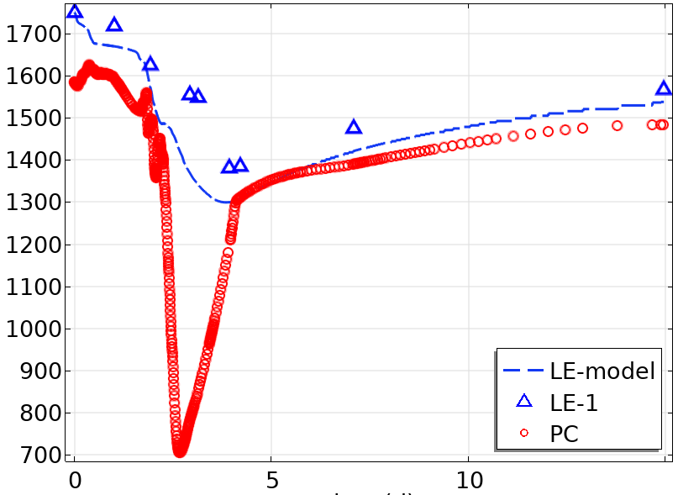
3. RESULTS – WATER QUALITY MODELLING
Q_{in}:30 l/s
COMSOL Multiphysics®
h:0.2 - 0.3 m
S:2.59 ha
CSTR (1 reactor)
R²:0.85
RMSE:139.5
C_{water}
HRT:1.5 d
Q_{out}:30 l/s
C_{sed}
Molecular diffusion
15
Molecular diffusion
Q_{in}:30 l/s
Source | Type | D (m²/s)
Surface water quality modeling (Chapra, 2008) | Natural Waters and sediments | 10⁻⁸ - 10⁻⁹ 10⁻⁹ - 10⁻¹²
Environmental Modeling Fate and Transport of Pollutants in Water, Air, and Soil (Schnoor, J. L. 1996) | Lakes (water -sediments) | 10⁻⁹ - 10⁻¹⁴
Gargallo Bellés, S. (2017) | TPCW | 2.0·10⁻⁹
Current study (2024) | TPCW | 3.0 - 5.0·10⁻⁸
h: 0.2 - 0.3 m
S:2.59 ha
CSTR (1 reactor)
R²:0.85
RMSE:102.4
Q_{out}:30 l/s
Molecular diffusion
15

Slide 12
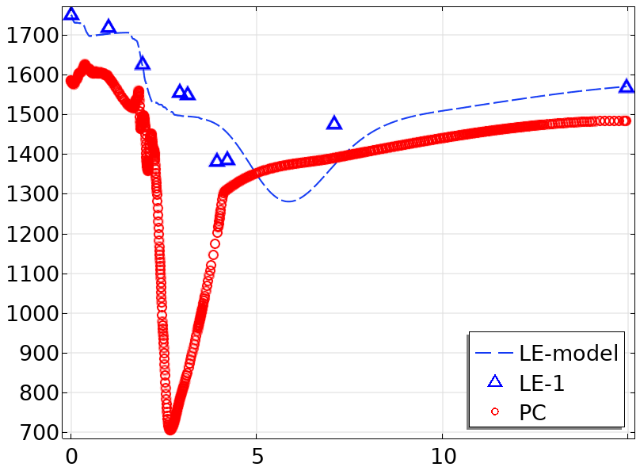
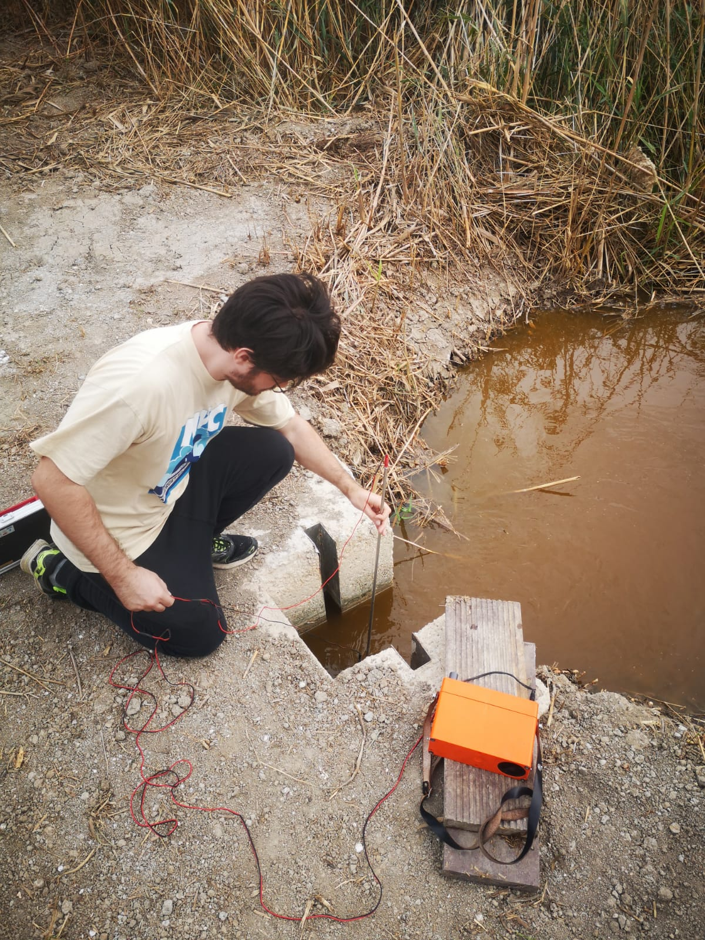
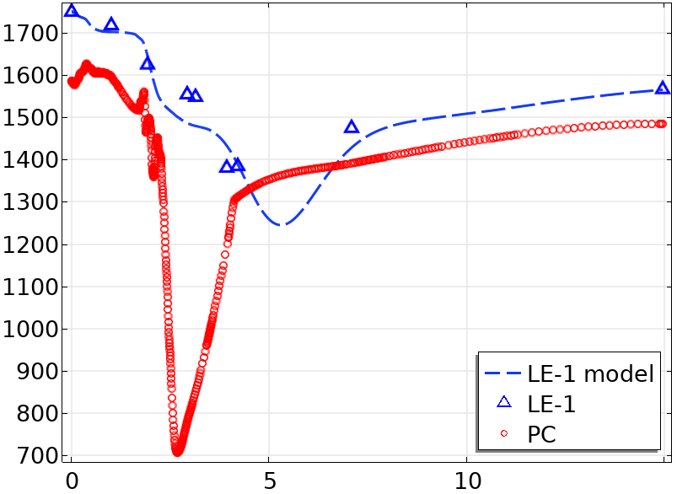
3. RESULTS – WATER QUALITY MODELLING
Q_{in}:30 l/s
COMSOL Multiphysics®
h: 0.2 - 0.3 m
S:2.59 ha
CSTR (10 reactors, 1 line)
R²:0.87
RMSE:57.2
Q_{out}:30 l/s
Molecular diffusion
15
Q_{3,in}
Q_{2,in}
Q_{1,in}
h: 0.2 - 0.3 m
S:≈ 0.86 ha each line
CSTR (10 reactors, 3 lines)
Q_{1,in}≈ 0.49 Q_{1,out}
Q_{2,in}≈ 0.40 Q_{2,out}
Q_{3,in}≈ 0.11 Q_{,3out}
R²:0.90
RMSE:39.2
Q_{3,out}
Q_{2,out}
Q_{1,out}
Molecular diffusion
15

Slide 13
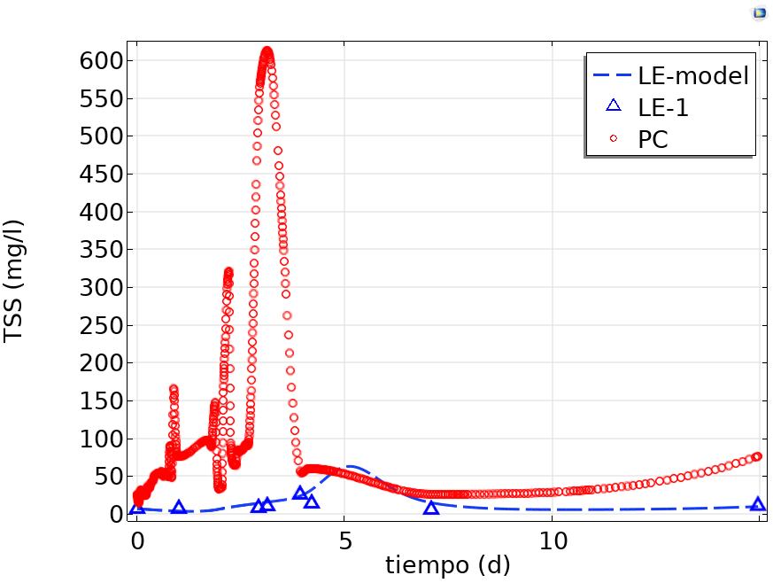
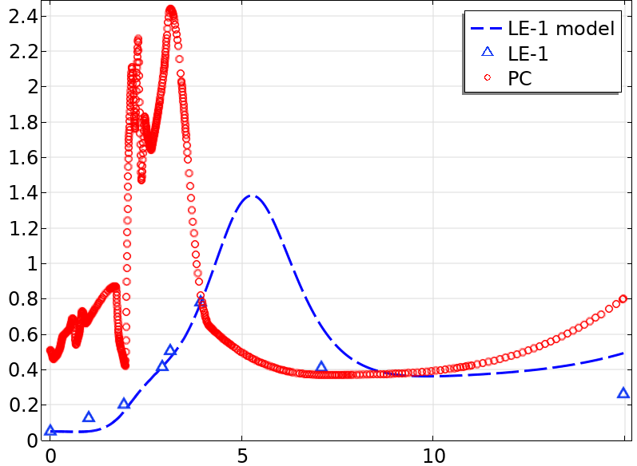


3. RESULTS – WATER QUALITY MODELLING
1st event, February 2023
Total Suspended Solids (TSS)
Ammonium (N-NH₄⁺)
R²: 0.91
RMSE:53.2
R²: 0.78
RMSE:60.1
mg TSS/l
mg N-NH₄⁺/l
15
15
$k_{sed}$ : 0.15 md⁻¹
$k_{nit}=$ 0.1 d⁻¹

Slide 14
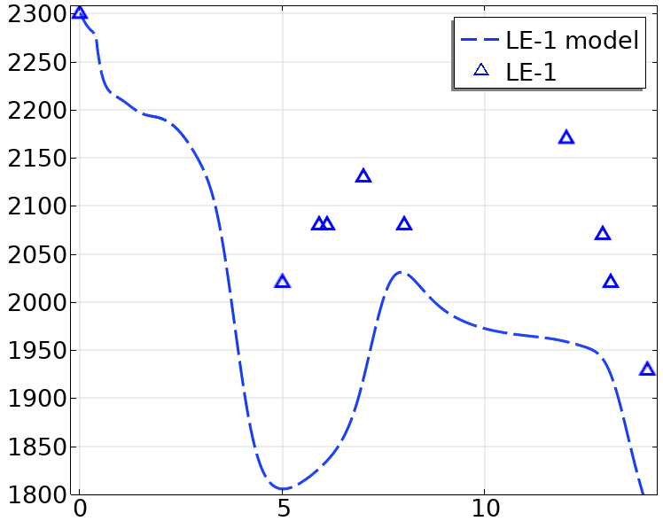
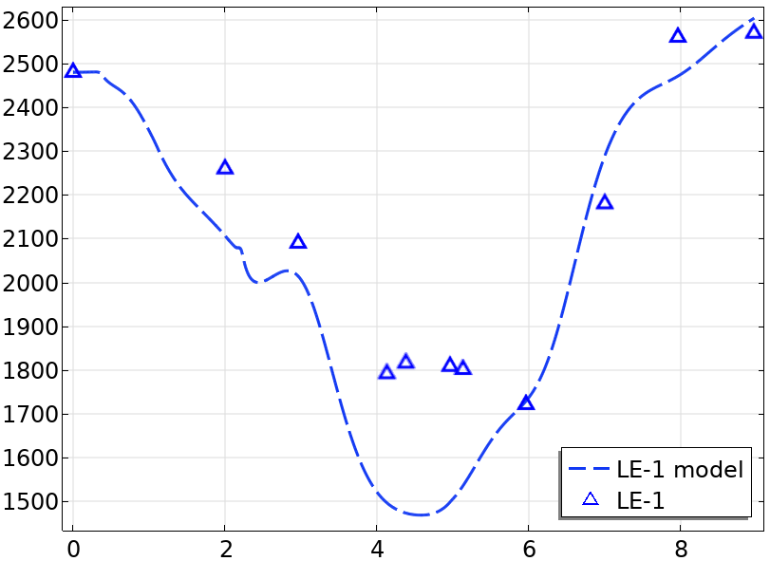
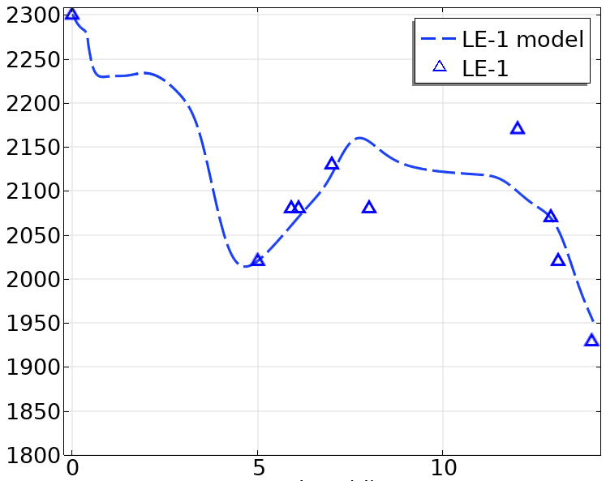
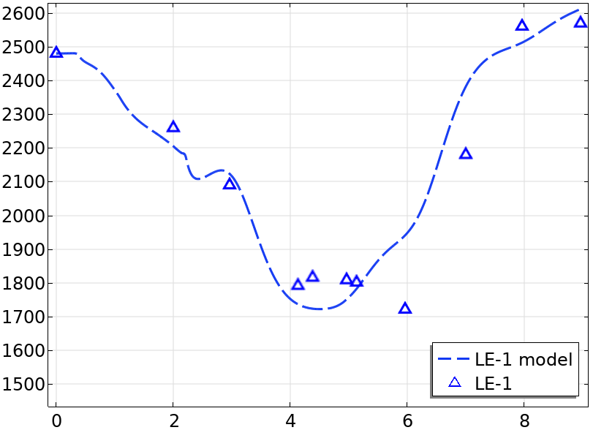
3. RESULTS – WATER QUALITY MODELLING
4th event, January 2024
7th event, June 2024
Diffusion term
Flow distribution
R²: 0.70
RMSE:176
Q_{3,in}
Q_{2,in}
Q_{1,in}
R²:0.89
RMSE:206
h: 0.2 - 0.3 m
S:≈ 0.86 ha each line
CSTR (10 reactors, 3 lines)
R²: 0.85
RMSE:37
Q_{3,out}
Q_{2,out}
Q_{1,out}
Diffusion Term
Flow distribution
R²: 0.91
RMSE:106

Slide 15
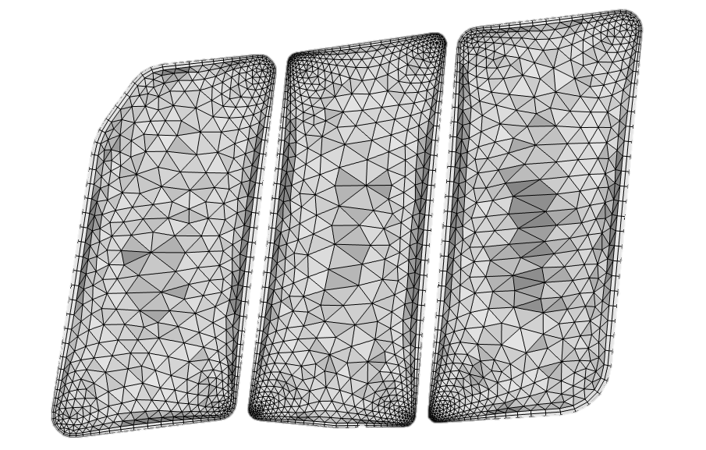
3. RESULTS – FUTURE LINES
INITIAL STEPS
Basic models to understand the F4 sub-sector.
Our simulations show good results, demonstrating the value of these models
Limited in adding processes or simulating management operations.
Q_{1,in}
Q_{2,in}
Q_{3,in}
CURRENT WORK
h: 0.3 m
S≈ 0.86 ha
h: 0.3 m
S≈ 0.86 ha
Developing a CFD Model for subsector F4 in COMSOL Multiphysics®
h: 0.3 m
S≈ 0.86 ha
NEXT STEPS
Complete the model by including the educational lagoon
Incorporating vegetation to study its effect on flow dynamics
Ultimate goal: to develop a full model for the TPCW
Q_{2,out}
Q_{1,out}
Q_{3,out}
Example of geometry design for a CFD model of subsector F4

Slide 16
4. CONCLUSIONS
Preliminary results confirm that pollutant loads from CSOs into Albufera Lake significantly increase concentrations in the BP and PC channels, reaching peaks higher than usual.
FWSCWs are effective at reducing pollutant peaks without compromising their functionality. In addition, they are able to mitigate urban and agricultural runoff.
The TPCW provides reasonable results with a basic model, tanks in series perform much better, although CFD are the best option for what we are looking for.
Mathematical models will help us to optimize the maximum inflow that the wetland is able to manage, without compromising standard quality at the outlet.

Slide 17

Acknowledgments
Thank you very much for your attention
The project TED2021-130567B-I00 RAINWETPIPA is financed by EU-Next Generation funds. Ministry of Science, Innovation and Universities. Government of Spain.

