Slide 1
EVERSE Webinar: a Credit and Recognition Framework for RSEs and Trainers
Introduction and Overview
Presented by:
Federica Quaglia - University of Padova, Italy
This project has received funding from the European Union’s Horizon Europe Programme under GA 101129744 — EVERSE — HORIZON-INFRA-2023-EOSC-01-02

Slide 2
Welcome and webinar roadmap
Introduce the recognition gap affecting software, workflows, and training
Explain why research assessment needs to evolve
Give a bird’s-eye view of the EVERSE Credit and Recognition Framework
Show how this connects to the practical platform sessions later in the webinar

Slide 3
Why this matters now
Modern research depends on outputs that are often not well recognised in formal assessment:
Research Software
Computational Workflows
Training Materials and delivery
Technical maintenance and improvement work
Yet evaluation systems still tend to be publication-centric.
This creates a recognition gap for the people who build and sustain the digital backbone of research.

Slide 4
The recognition gap in research assessment
Current assessment systems often do not adequately recognise contributions beyond publications, affecting:
software development and maintenance
training and educational contributions
technical support for reproducibility and reuse
The result:
important work remains invisible
contributors struggle to demonstrate impact
career progression for RSEs and other dRTPs remains unclear

Slide 5
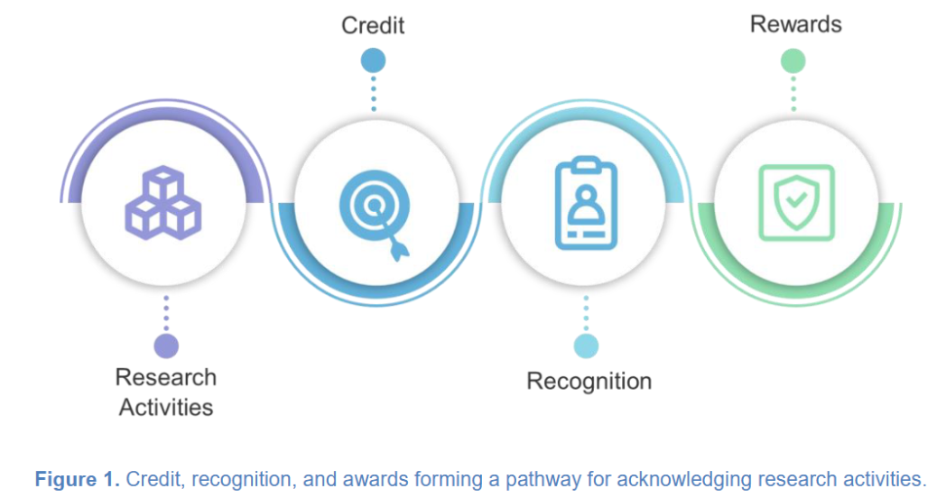
From Contributions to Career Value: Credit, Recognition and Rewards
Credit: Formal attribution of a person’s role or contribution in a research activity or output
Recognition: Broader acknowledgement of the value of that contribution by communities, institutions, or infrastructures
Rewards: Tangible outcomes such as career progression, promotion, funding opportunities, or formal roles
D5.1 Landscape analysis of existing rewards and mechanisms for research software and training activities. Zenodo. https://doi.org/10.5281/zenodo.14978474

Slide 6
Why publication-centric assessment is not enough
The current system tends to reward what is easiest to count, not always what is most foundational.
Challenges highlighted in the EVERSE landscape analysis include:
insufficient acknowledgement of diverse research-related activities beyond publications
over-reliance on narrow quantitative indicators
lack of transparency and openness in assessment data and methods
limited standardisation and interoperability for recognising software and training contributions

Slide 7
The EVERSE Credit and Recognition Framework: bird’s-eye view
The framework is being developed to support more visible and structured recognition of research software and training contributions. It brings together:
existing infrastructures rather than building everything from scratch
standards and vocabularies to describe who did what
contribution tracking and profile platforms
researcher identifiers such as ORCID
alignment with broader European research assessment reform

Slide 8
What the framework is built from
1. Research artefacts and activities:
Software, workflows, datasets, training materials, events, maintenance work
2. Standards for structured attribution:
Examples include contributor roles, metadata schemas, and software citation approaches
3. Infrastructures and platforms:
APICURON, BIP! Scholar, ORCID, Open infrastructures and metadata services
4. Institutional and policy uptake:
Assessment reform, CV use, promotion criteria, career structures, responsible metrics
MS16 A mechanism for recognition of activities to be easily used in CVs. Zenodo. https://doi.org/10.5281/zenodo.16941917

Slide 9
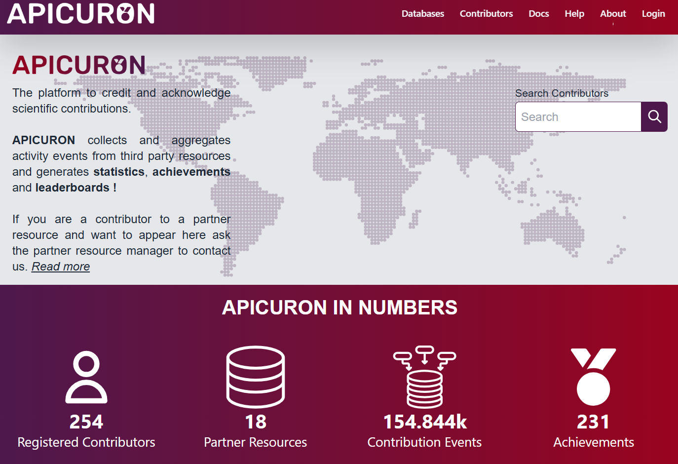
APICURON: tracking and evidencing contributions
APICURON helps make often overlooked research contributions visible, by:
tracking of contributions to research artefacts and activities
visible links between contributors and specific outputs
incentives and engagement through recognisable contribution records
connection to persistent identifiers and broader recognition workflows
Turning technical and training work into something visible, structured, and portable.
https://apicuron.org/

Slide 10
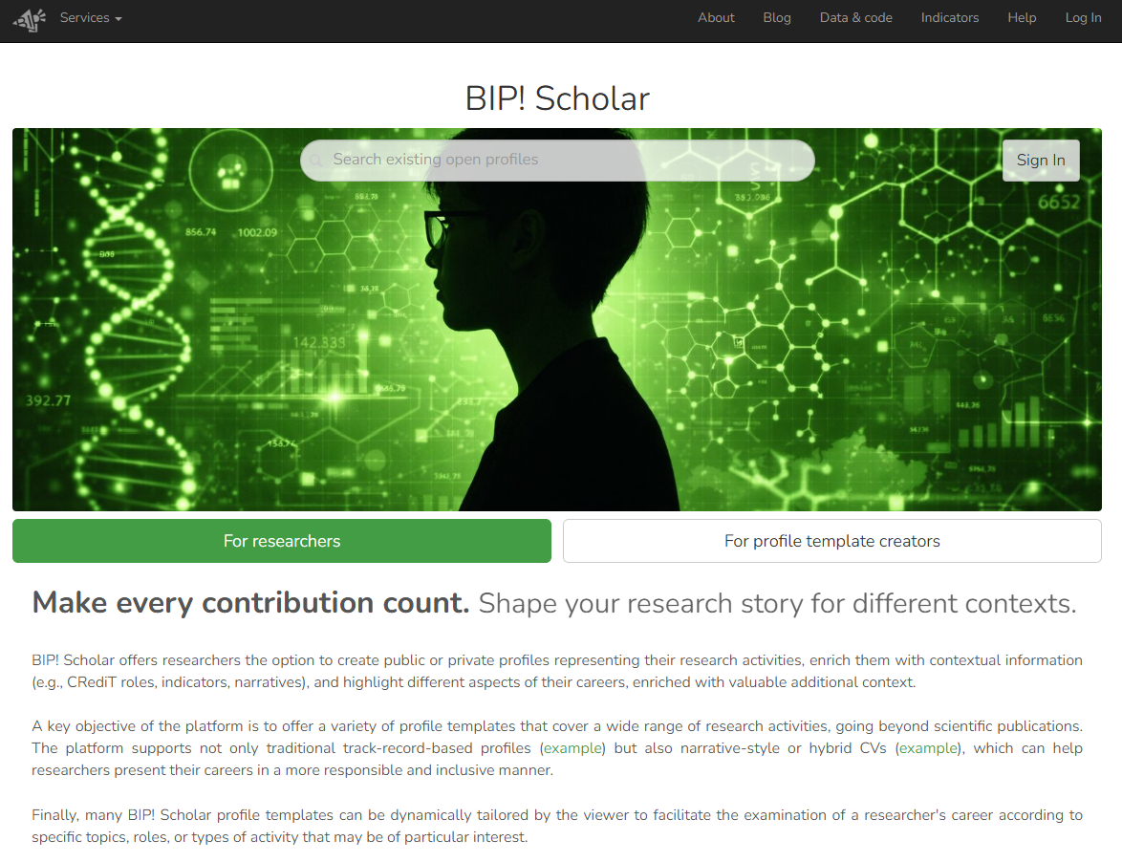
BIP! Scholar: showcasing broader scholarly contribution
BIP! Scholar supports richer researcher visibility by showcasing a broader range of outputs and indicators. In this framework, it can help:
present diverse scholarly contributions beyond papers alone
support richer researcher profiles
connect contributions, metadata and indicators in a more transparent way
Recognition is not just about counting outputs; it is also about making contributions legible and visible.
https://bip.imsi.athenarc.gr/scholar

Slide 11
Building on existing initiatives and turning them into practice
EVERSE builds on a wider movement toward more responsible and inclusive research assessment and adds:
a concrete focus on research software and training activities
an implementable link between contributions, standards, platforms, and researcher profiles
a pathway from activity tracking to structured credit to visible recognition
practical integration with tools researchers can actually use
The framework is not just aligned with assessment reform - it helps operationalise it for software and training.

Slide 12
Why this matters for RSEs, trainers, and digital research professionals
Recognition is also about better careers, better incentives, and more sustainable research practice. A stronger framework can help:
make contributions more visible
support fairer assessment
strengthen career cases for RSEs, trainers and related roles
encourage institutions to build clearer and more sustainable career pathways

Slide 13
What comes next in this webinar
In the next parts of the session, we will move from the big picture to the practical implementation:
Platform walkthroughs: APICURON and BIP! Scholar
Your feedback
Hands-on profile setup and contribution tracking
Adoption opportunities for new partner resources
The goal is not only to discuss recognition in principle, but to start making it usable in practice.

