Slide 1

EVERSE Webinar: a Credit and Recognition Framework for RSEs and Trainers
BIP! Scholar Walkthrough
Presented by:
Dr. Maria Makaronidou - Athena Research Center (ARC), Greece
This project has received funding from the European Union’s Horizon Europe Programme under GA 101129744 — EVERSE — HORIZON-INFRA-2023-EOSC-01-02

Slide 2
https://bip.imsi.athenarc.gr/site/home
A Suite Built for Researcher Support
BIP! Services was designed with a clear mission: to empower the research community through tools that explore novel ideas to simplify researchers’ daily routines. Today, the suite includes four complementary services:
Finder, an open academic search engine enhancing knowledge discovery across scientific publications;
Scholar, an open profiling platform where researchers can build and share career summaries using diverse templates, while research assessment experts can experiment with and evaluate new profile templates in collaboration with volunteers;
Readings, a library of user-curated publication lists that supports literature organization and note-taking; and
Spaces, a service for creating tailored search engines designed to meet the needs of specific organisations or communities, connecting them with curated knowledge bases.
Together, these services address a wide range of researcher needs, supporting activities that are common across diverse scientific domains.

Slide 3
https://bip.imsi.athenarc.gr/site/data
Zenodo
(Research Outputs Repository)
Crossref
(Aggregator)
OpenCitations
(Aggregator)
Research Outputs metadata & citations
Citations
Research Outputs metadata
OpenAIRE Graph
ORCID
Links between Researchers and Research Outputs (publications, datasets, research software)
Research Outputs metadata & citations
Scholar

Slide 4
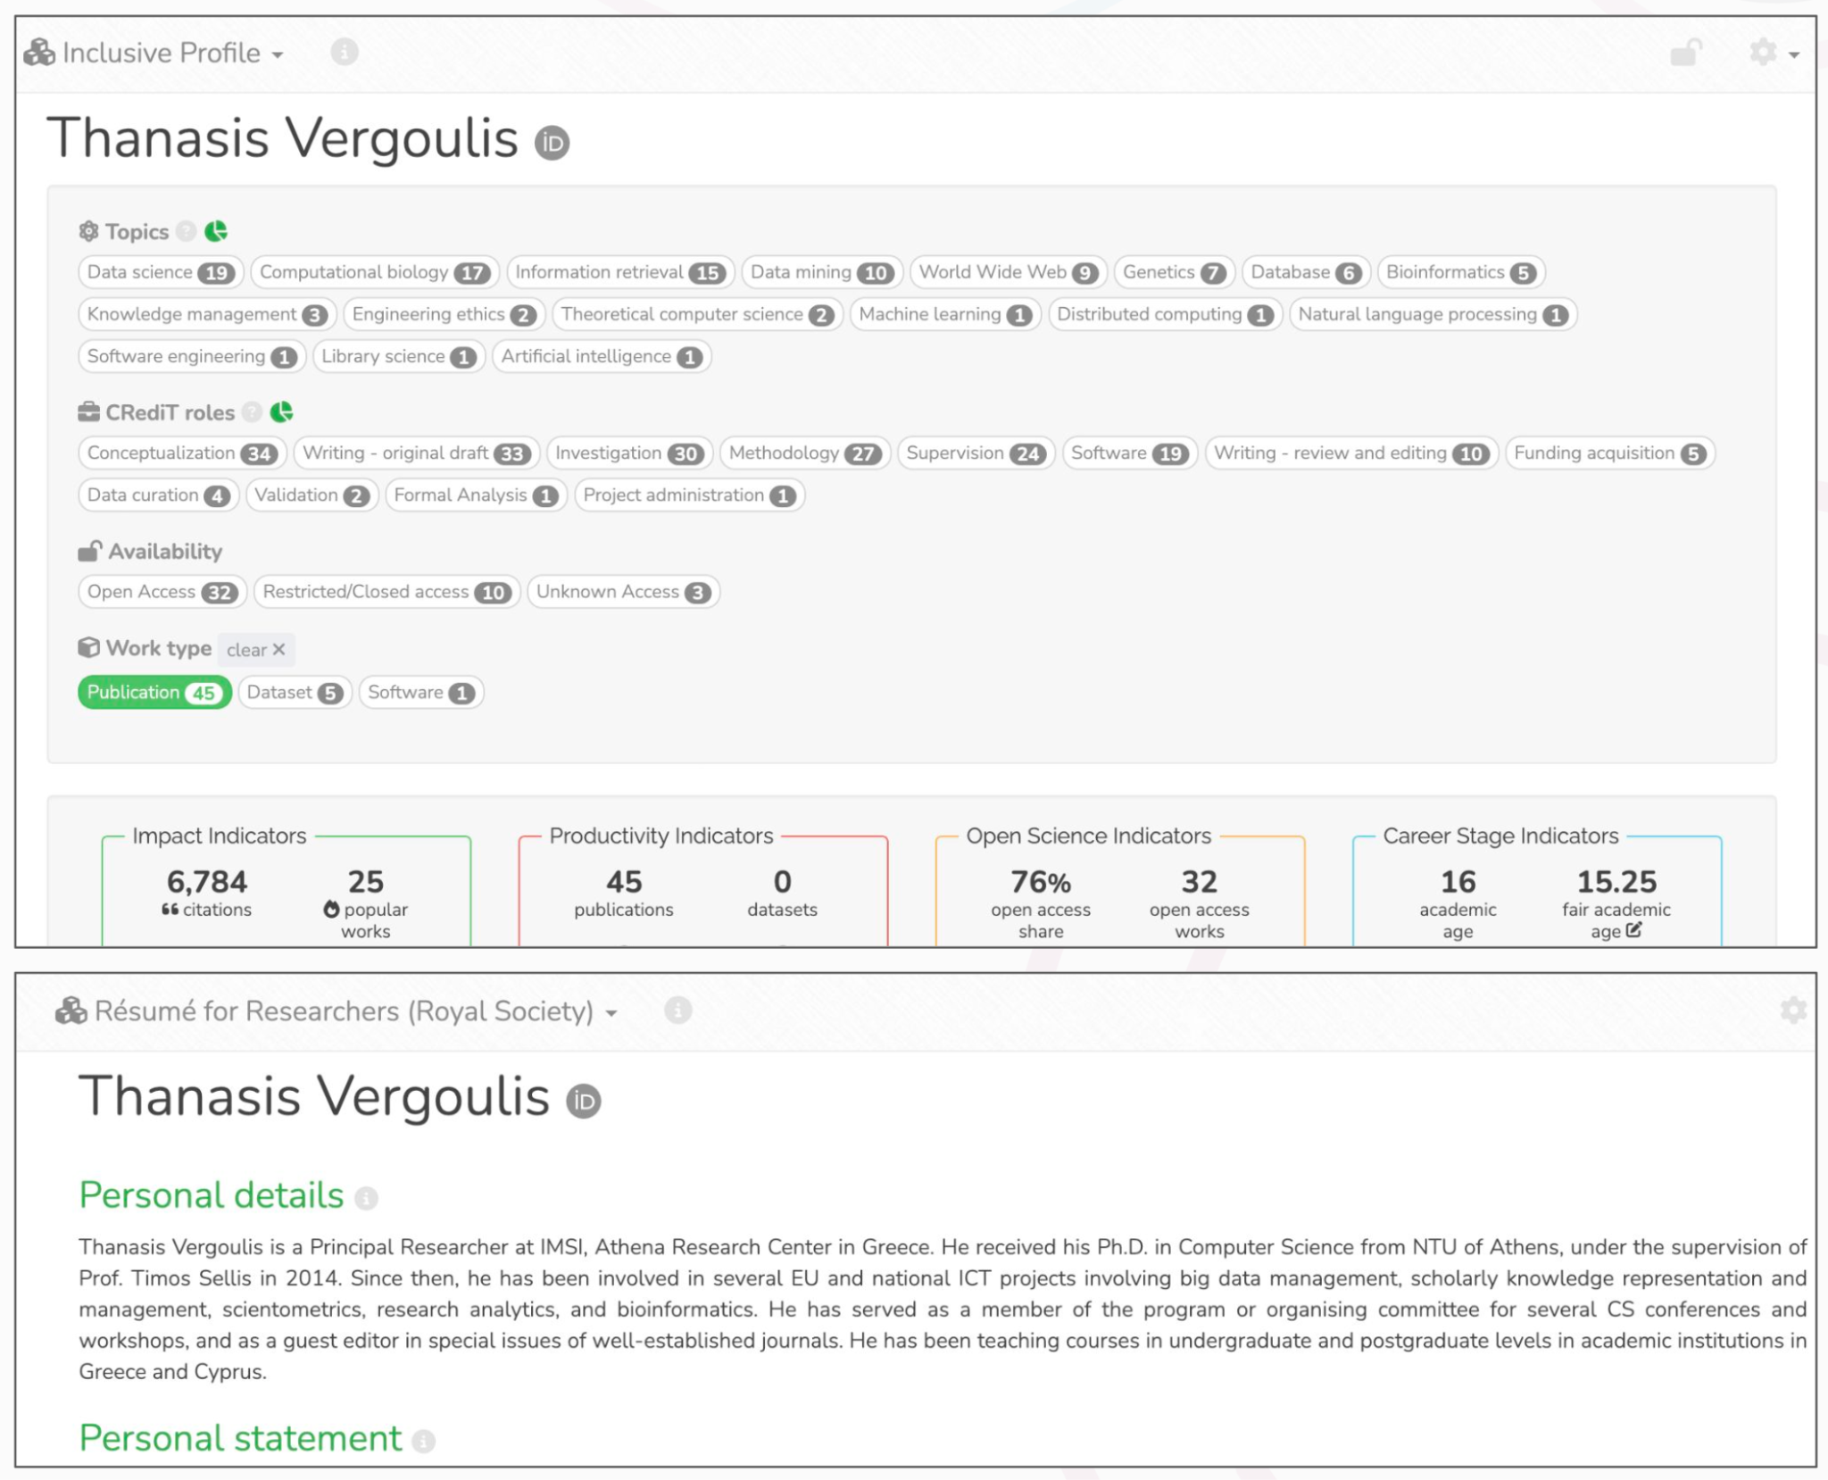
BIP! Scholar (in general)
https://bip.imsi.athenarc.gr/scholar
Supports multiple profile templates, including a variety of types (e.g., indicators-focused, narrative-style, etc).
Builds researcher profiles covering a wide range of research outputs (publications, datasets, software).
Provides output-level and researcher-level indicators covering different impact dimensions.
Highlights researcher’s roles and contributions using appropriate taxonomies (e.g., the CRediT taxonomy).

Slide 5
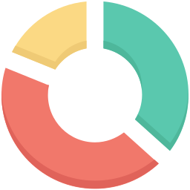



BIP! Scholar for EVERSE
“Research Software Portfolio” concept
mockup
Objective 1: Tailored impact indicators for software
Tete Vuvuli
Languages
Python (2), PHP (3), Javascript (1)
Roles
Design (2), Coding (5), Testing (4), Documentation (3)
Objective 2: Tailored contributions/role taxonomy for software*
Software tools (5)
Objective 3: Incorporation of aggregated statistics based on software-related activity (by APICURON)
Toolara
[v10 | Python | MIT Licence]
Roles: Design, Coding, Testing, Documentation
Tracked actions: 450 commits, 19 pull requests
Objective 4: Incorporation of RSQ indicators suggested by EVERSE experts
…
*based on taxonomy proposed by INRIA (reported in D5.1).
Early demo: https://bip.imsi.athenarc.gr/scholar/profile/0000-0003-0555-4128/sw-portfolio

Slide 6
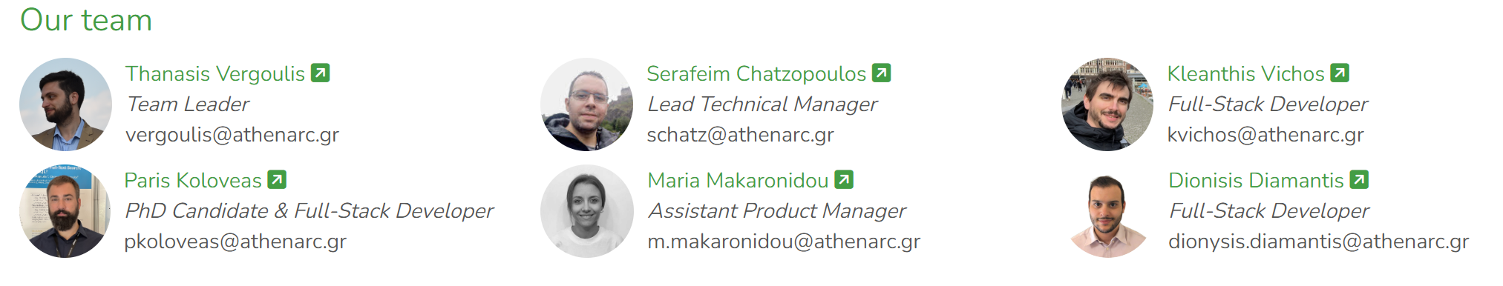
BIP! Services
Contact us
Send us your feedback at:
Email: bip@athenarc.gr
Address: Athena Research Center, Egialias 19 & Chalepa, Maroussi 15125, Greece

Slide 7
Useful links:
Home: https://bip.imsi.athenarc.gr/site/home
Log-in / Sign-up: https://bip.imsi.athenarc.gr/site/login
Data: https://bip.imsi.athenarc.gr/site/data
Indicators: https://bip.imsi.athenarc.gr/site/indicators
EVERSE-related links:
Scholar: https://bip.imsi.athenarc.gr/scholar
Research software portfolio: https://bip.imsi.athenarc.gr/scholar/myprofile/sw-portfolio
Thank you for your attention!

