Slide 1
EVERSE Webinar: a Credit and Recognition Framework for RSEs and Trainers
Community feedback and opportunities to get involved
Presented by:
Federica Quaglia - University of Padova, Italy
This project has received funding from the European Union’s Horizon Europe Programme under GA 101129744 — EVERSE — HORIZON-INFRA-2023-EOSC-01-02

Slide 2
Why community feedback matters for this framework
The EVERSE Credit and Recognition Framework is not being designed in isolation.
Community feedback helps us:
test whether the framework addresses real recognition needs
understand which contributions people most want represented
identify what kinds of indicators and profiles are actually useful
refine the framework before wider testing and uptake
The goal is not just to build a technically correct framework, but one that communities find meaningful and worth using.

Slide 3
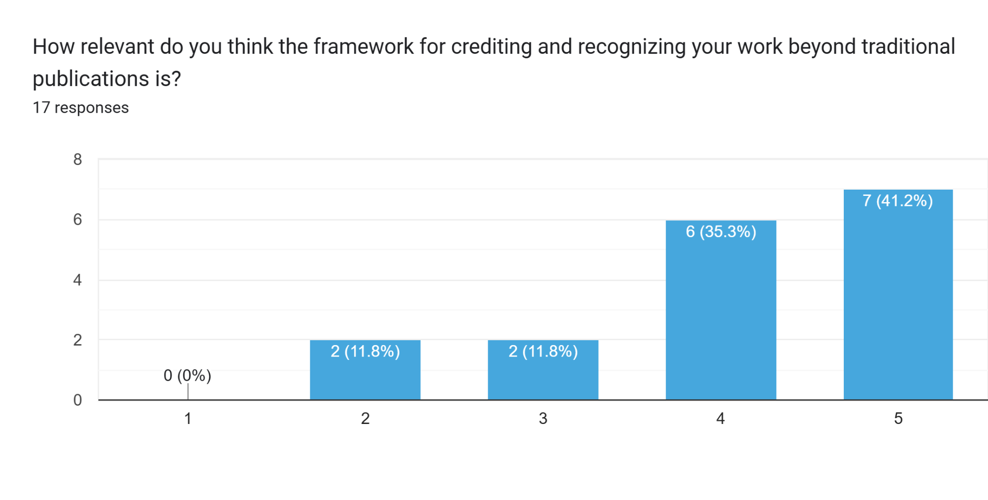
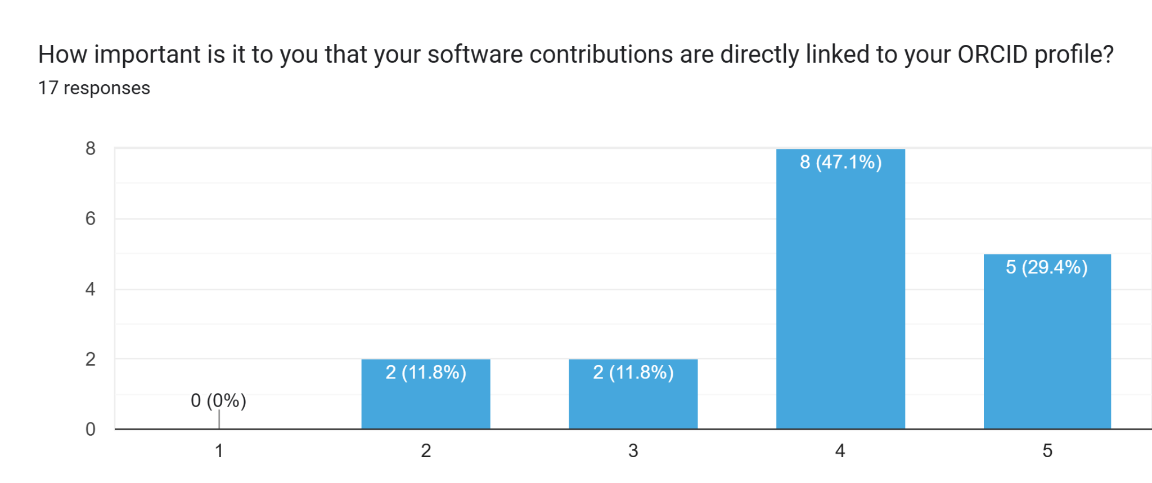
The strongest message: the recognition need is real
The survey gives a clear overall signal:
participants see clear value in making software contributions more visible
the overall direction of the framework is seen as relevant
there is strong interest in recognition workflows that are more structured and less manual
Need for recognition framework that is usable, visible, and connected to real research practice

Slide 4
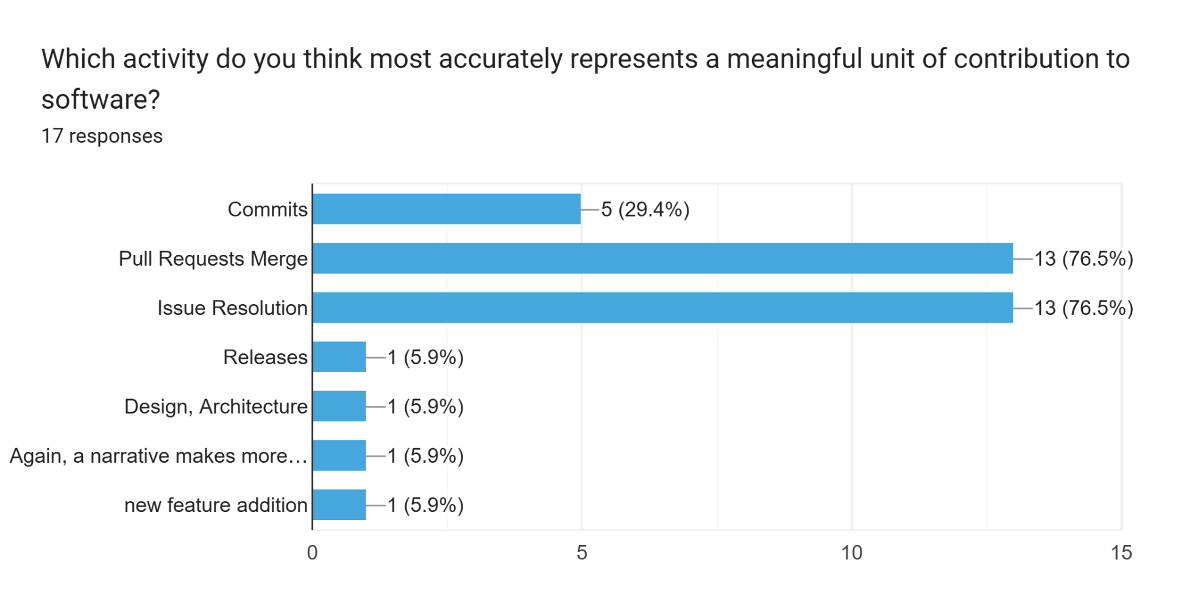
Community priorities for recognition and visibility
The survey points to four recurring priorities:
1. Visible contribution tracking
People want software and related work to be captured as real contributions, not left implicit.
2. Meaningful units of contribution
Pull request merges and issue resolution emerged as especially meaningful signals of work.
3. Better researcher-facing profiles
Participants value updated records, aggregation by role/topic, and richer contribution visibility.
4. Recognition beyond publications
The need is not for more paper-centric metrics, but for broader representation of research work.

Slide 5
Specific roles: important for demonstrating my skills and what I can bring to a project/collaboration
Implications for the design of recognition indicators
Participants pointed to the need for:
clearer role attribution
transparent and explainable indicators
room for narrative and context
recognition of training and enabling work
fairer representation, not just more counting
…"liveliness" of the development and also a clear explanation of my role in the project. Impact indicators are difficult if they are absolute numbers…
Aggregated activity statistics: important for showing productivity over time.
…an impact narrative?
Citations… Downloads.. List of projects… List of tools used

Slide 6
Training contributions and career relevance
The survey also reinforced that training should be treated as a primary of the framework. Participants highlighted:
a wide variety of platforms used to share training work
different ways of measuring training value and impact
the importance of recognising organisation, facilitation, delivery, and follow-up
the need for recognition that supports career progression, not only visibility
Recognition is not only about software artefacts. It is also about the people and activities that build capacity, support reuse, and sustain research communities.
…being actively involved in training events in any role (lecturer, mentor, facilitator, ...), contributor to training material.
nº of trainings and nº of attendees per training, if training is asyncronous: nº of views/users
…years of practice… number of trained people…

Slide 7
Implications for the next phase of framework development
The survey helps us sharpen the core direction of the framework. So far, the feedback confirms the importance of:
structured role attribution
recognising software and training together
linking activities to persistent identifiers
using transparent, explainable indicators
keeping space for context and narrative
designing outputs that are useful in profiles and CVs
Our goal: designing a framework not just broader, but more grounded in actual RSEs and trainers community needs.

Slide 8
Early adopters and pilot participation
We are now looking for early adopters to help move from proof of concept to practical refinement. Early adopters can help us:
test whether tracked activities are meaningful
refine indicators, roles, and profile structures
identify gaps in software and training representation
assess whether outputs are useful in real profile and CV contexts
improve the user journey across platforms
Who we welcome
RSEs
trainers
maintainers
project leads
researchers with substantial software or training contributions
communities and institutions interested in piloting recognition workflows
📝
Framework for Credit and Recognition: Early Adopters
📝
EVERSE Framework for Credit & Recognition Feedback Survey

