Slide 1

„Digital Structure of a Home Movie Archive: Case Study of the Polish Archive of Home Movies as a Repository of Cultural Memory”
Przemysław Murawski
Doctoral School of Languages and Literatures
przmur@amu.edu.pl

Slide 2
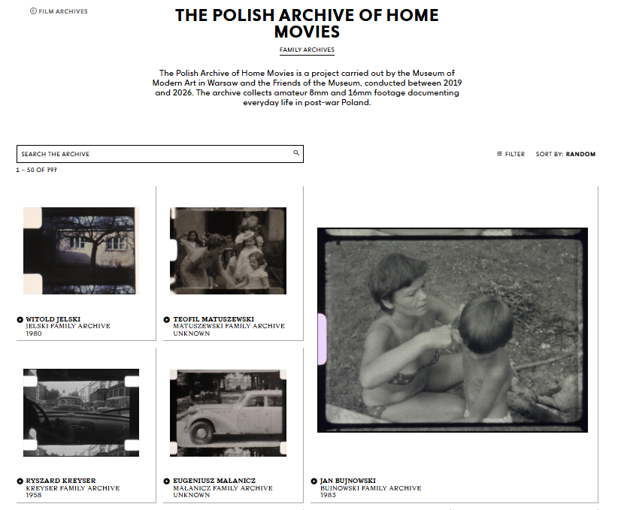

Slide 3
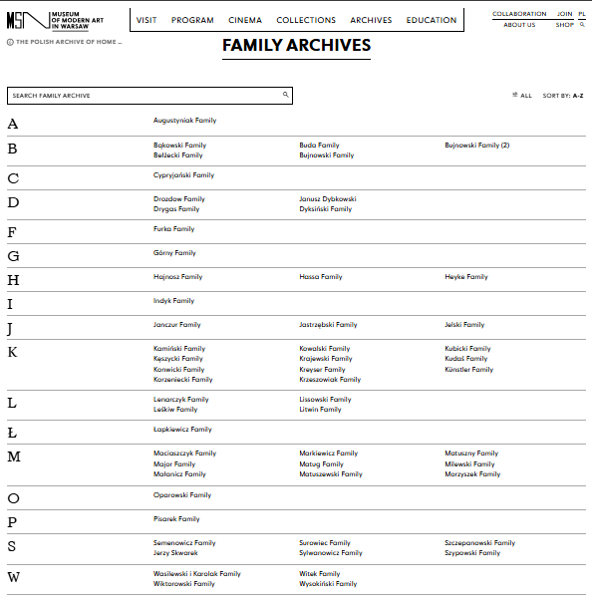

Slide 4

„The home movies offer a fiction of the family that reinforces what they want to know about themselves and sanctions a public view of a most private space: the home […] home movies show us an ideal image of the family with everyone in his or her proper place: parents in charge, men in control, families together.”
Michelle Citron, Home Movies and Other Necessary Fictions, Minneapolis 1999.

Slide 5
Digital Infrastructure & Filtering
Geographic
Analyzes technological disparities between regions and underscores the privileged class status associated with amateur filmmaking
Thematic
Groups films according to phenomena present in them. Enables anthropological and cultural studies research.
Chronological
Allows to investigate whether and how authorial strategies in home filmmaking evolved over time

Slide 6
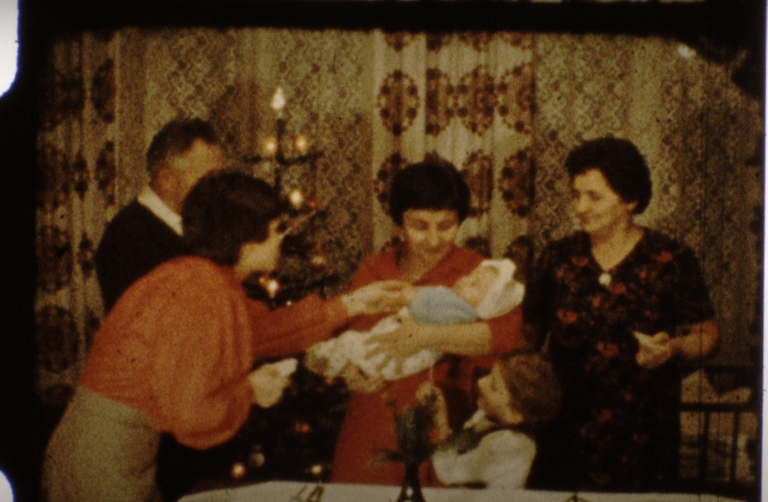
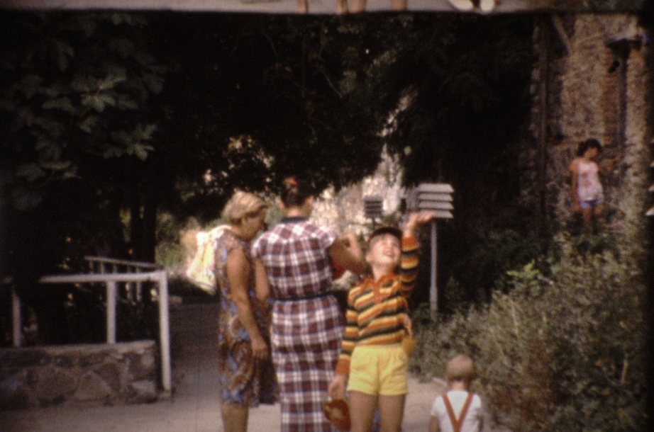
Home movie archives are no longer merely static—“not actively used”—and vulnerable to the destructive passage of time. They have been revitalized—brought back into use—by numerous processes that influence the nature and status of home movie footage. The digital age plays a particularly significant role in this transformation.

Slide 7
Bibliography
Aasman, S. (2014): “Saving Private Reels: Archival Practices and Digital Memories (Formerly Known as Home Movies) in the Digital Age”, in: Rascaroli, L. / Young, G. / Monahan, B. (eds.): Amateur Filmmaking: The Home Movie, the Archive, the Web. New York–London–New Delhi–Sydney: Routledge, 245-256.
Baron, J. (2014): The Archive Effect. Found footage and the audiovisual experience of history. London–New York: Routledge.
Benjamin, W. (2011): The Work of Art in the Age of Mechanical Reproduction. London: Penguin Books Ltd.
Blom, I. / Lundemo, T. / Røssaak, E. (eds.) (2017): Memory in Motion. Archives, Technology, and Social. Amsterdam: Amsterdam University Press.
Citron, M. (1999): Home Movies and Other Necessary Fictions. Minneapolis: University of Minnesota Press.
Haratyk, P. / Sitek, K. (2018): “Found footage jako kino odnowy znaczenia home movies w filmach A Song of Air i Sea In the Blood”, in: Kwartalnik Filmowy 104: 178–192.
Ishizuka, K.L. / Zimmermann, P.R. (eds.) (2008): Mining the home movie: excavations in histories and memories. Berkeley–Los Angeles–London: University of California Press.
Manovich, L. (2002): The Language of New Media. Cambridge, MA: MIT Press.
McLuhan, M. (1994): Understanding Media: The Extensions of Man. Cambridge, MA: MIT Press.
Moran, J.M. (2002): There's No Place Like Home Video. Minneapolis: University of Minnesota Press.
Røssaak, E. (ed.) (2010): The Archive in Motion. New Conceptions of the Archive in Contemporary Thought and New Media Practices. Oslo: National Museum of Norway.
Sobchack, V. (2019): “Me, Myself, and I: On the Uncanny in Home Movies”, in: Hanich, J. / Fairfax, D. (eds.): The Structures of the Film Experience by Jean-Pierre Meunier: Historical Assessments and Phenomenological Expansions. Amsterdam: Amsterdam University Press 205–231.
Spieker, S. (2008): The big archive: art from bureaucracy. Cambridge, MA: MIT Press.
Zielinski, S. (2006): Deep Time of the Media: Toward an Archaeology of Hearing and Seeing by Technical Means. Translated by Custance, G. Cambridge, MA: MIT Press.
Zimmermann, P.R. (1995): Reel Families: a social history of amateur film. Bloomington–Indianapolis: Indiana University Press.

Slide 8
Thank you for your attention
Przemysław Murawski
Doctoral School of Languages and Literatures
przmur@amu.edu.pl

