Slide 1


Geoscience SIG @ RSECon 2026

Slide 2

Agenda
Friday 11th Sept 13:30-15:30
13:30 Introduction
13:35 Keynote from Nick Jefferson
13:55 Lightning talks
14:30 comfort break
14:35 SIG AGM
14:45 Panel discussion
15:30 Close
https://bit.ly/geoscience26

Slide 3

SIG Committee
Chair: Helen Burns
Deputy: Isabel Fenton
General members:
Luke Abraham
Jack Atkinson
Mark Richardson
Emma Hogan
Joe Marsh Rossney
Kirsty Pringle
Colin Sauze
Esther Turner
Declan Valters
Marion Weinzierl

Slide 4
Housekeeping
Please feel free to use the slack channel in RSECon26 Slack space #geosciencesig for session related discussion; zoom participants you might need to use this to communicate any technical issues
All questions will be taken via slido
All links are in the hackpad which is linked in the abstract and on QR codes below https://bit.ly/geoscience26
Please be considerate of others when using the hackpad and slido
Sheffield solidarity fund:
https://ucu.group.shef.ac.uk/hardship-fund/

Slide 5
Links
All links are in the HackPad
https://bit.ly/geoscience26
Schedule + talk titles
Slido, Mentimeter, sign up forms.
Link to ucu sheffield solidarity fund

Slide 6
Agenda
Friday 11th Sept 13:30-15:30
13:30 Introduction
13:35 Keynote from Nick Jefferson
13:55 Lightning talks
14:30 comfort break
14:35 SIG AGM
14:45 Panel discussion
15:30 Close

Slide 7



FASTA
Forecasting African STorms Application
Nick Jefferson
CEMAC, University of Leeds
Notes:
FASTA brings near real-time storm information to Africa.
An Android app, Web app and Application Programming Interface (API) provide instant access to current and approaching storm activity

Slide 8
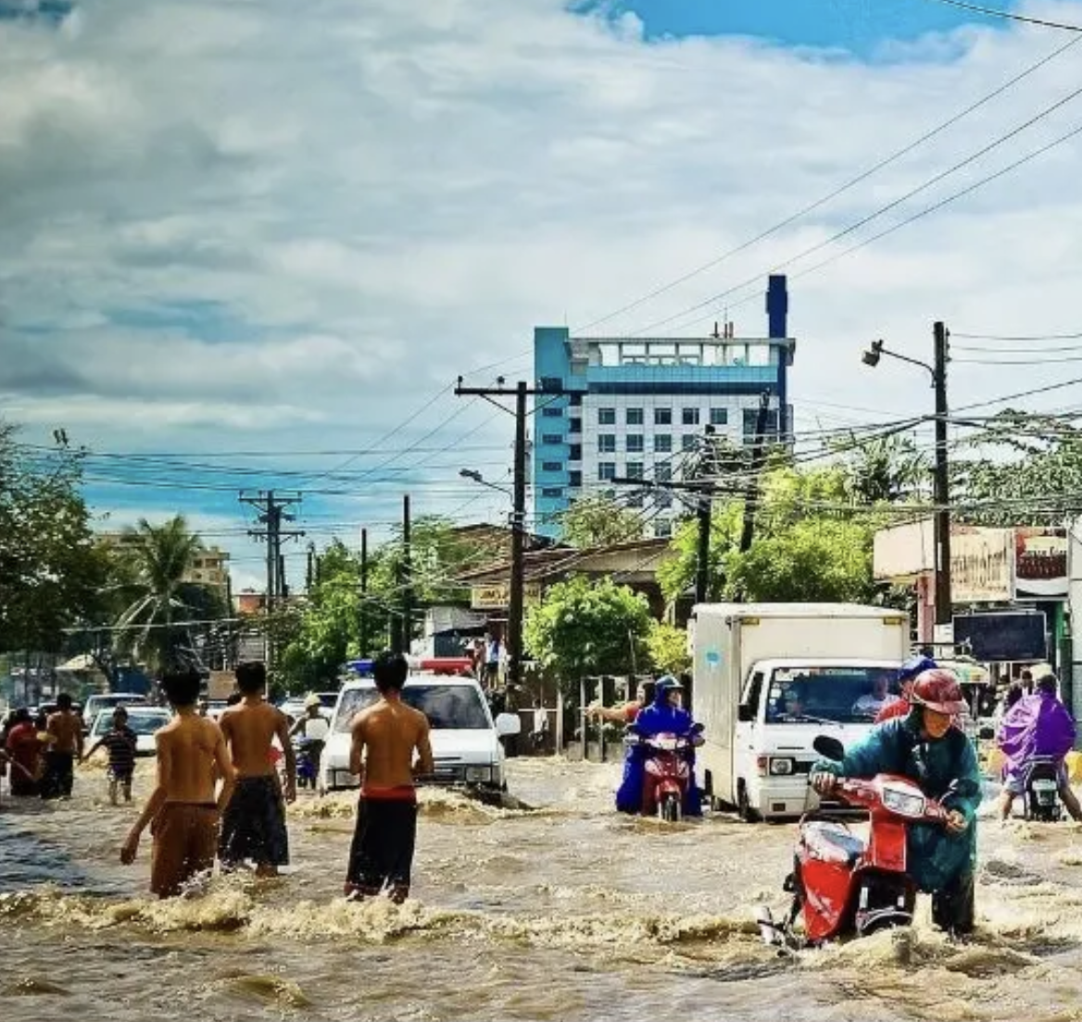
The challenge in Africa
Intense rainstorms are disruptive and damaging
  Danger to life and property: extreme conditions, vulnerable people
There is a lack of early warnings, getting information to vulnerable communities is difficult
Traditional global NWP models have poor skill in Africa
Observation based nowcasts perform better:
  Lack of rainfall radars (cost, skills)
  Satellite observations have been available for many years (MeteoSat) but uptake has been slow and limited

Slide 9

FASTA Android App

Slide 10
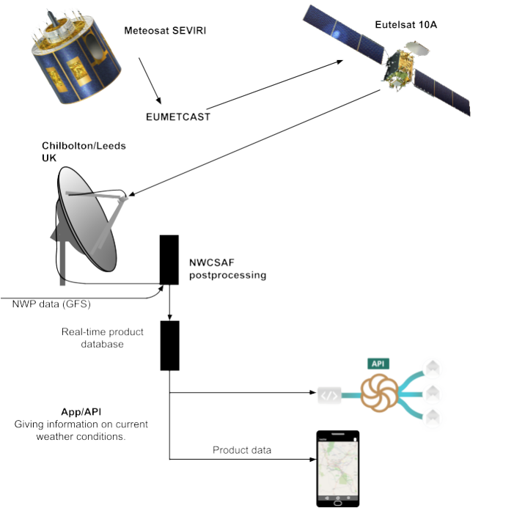
How does data flow from satellite to device?
Image credit: Alex Roberts, University of Leeds
Notes:
Images arrive at our server, are then processed by NWCSAF to produce gridded rainfall retrievals, these are then smoothed and processed into vectors (polygons), stored as GeoJSON, and as vector tiles, and made available via an API.
Note a couple of changes:
1. we no longer rely on the EUMETCAST broadcast: meteosat data is received from a terrestrial feed from EUMETSAT.
2. As well as NWCSAF postprocessing, we use a ML system called Rain over Africa.
Researchers at Leeds had got the first part of this operational in a previous project called African SWIFT, they were receiving the satellite data and set up the processing, producing Python plots and making them available over the web in a catalog. Problem was …

Slide 11
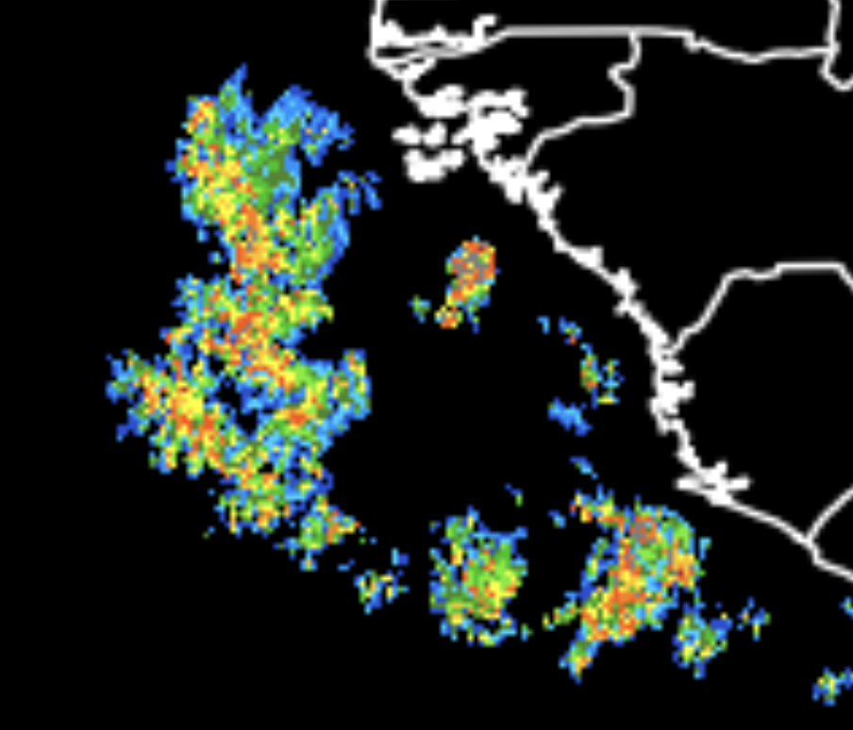
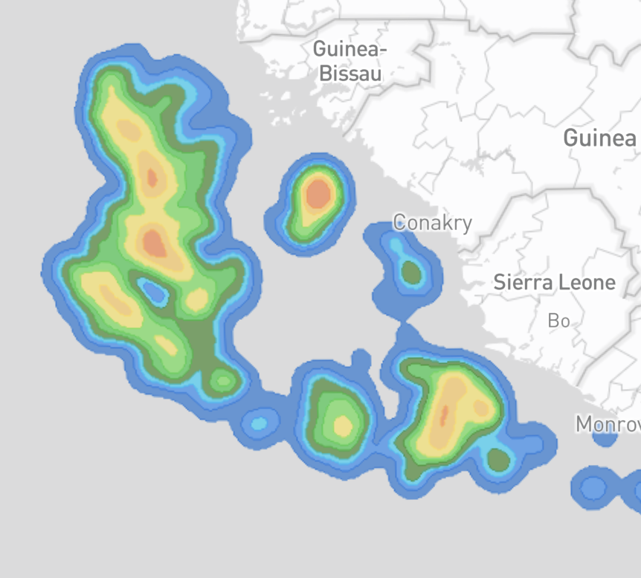
Data
Challenges
Hi-res (3km grid) outputs from processing
Patchy network, expensive data, basic smartphones
Convert into smoothed vector data: geoJSON/tiles
Notes:
Researchers were producing large python plots of nowcasting products aimed at forecasters.
Not suitable for mobile devices:
patchy 3G/4G network, expensive data costs.
Also, data could not be readily searched or queried.
Data needed to be converted into compact formats more appropriate for mobile and web maps.

Slide 12
Development/product lifecycle
UKRI GCRF African SWIFT
WISER-EWSA
UKRI EW4Energy
Initial launch
in Kenya
Official launch
in Ghana
2020
2021
2022
2023
2024
2025
2026
Establish infrastructure / backend
Design and build API
App demonstrators / prototypes, testing and initial launch in Kenya
Timelines
CAP Warnings and push notifications
Web App
MTG Lightning layer
Move to ML data model:
Rain over Africa
Infrastructure/server maintenance
Ongoing bug fixes, user feedback, UI tweaks, Google Play Store policies
Notes:
Funding presents a challenge. We don’t currently take sponsorship, and we want to keep the product free to use. And yet ongoing support and maintenance has costs.
Met Services don’t want to promote (and depend on) a product that does not have a guaranteed future, so they do not actively promote.

Slide 13


GCRF African SWIFT
Science for Weather Information and Forecasting Techniques (2017 – 2022)
Initially focused on building a flexible backend:
  automated processing workflow to process, convert and store continually incoming data
  system monitoring, failover and backup for service continuity
  design and build APIs for retrieving rainfall/storm data as GeoJSON and map tiles
App: Demonstrator 🡪 Prototype 🡪 Product
Testing in Kenya late 2021, launch Jan 2022
Notes:
Focussed on building a flexible platform at this stage. Was unclear what product we would deliver: API? App? requirements changed frequently.

Slide 14



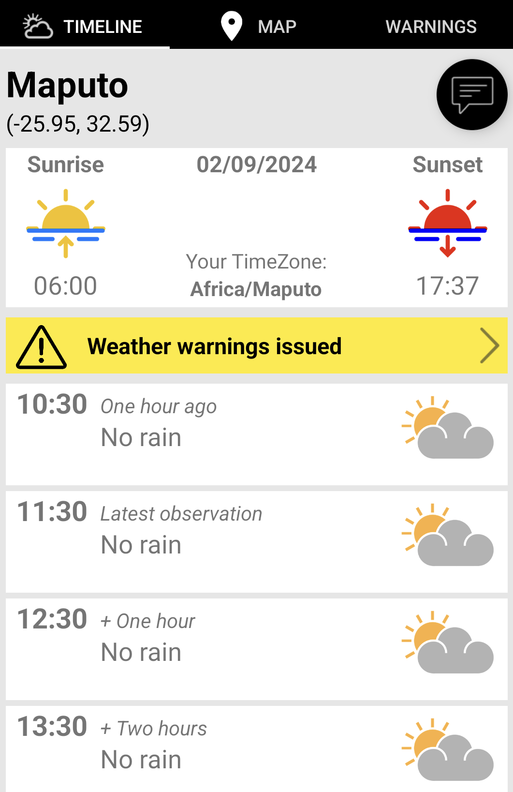
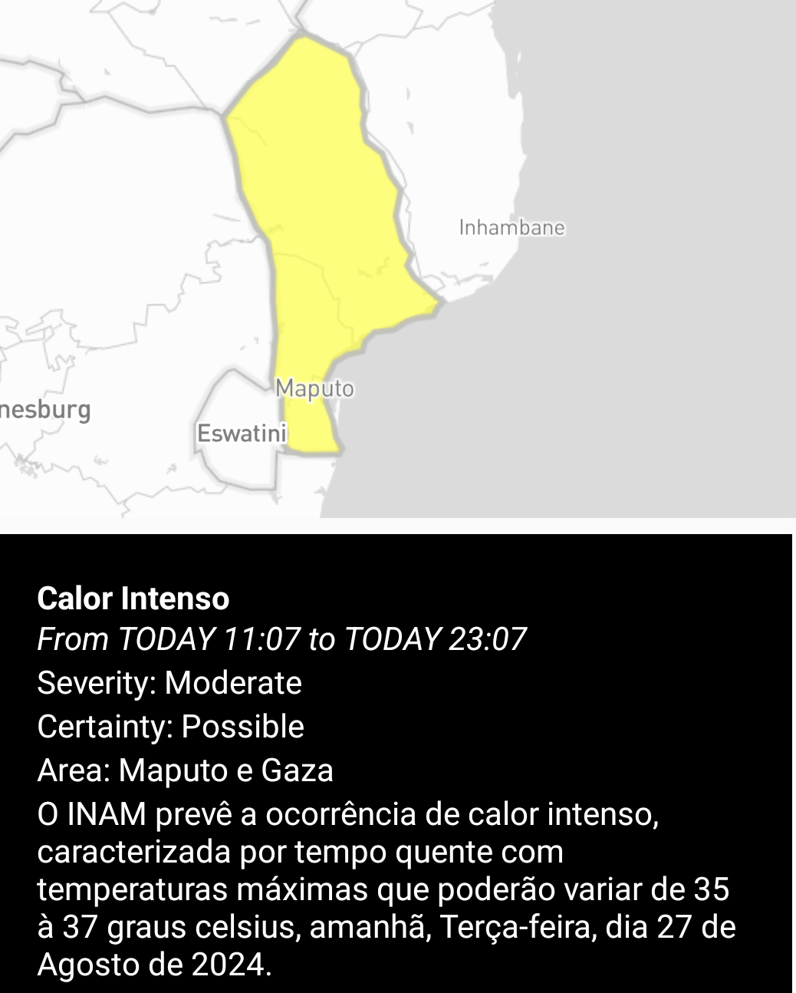
WISER Early Warnings for Southern Africa (WISER-EWSA), 2023 - 2025
Improving access to early weather warning systems for urban communities in South Africa, Zambia and Mozambique
Timelines
CAP Messages
Push notifications

Slide 15
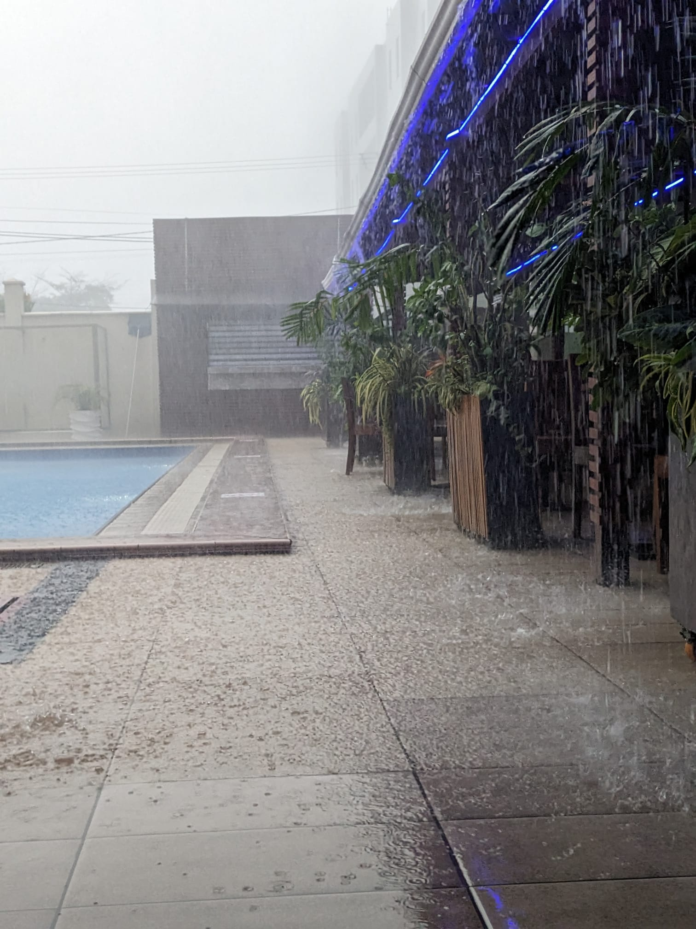
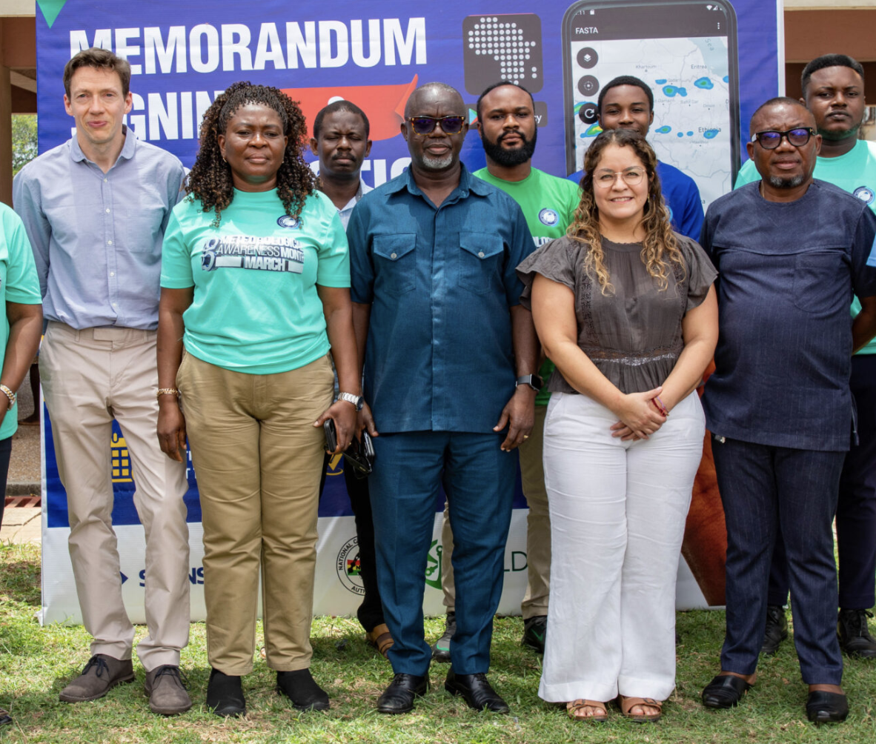
Early Warnings for Energy (EW4Energy)
Developing capacity for storm and lightning early
warning for the energy sector in Ghana, 2025 – 2027
Official launch of FASTA in Ghana, March 2025
Local weather conditions!
Notes:
“ … not to undermine local capacity or compete with local agencies who are already supplying something similar. The aim is, where possible, to partner with the national meteorological agencies so the now-casting service can be put out under their badge.”

Slide 16
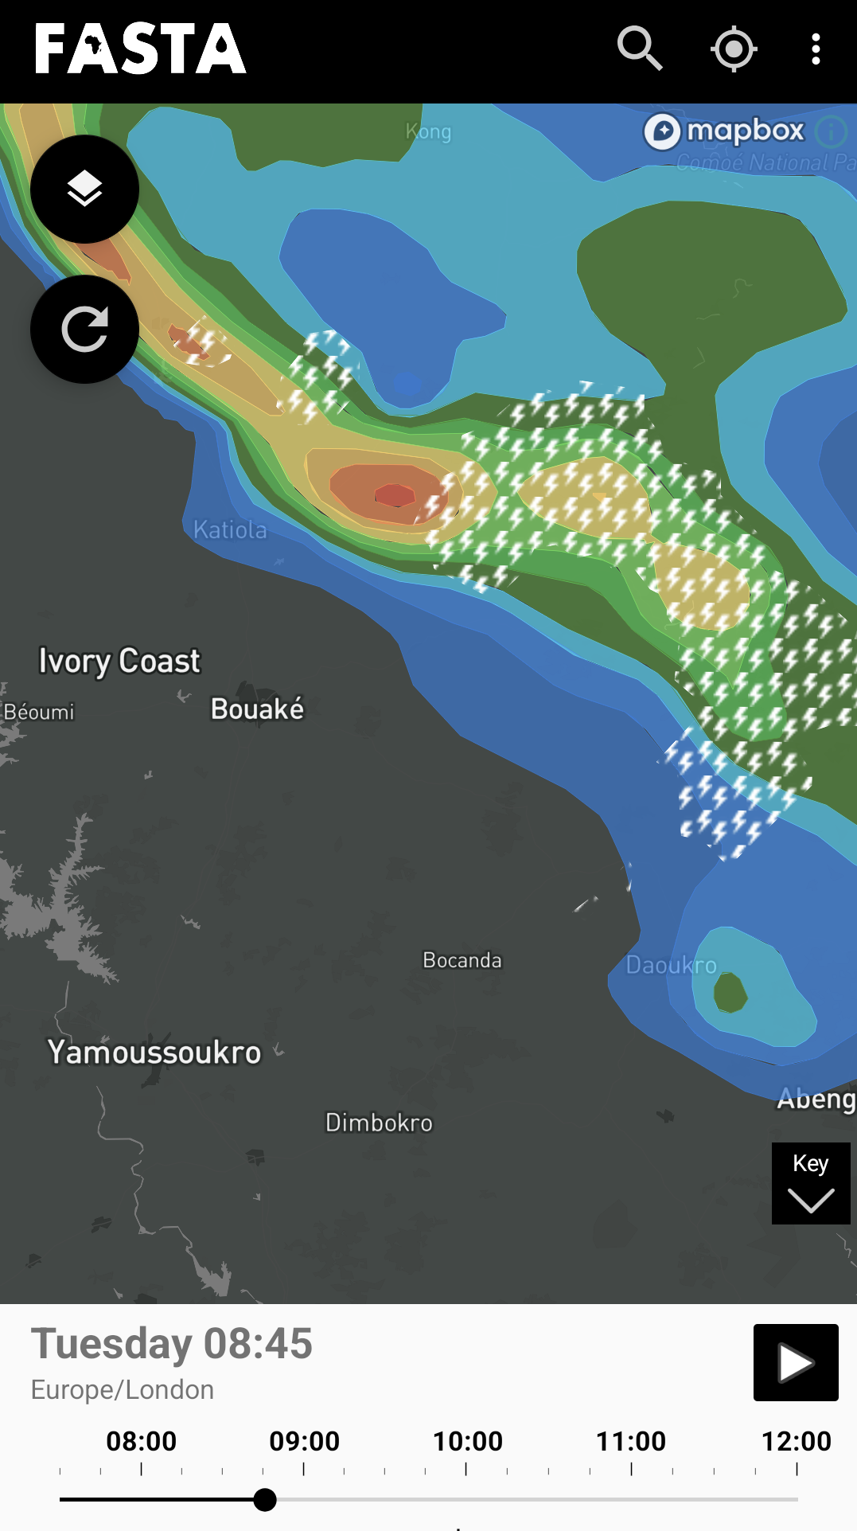
EW4Energy and beyond
Lightning data from MTG
Move to ML based models:
  Rain over Africa
  University of Leeds AI nowcasting group
Impact analysis
https://rainoverafrica.ai/

Slide 17
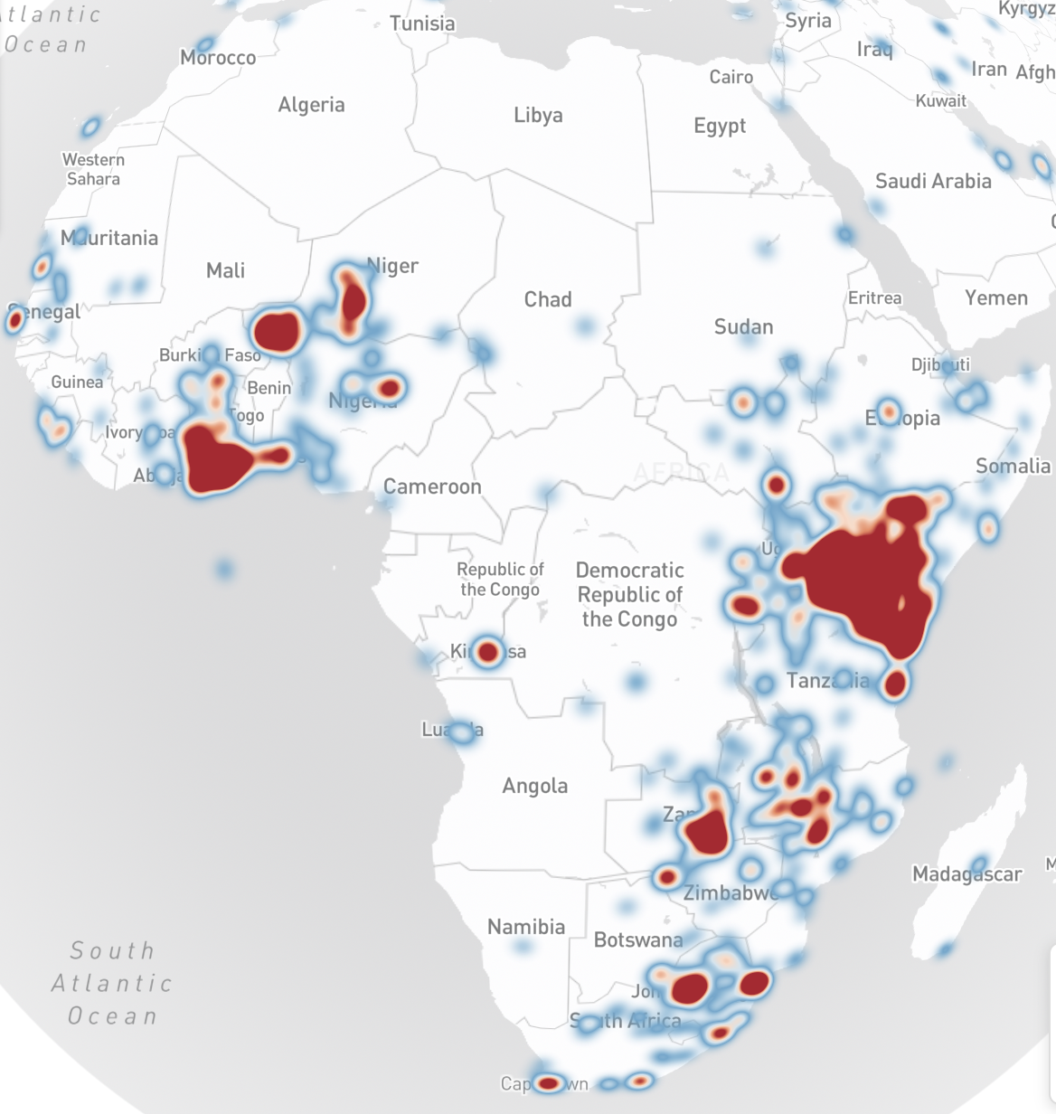
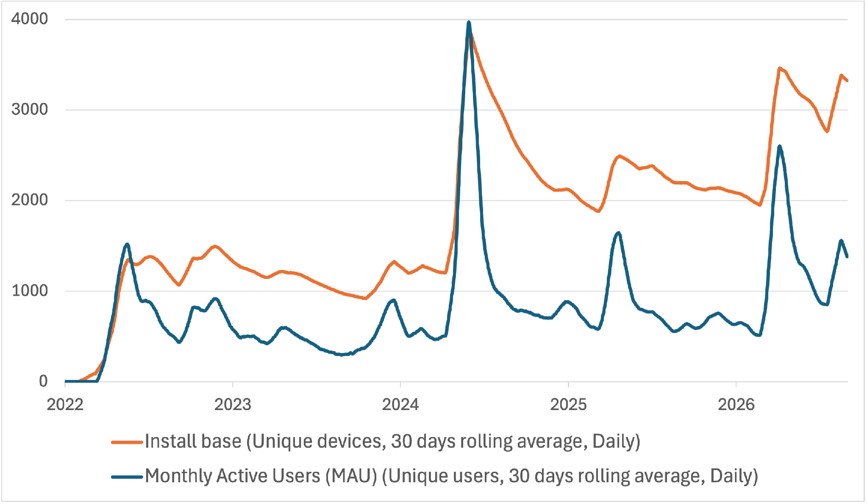
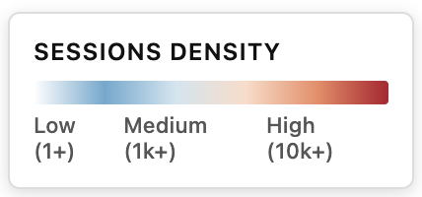
Impact: Installs and Usage

Slide 18
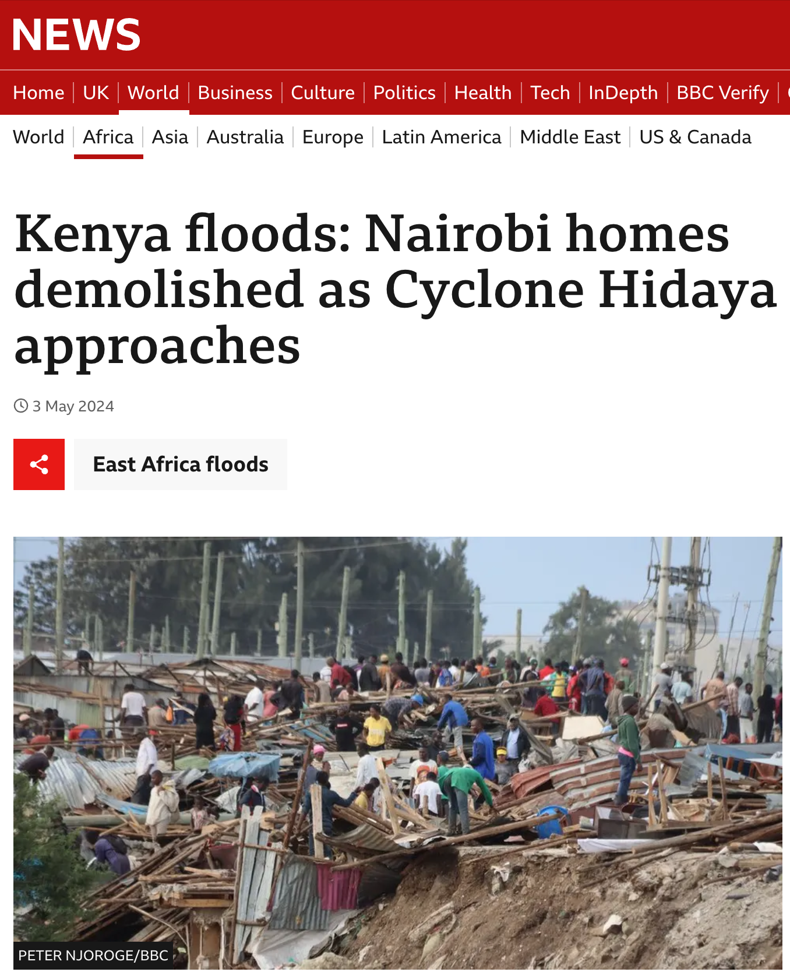
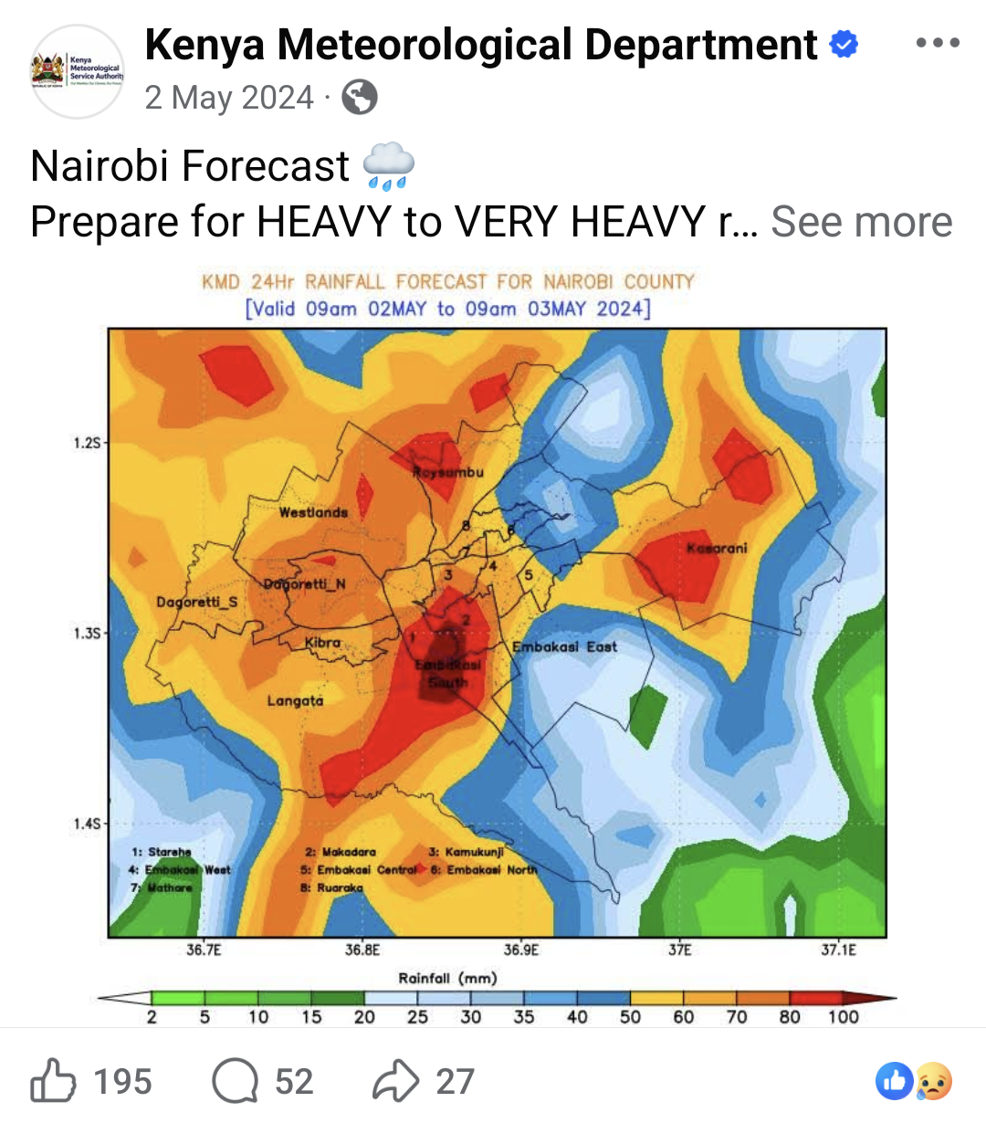
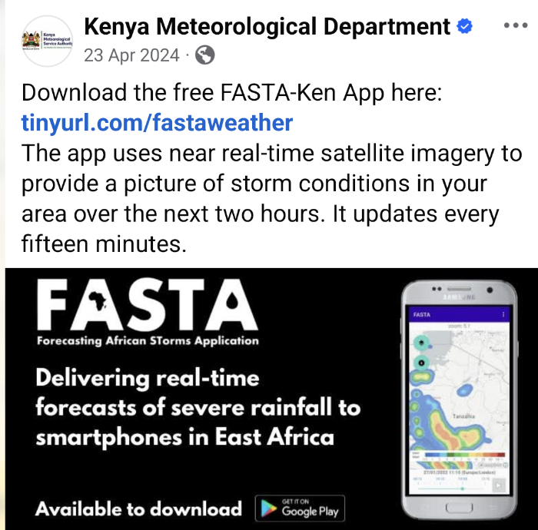
Kenya Floods :18 April to 5 May 2024
Notes:
Extreme rain, driven by Indian Ocean Dipole (IOD) and El Nino. Capital Nairobi particularly affected. 300 deaths, 300k displaced people. Cyclone Hidaya early May, “most

Slide 19
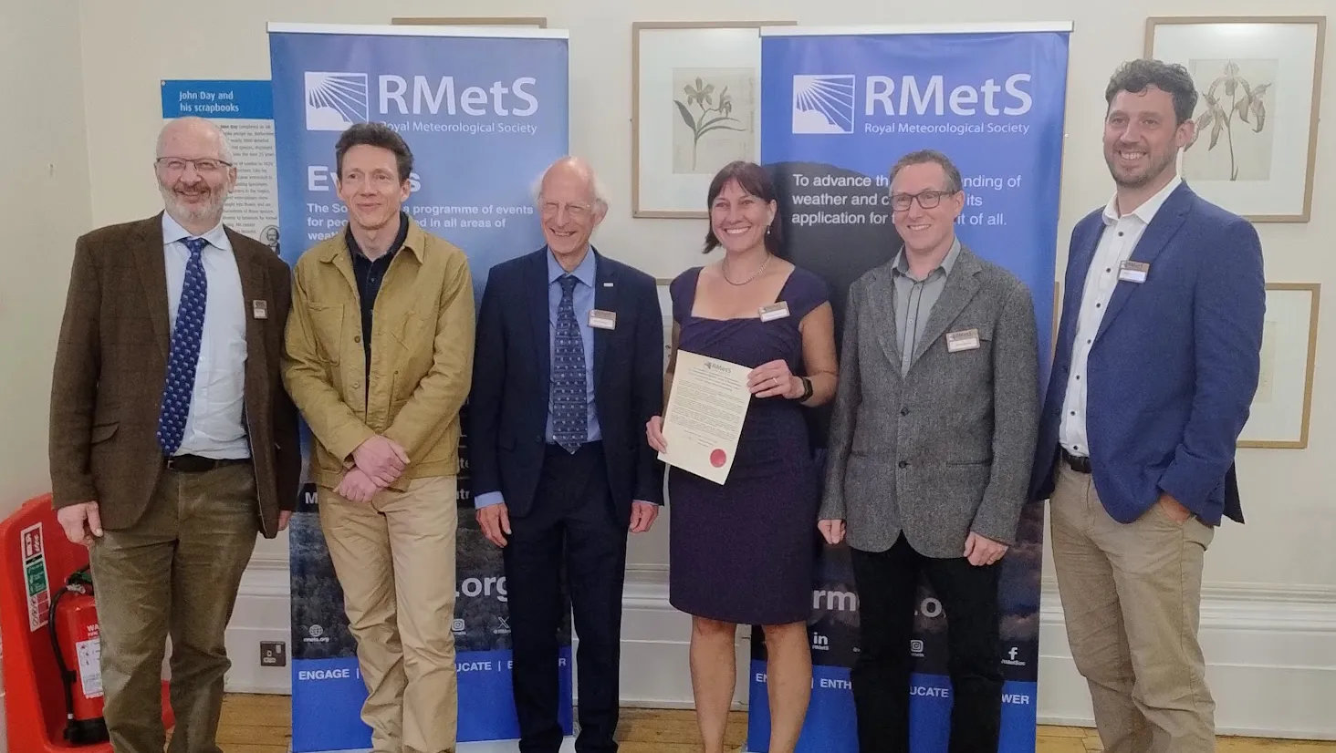

RMetS Award for Impact
FASTA is the winner of the 2025 Royal Meteorological Society :
Award for Innovation in Development of Computational Models, Tools or Visualisation.
https://www.rmets.org/rmets-awards/2025-winner/

Slide 20


Thank You!
Acknowledgements:
Doug Parker
John Marsham
Denise Groves
Alexander Roberts
Richard Rigby
Tom Illet
Itzel San Roman
Mark Richardson
James Groves
Abhilash Singh
Tamora James
Pheobe Darling
Adrià Amell
Laurents Marker
https://fastaweather.com
https://play.google.com/store/apps/details?id=uk.ac.ncas.sci.apps.fasta

Slide 21
Agenda
Friday 11th Sept 13:30-15:30
13:30 Introduction
13:35 Keynote from Nick Jefferson
13:55 Lightning talks
14:30 comfort break
14:35 SIG AGM
14:45 Panel discussion
15:30 Close

Slide 22
Lightning talks
Sophie Grunau: From Ice Sheets to Shipping Routes: RSE at BAS
James Frost: CSET, the Community Seamless Evaluation Toolkit
Martin Yeo Elias Sadek: Switching from grids to meshes
Andrew Clarke: Performance improvements to the Leeds Spherical Dynamo Code
Tobias Ferreira: Building Cloud-Native Skills in Geoscience: Lessons from a UK-Brazil Training Initiative.
Julia Crook: Geomechanical Mapping of the UK Subsurface for the North Sea Energy Transition

Slide 23

British Antarctic Survey

Slide 24
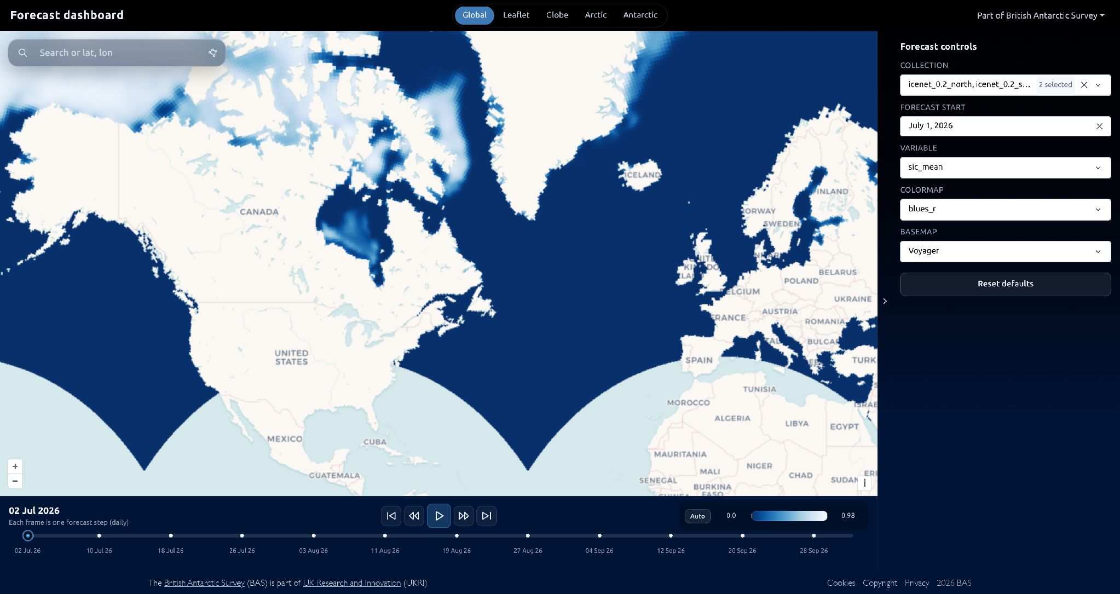
IceNet
Sophie Grunau sophie.grunau@bas.ac.uk

Slide 25
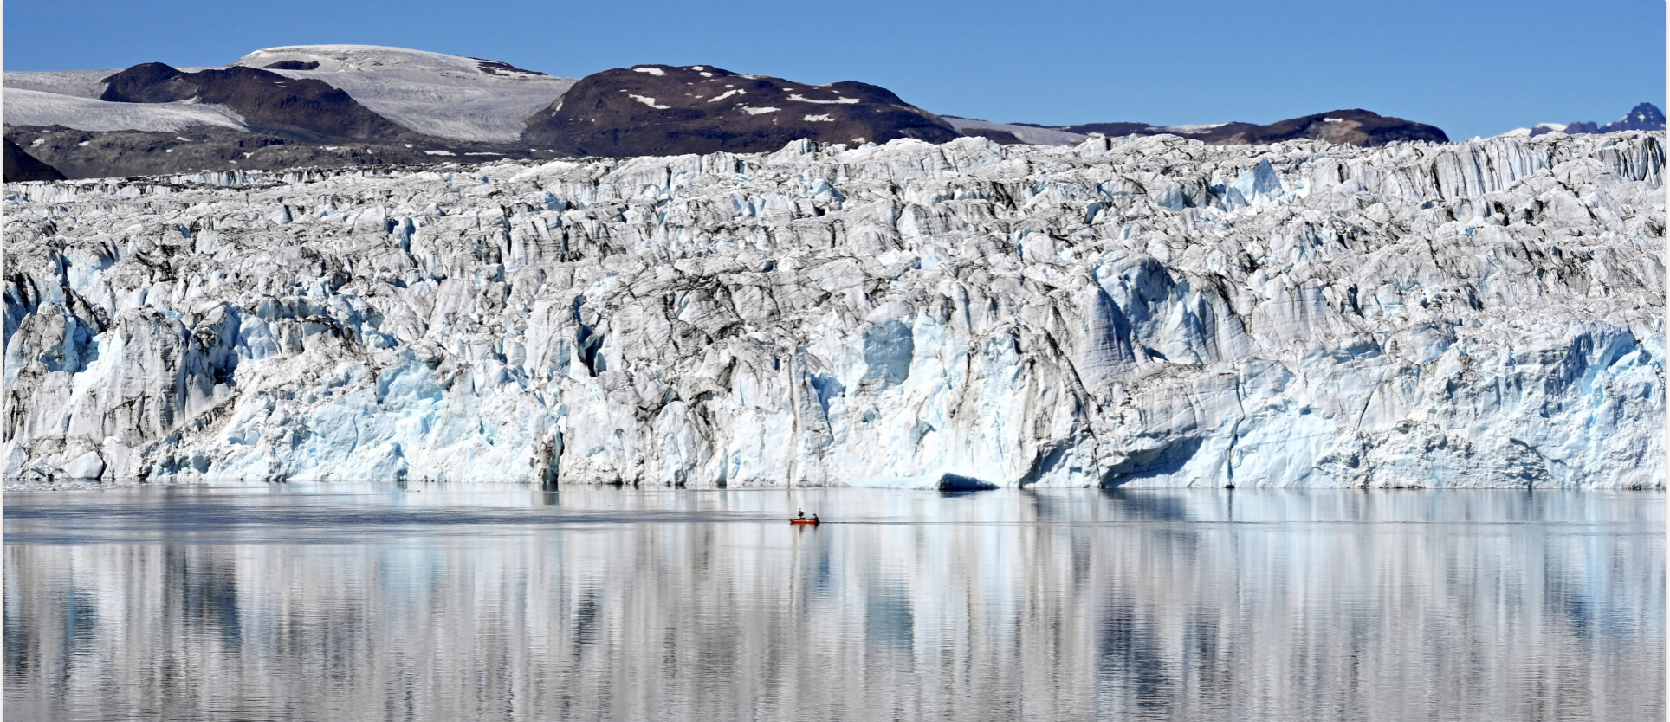
Giant
Sophie Grunau sophie.grunau@bas.ac.uk

Slide 26
Lightning talks
Sophie Grunau: From Ice Sheets to Shipping Routes: RSE at BAS
James Frost: CSET, the Community Seamless Evaluation Toolkit
Martin Yeo Elias Sadek: Switching from grids to meshes
Andrew Clarke: Performance improvements to the Leeds Spherical Dynamo Code
Tobias Ferreira: Building Cloud-Native Skills in Geoscience: Lessons from a UK-Brazil Training Initiative.
Julia Crook: Geomechanical Mapping of the UK Subsurface for the North Sea Energy Transition

Slide 27

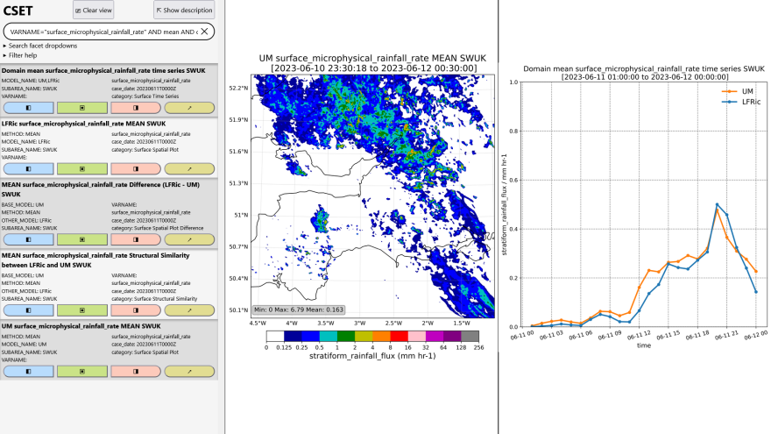
CSET – Community Seamless Evaluation Toolkit
Ad hoc evaluation no longer scales to modern NWP models.
CSET is a tool to support evaluation and verification of physical and
machine learning models.
Developed across the Momentum®️ Partnership, enabling a common approach to model evaluation.
Flexible software framework to meet a range of requirements, underpinned by modern software development practices.
Open source at github.com/MetOffice/CSET

Slide 28


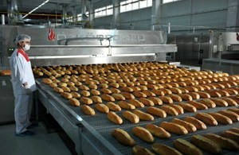
Operators
Recipes
“Written recipes”: makes diagnostics such as
spectra, spatial plots.
Combines operators into reusable diagnostics.
Run via the command line, good for looking at specific diagnostics.
Workflow
“The factory”: bakes recipes en masse.
Fetches data, bakes many recipes, produces results website.
Ideal for multi-model comparisons over many cases.
“Raw ingredients”: read, filter, calculate, plot.
Import operators in python
and use as functions.
For developers, exploratory analysis, rapid prototyping.

Slide 29
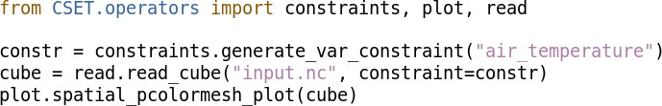
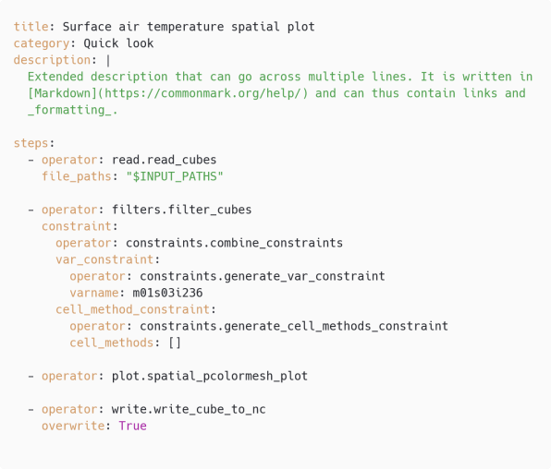
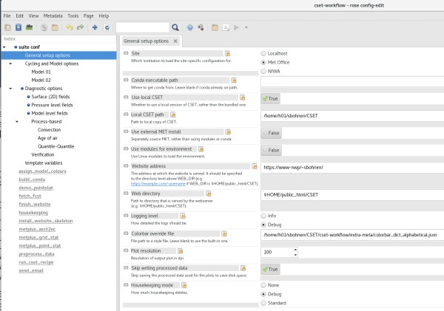
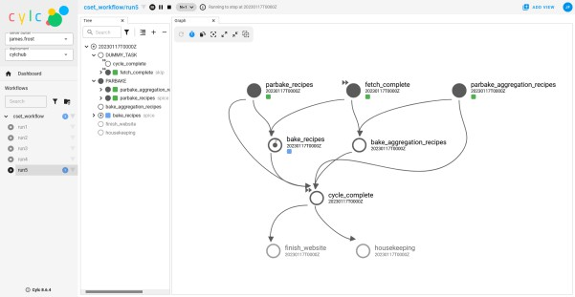


Operators
Recipes
Recipes are written in YAML and run via the command line.
Workflow
The cylc 8 workflow produces a website.
Import operators in python and use as functions.
CSET can be used many ways!

Slide 30
Lightning talks
Sophie Grunau: From Ice Sheets to Shipping Routes: RSE at BAS
James Frost: CSET, the Community Seamless Evaluation Toolkit
Martin Yeo & Elias Sadek: Switching from grids to meshes
Andrew Clarke: Performance improvements to the Leeds Spherical Dynamo Code
Tobias Ferreira: Building Cloud-Native Skills in Geoscience: Lessons from a UK-Brazil Training Initiative.
Julia Crook: Geomechanical Mapping of the UK Subsurface for the North Sea Energy Transition

Slide 31
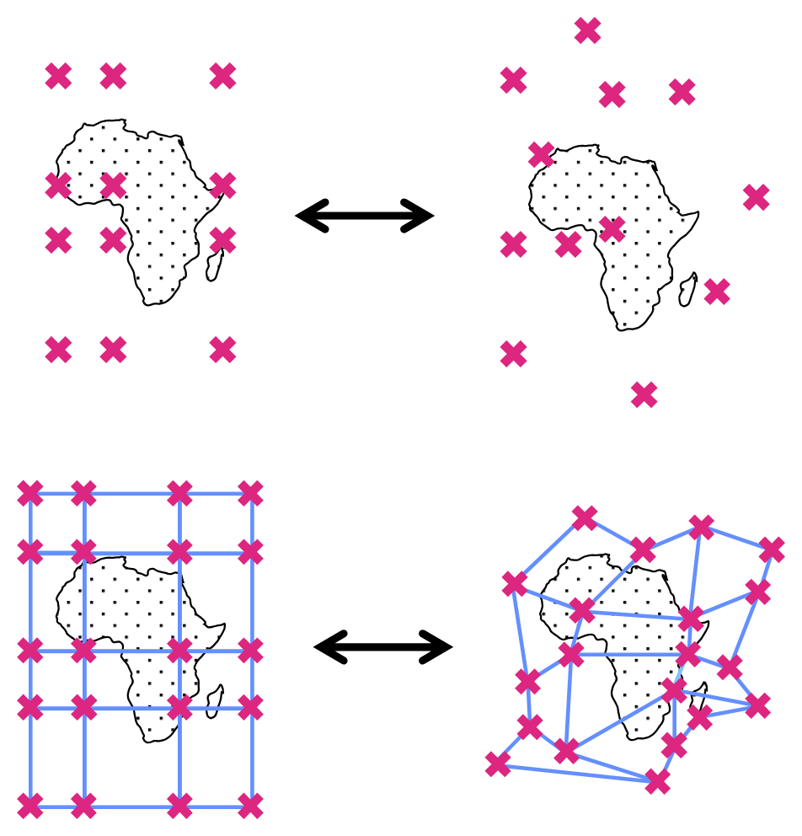
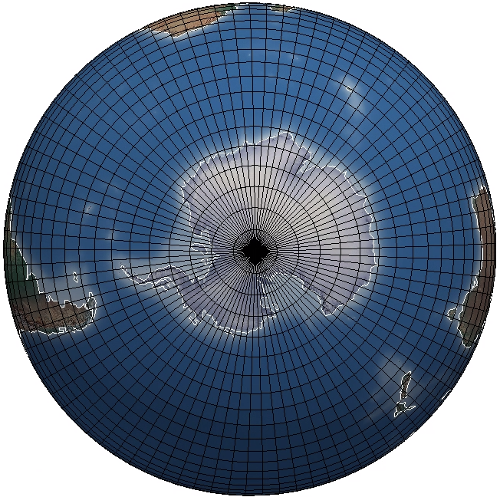


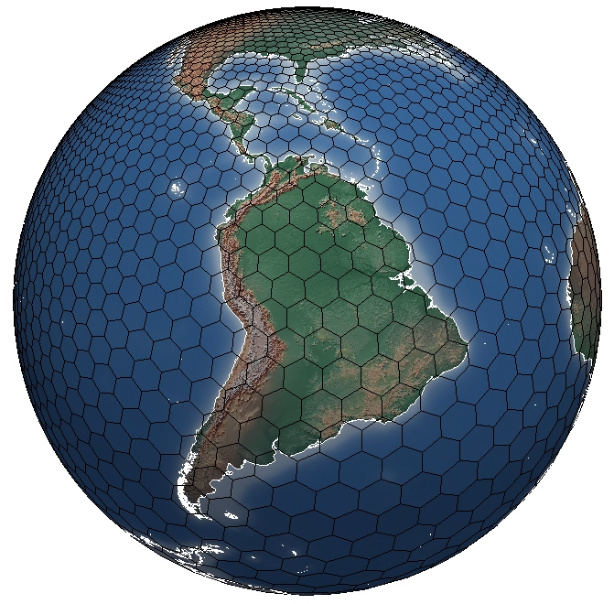
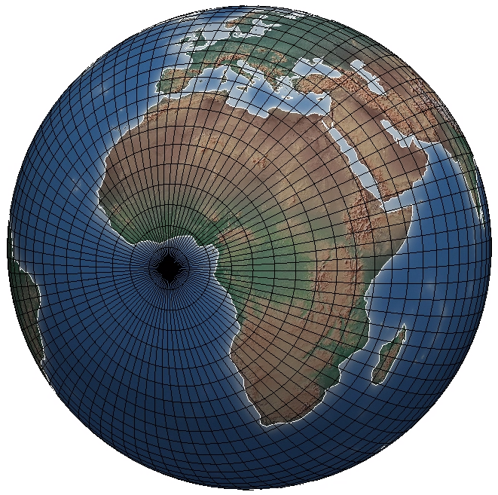
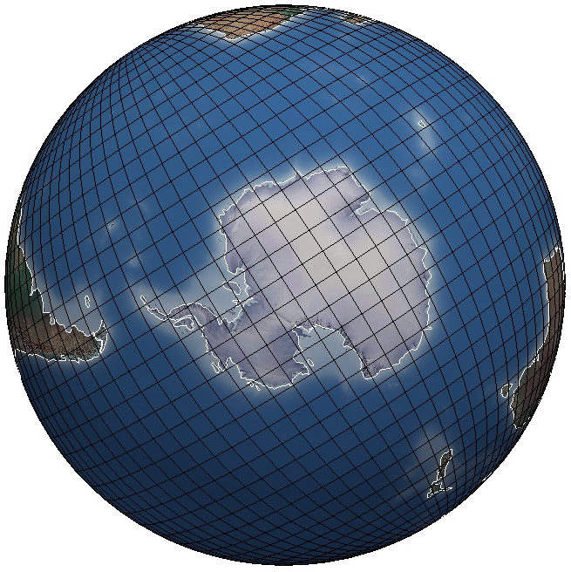
Hello (unstructured) World!
Email us at:
elias.sadek@metoffice.gov.uk
martin.yeo@metoffice.gov.uk
‘true’ lon-lat
What is unstructured data?
What’s wrong with standard grids?
Other approaches
The future is coming!
cube-sphere
hex-sphere
rotated pole (0, 0)
Notes:
What is unstructured data?
- Instead of typical, gridded data, it’s a collection of data points, each holding their own geospatial metadata. Ugrid calls this collection of data a mesh, and we’ve implemented ugrid.
Why are meshes needed?
- Standard grids can have singularities, and if you rotate the pole you’re messing up another section
- Other structured formats such as hex grids exist, but there’s no single standard and so collobration would be hard.
- The world is adopting various unstructured formats, so we need to adapt to that
-

Slide 32


What might change for you?
mesh nodes+edges+faces
Size of meshes
Regions aren’t reality
Need new tools and techniques:
  Iris
  Iris-esmf-regrid
  geovista
0
0
0
0
0
grid lats+lons
0
0
0
0
0
0
0
0
0
0
0
0
0
data
0
0
0
0
0
0
0
0
0
0
0
0
0
0
0
0
0
0
0
0
0
0
0
0
0
0
0
0
0
0
0
0
0
1
0
0
0
0
0
1
1
0
0
0
1
1
0
0
0
0
0
0
0
0
0
0
0
0
0
0
0
0
0
0
0
0
0
0
0
0
…
Try googling “scitools iris meshes”
Mesh Support — Iris 3.17.0.dev14 documentation
Notes:
Size of meshes
Because each mesh point holds all the meta data, it’s magnitudes larger than a gridded data structure
Regions aren’t reality
Two data points next to each other in an array aren’t necessarily next to each other geographically; it can be hard to extract geographical regions
Need new tools
Meshes break assumptions in geospatial libraries, which makes them slow or unusable.
You’ll need new tools or techniques to overcome this
To use unstructured data in Iris, you’ll also need iris-esmf-regird and geovista – for visulaisation and pacial operations such as regional extraction

Slide 33
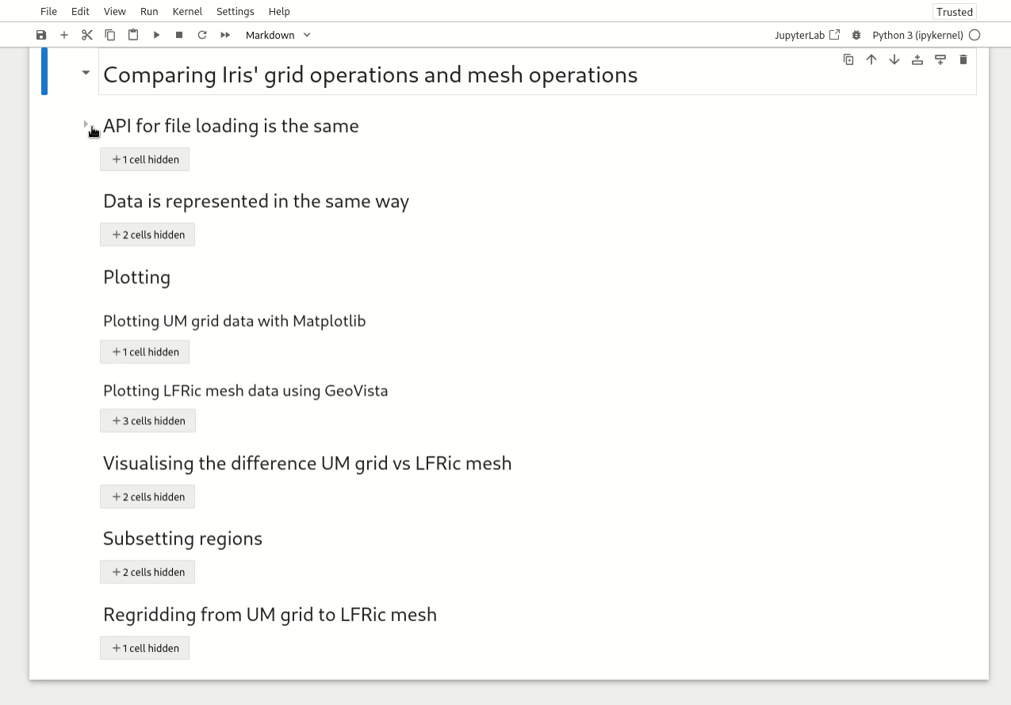
‘Undead’ Demo

Slide 34
Lightning talks
Sophie Grunau: From Ice Sheets to Shipping Routes: RSE at BAS
James Frost: CSET, the Community Seamless Evaluation Toolkit
Martin Yeo & Elias Sadek: Switching from grids to meshes
Andrew Clarke: Performance improvements to the Leeds Spherical Dynamo Code
Tobias Ferreira: Building Cloud-Native Skills in Geoscience: Lessons from a UK-Brazil Training Initiative.
Julia Crook: Geomechanical Mapping of the UK Subsurface for the North Sea Energy Transition

Slide 35
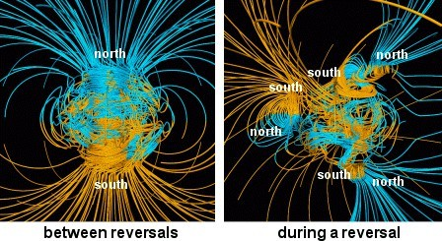
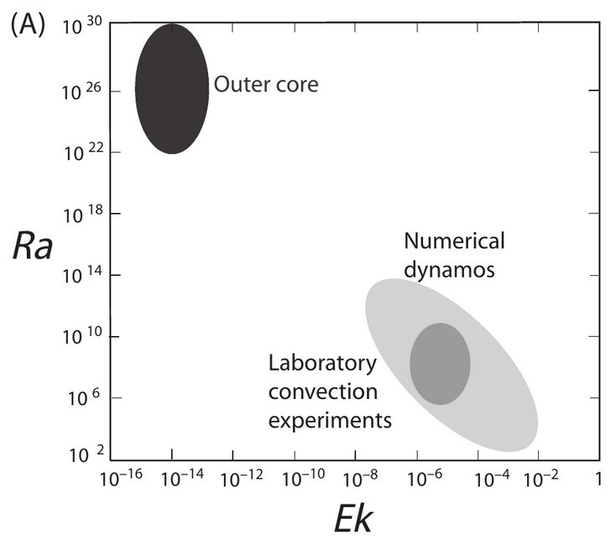
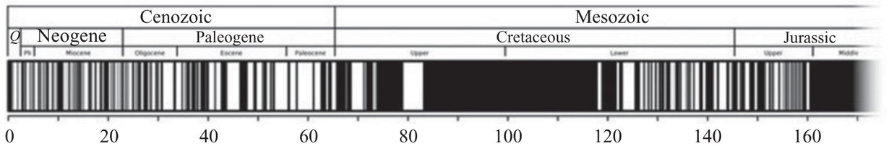

Performance Improvements: Leeds Spherical Dynamo Code
Andrew Clarke, CEMAC, University of Leeds
Geodynamo - Magnetic field generated by flow of molten iron in Earth’s outer core
Computationally intensive problem:
High numerical resolution Very long durations, both wall
clock (weeks for a single run) and in-simulation (millions of years).
●
State of the art DNS simulations don’t approach realistic parameter conditions
●
Non-linear dynamics
Complex phenomena eg reversals
●

Slide 36


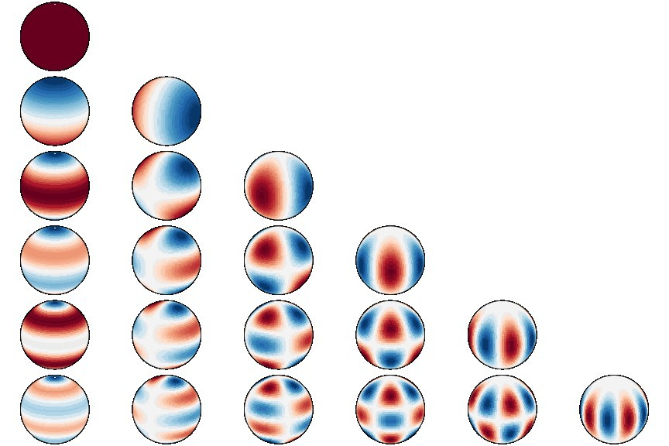
Performance Improvements: Leeds Spherical Dynamo Code
Andrew Clarke, CEMAC, University of Leeds
Overview:
Shtns – optimised spherical transforms
●
Fortran, 3D spherical shell domain
Parallelised using OpenMP
Different normalisation/harmonic ordering
Ω
_{θ} a⃗
D
ϕ
●
●
2D Parallel Decomposition (MPI–MPI) Spectral Code – spherical harmonics
Bottleneck: transform between real and spectral space.
FFT handled by FFTW
Legendre transform is most intensive part – split over latitude with MPI.
●
●
●
Implementation - Replaced latitudinal MPI parallelisation with OpenMP
●
●
Split MPI communicators Explicit do loops
●
●

Slide 37
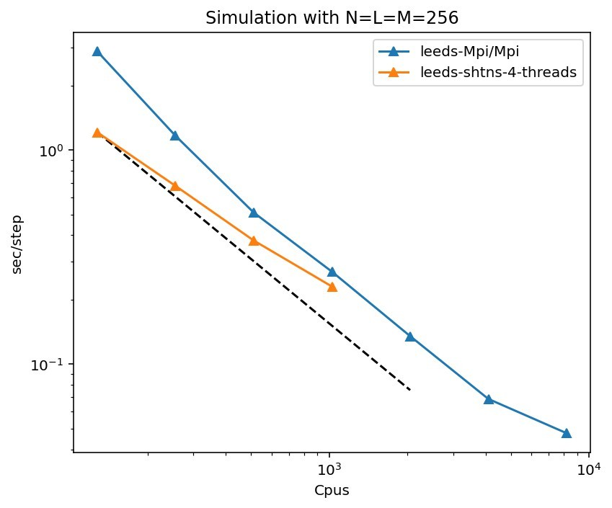
Performance Improvements: Leeds Spherical Dynamo Code
Andrew Clarke, CEMAC, University of Leeds
Outcomes:
Architecture changes enable future development:
Over 2x speed increase at lower core counts
Worse scaling, especially at very high core counts
NUMA memory regions
Shtns: CUDA/ROC
OpenMP parallelisation in rest of code is a candidate for GPU offload
GPU data residency
●
●
●
●
●
●
Code used for number of studies:
●
Biggin, A.J. et. al., 2026. Mantle heterogeneity influenced Earth’s ancient magnetic field. Nature Geoscience
●
Clarke, A.T. et. al., 2026. Accessing the dipole-multipole transition in rapidly rotating spherical shell dynamos. Geophysical Journal International
●
Naskar, S. et. al., 2026. Thermochemical models of outer core convection with heterogeneous core-mantle boundary heat flux. Journal of Studies of Earth’s Deep Interior
https://github.com/Leeds-Spherical-Dynamo/leeds-code

Slide 38
Lightning talks
Sophie Grunau: From Ice Sheets to Shipping Routes: RSE at BAS
James Frost: CSET, the Community Seamless Evaluation Toolkit
Martin Yeo & Elias Sadek:: Switching from grids to meshes
Andrew Clarke: Performance improvements to the Leeds Spherical Dynamo Code
Tobias Ferreira: Building Cloud-Native Skills in Geoscience: Lessons from a UK-Brazil Training Initiative.
Julia Crook: Geomechanical Mapping of the UK Subsurface for the North Sea Energy Transition

Slide 39
CLOUD-NATIVE
GEOSCIENCE
FROM A WORKSHOP IN BRAZIL TO A KNOWLEDGE-EXCHANGE COMMUNITY
TOBIAS FERREIRA

Slide 40



INTRODUCTION
Environmental datasets are growing, but many of our workflows are still built around files, downloads and local processing
How can we help geoscience researchers and RSEs move towards scalable, cloud-native workflows?
I started developing an open, practical training programme around this question
The first pilot: Brazil, September 2026

Slide 41
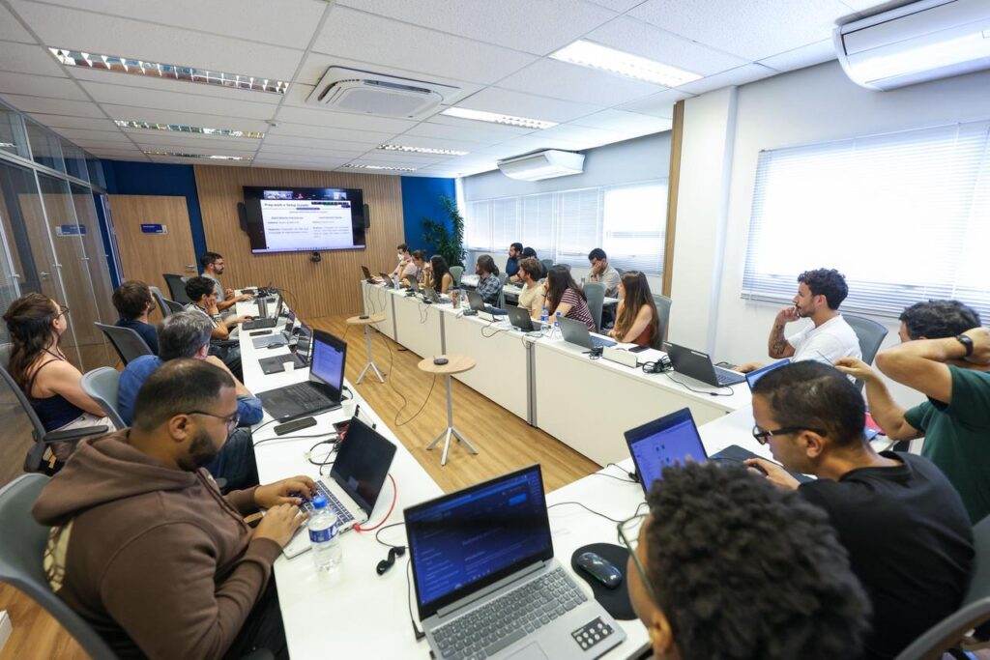
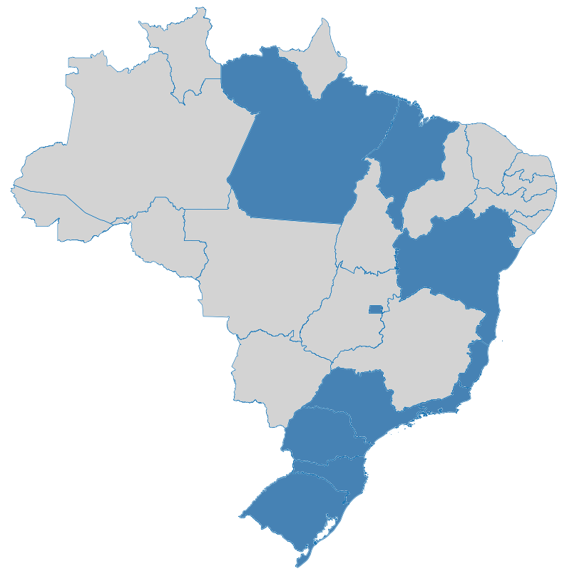
THE FIRST EXPERIMENT: BRAZIL
3 days
90+ participants (20 in-person)
Researchers, “RSEs”, Software Engineers and geoscientists from across Brazil
The goal was to explore the complete journey:
Learn - Experiment - Exchange
Notes:
Decision to start building the phase 1 launch platform using the datasets which would be ready – workshop happened with Stakeholders before build
WP 1.3 & WP 2.1 Focus on visualisation

Slide 42
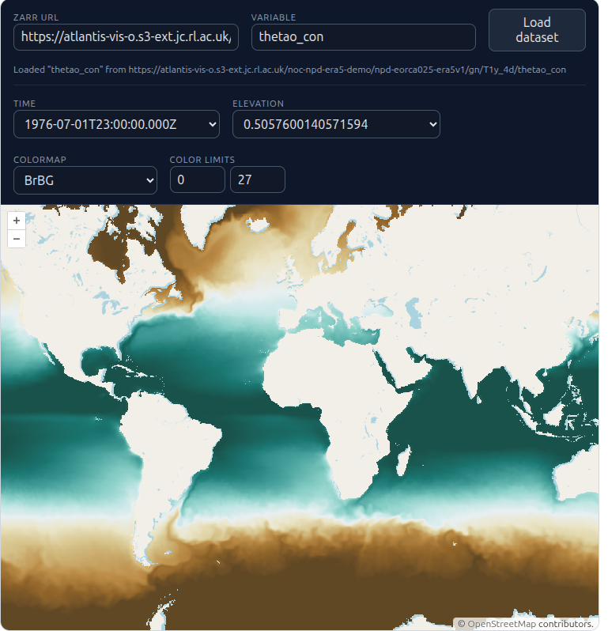


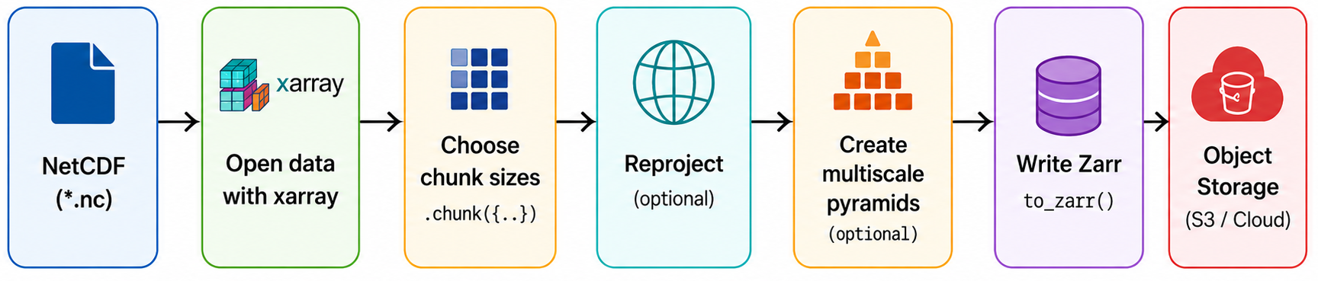




WHAT DID WE ACTUALLY COVER?
Building the cloud-native workflow, piece by piece
VirtualiZarr
Live coding + hands-on exercises + real multi-terabyte datasets (ERA5, GLORYS, Spotter Wave drifters, NEMO, ECMWF AIFS)
Case-studies session: UKCEH, NOC and EARTHMOVER

Slide 43
WHAT DID WE LEARN FROM THE PARTICIPANTS?
Rating 10/10 (in-person) and 9.7/10 (on-line)
What did the Brazilian community tell us?
“A hands-on course connecting modern cloud-native technologies into a complete geoscience workflow.”
“The biggest challenge was having too much content for only three days.”
There is demand not only for training, but for continued exchange and a community where people can share implementations, problems and lessons learned.
Notes:
Decision to start building the phase 1 launch platform using the datasets which would be ready – workshop happened with Stakeholders before build
WP 1.3 & WP 2.1 Focus on visualisation

Slide 44
BRAZIL WAS THE BEGINNING…
From workshop to community
Next stop: UK
Two workshops: online + in person
Build a UK cloud-native geoscience knowledge-exchange community
Connect RSEs, researchers, data managers and infrastructure providers
Strengthen UK–Brazil collaboration and knowledge sharing
Register your interest in the community and upcoming workshops

Slide 45


THANK YOU!
ANY QUESTIONS?
INTERESTED? JOIN US.
TOBIAS.FERREIRA@NOC.AC.UK
COURSE MATERIAL
https://noc-oi.github.io/cloud-native-geoscience-course/
FORM FOR REGISTRATION
https://forms.cloud.microsoft/e/yJ5CVQZUGv

Slide 46
Lightning talks
Sophie Grunau: From Ice Sheets to Shipping Routes: RSE at BAS
James Frost: CSET, the Community Seamless Evaluation Toolkit
Martin Yeo & Elias Sadek: Switching from grids to meshes
Andrew Clarke: Performance improvements to the Leeds Spherical Dynamo Code
Tobias Ferreira: Building Cloud-Native Skills in Geoscience: Lessons from a UK-Brazil Training Initiative.
Julia Crook: Geomechanical Mapping of the UK Subsurface for the North Sea Energy Transition

Slide 47
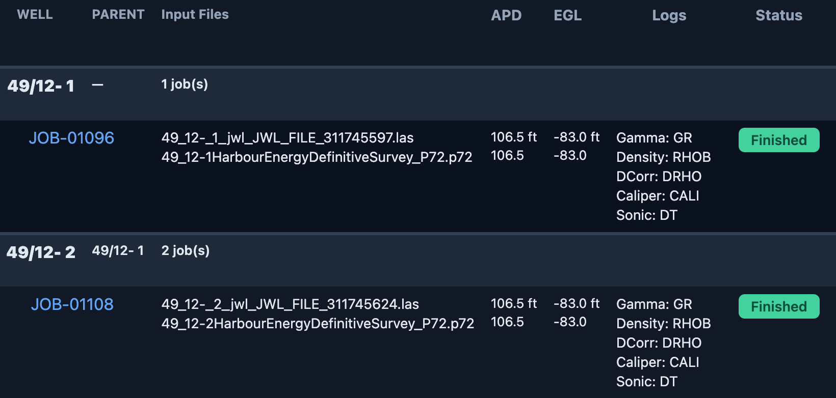
Geomechanical Mapping of the UK Subsurface for the North Sea Energy Transition (CEMAC + Geosolutions Leeds)
Context
Examine suitability for CO₂ storage in subsurface rock in the North Sea, by analysing logs of gas and oil wells drilled since the1960’s​ (~10,000 wells).
CEMAC Role
Take code and Petrel scripts developed for specific Viking A wells and generalise to more wells and gas fields
Perform analysis of well logs to calculate vertical stress and produce plots
Automate download and processing of well data from North Sea Transition Authority’s National Data Repository (ukNDR).
Download specific well data through NDR API and create config file for the well
LAS file
Survey file
Config file
Web portal
Various plots including vertical stress profiles
Dr. Julia Crook (CEMAC, University of Leeds)
Dr Nick Jefferson (CEMAC, University of Leeds)
Prof Dave Healy, Erika Calderon Medina (Geosolutions Leeds)
Call Borehole processor

Slide 48
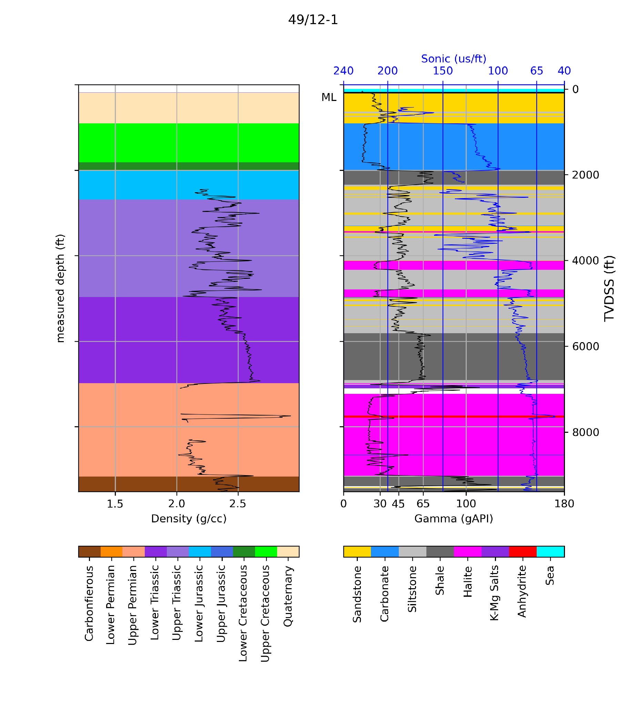
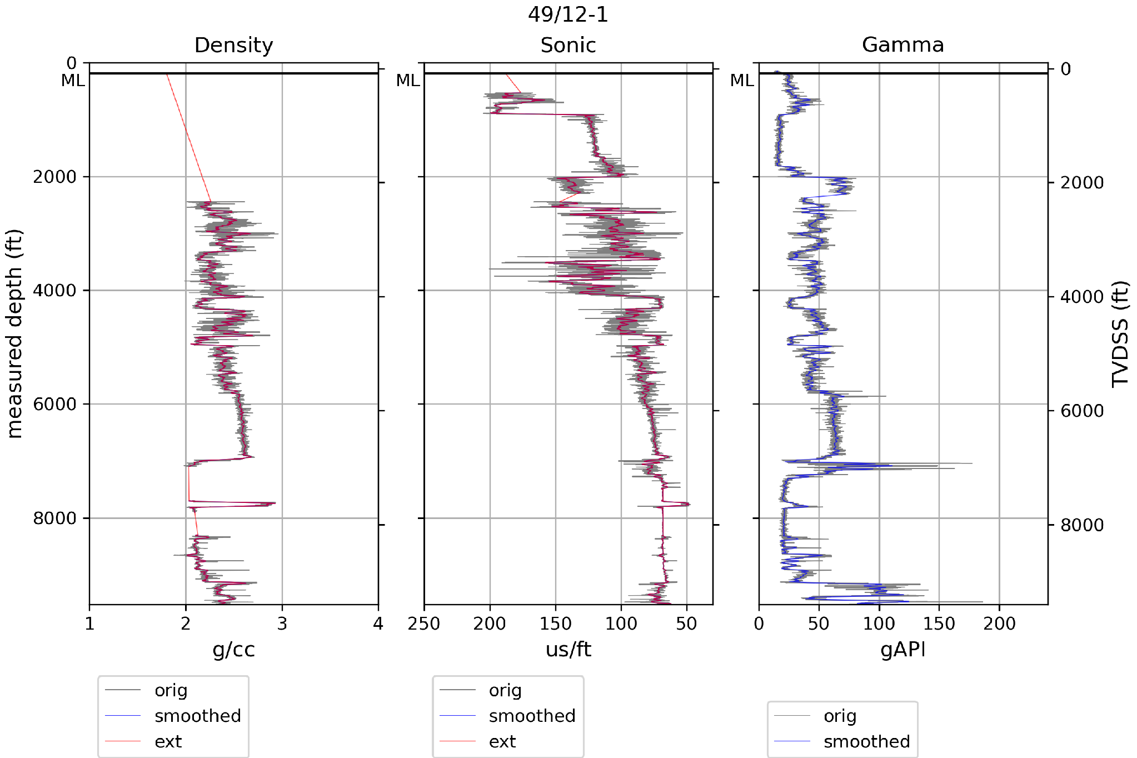
Borehole Processor
Density_Smooth, DensityExt, SonicSmooth, SonicExt, GammaSmooth
Read logs from LAS file and deviation from survey file
Density, Sonic, Gamma logs
Smooth and extrapolate to mudline, adding parent logs at the top if required
Calculate lithology and normal compaction curves (needs ages in config file)
Note that in some wells, the density log may be missing or only have data in the lower part of the well; gaps can be filled by normal compaction curve or by extrapolation

Slide 49
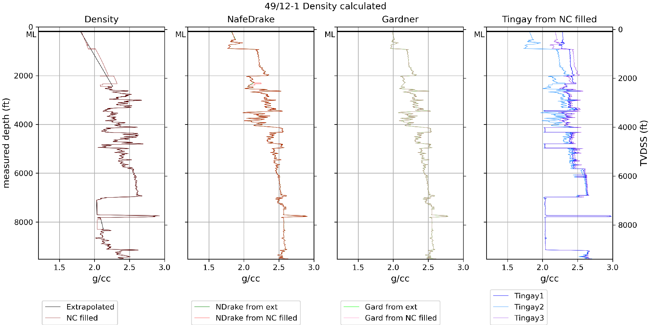
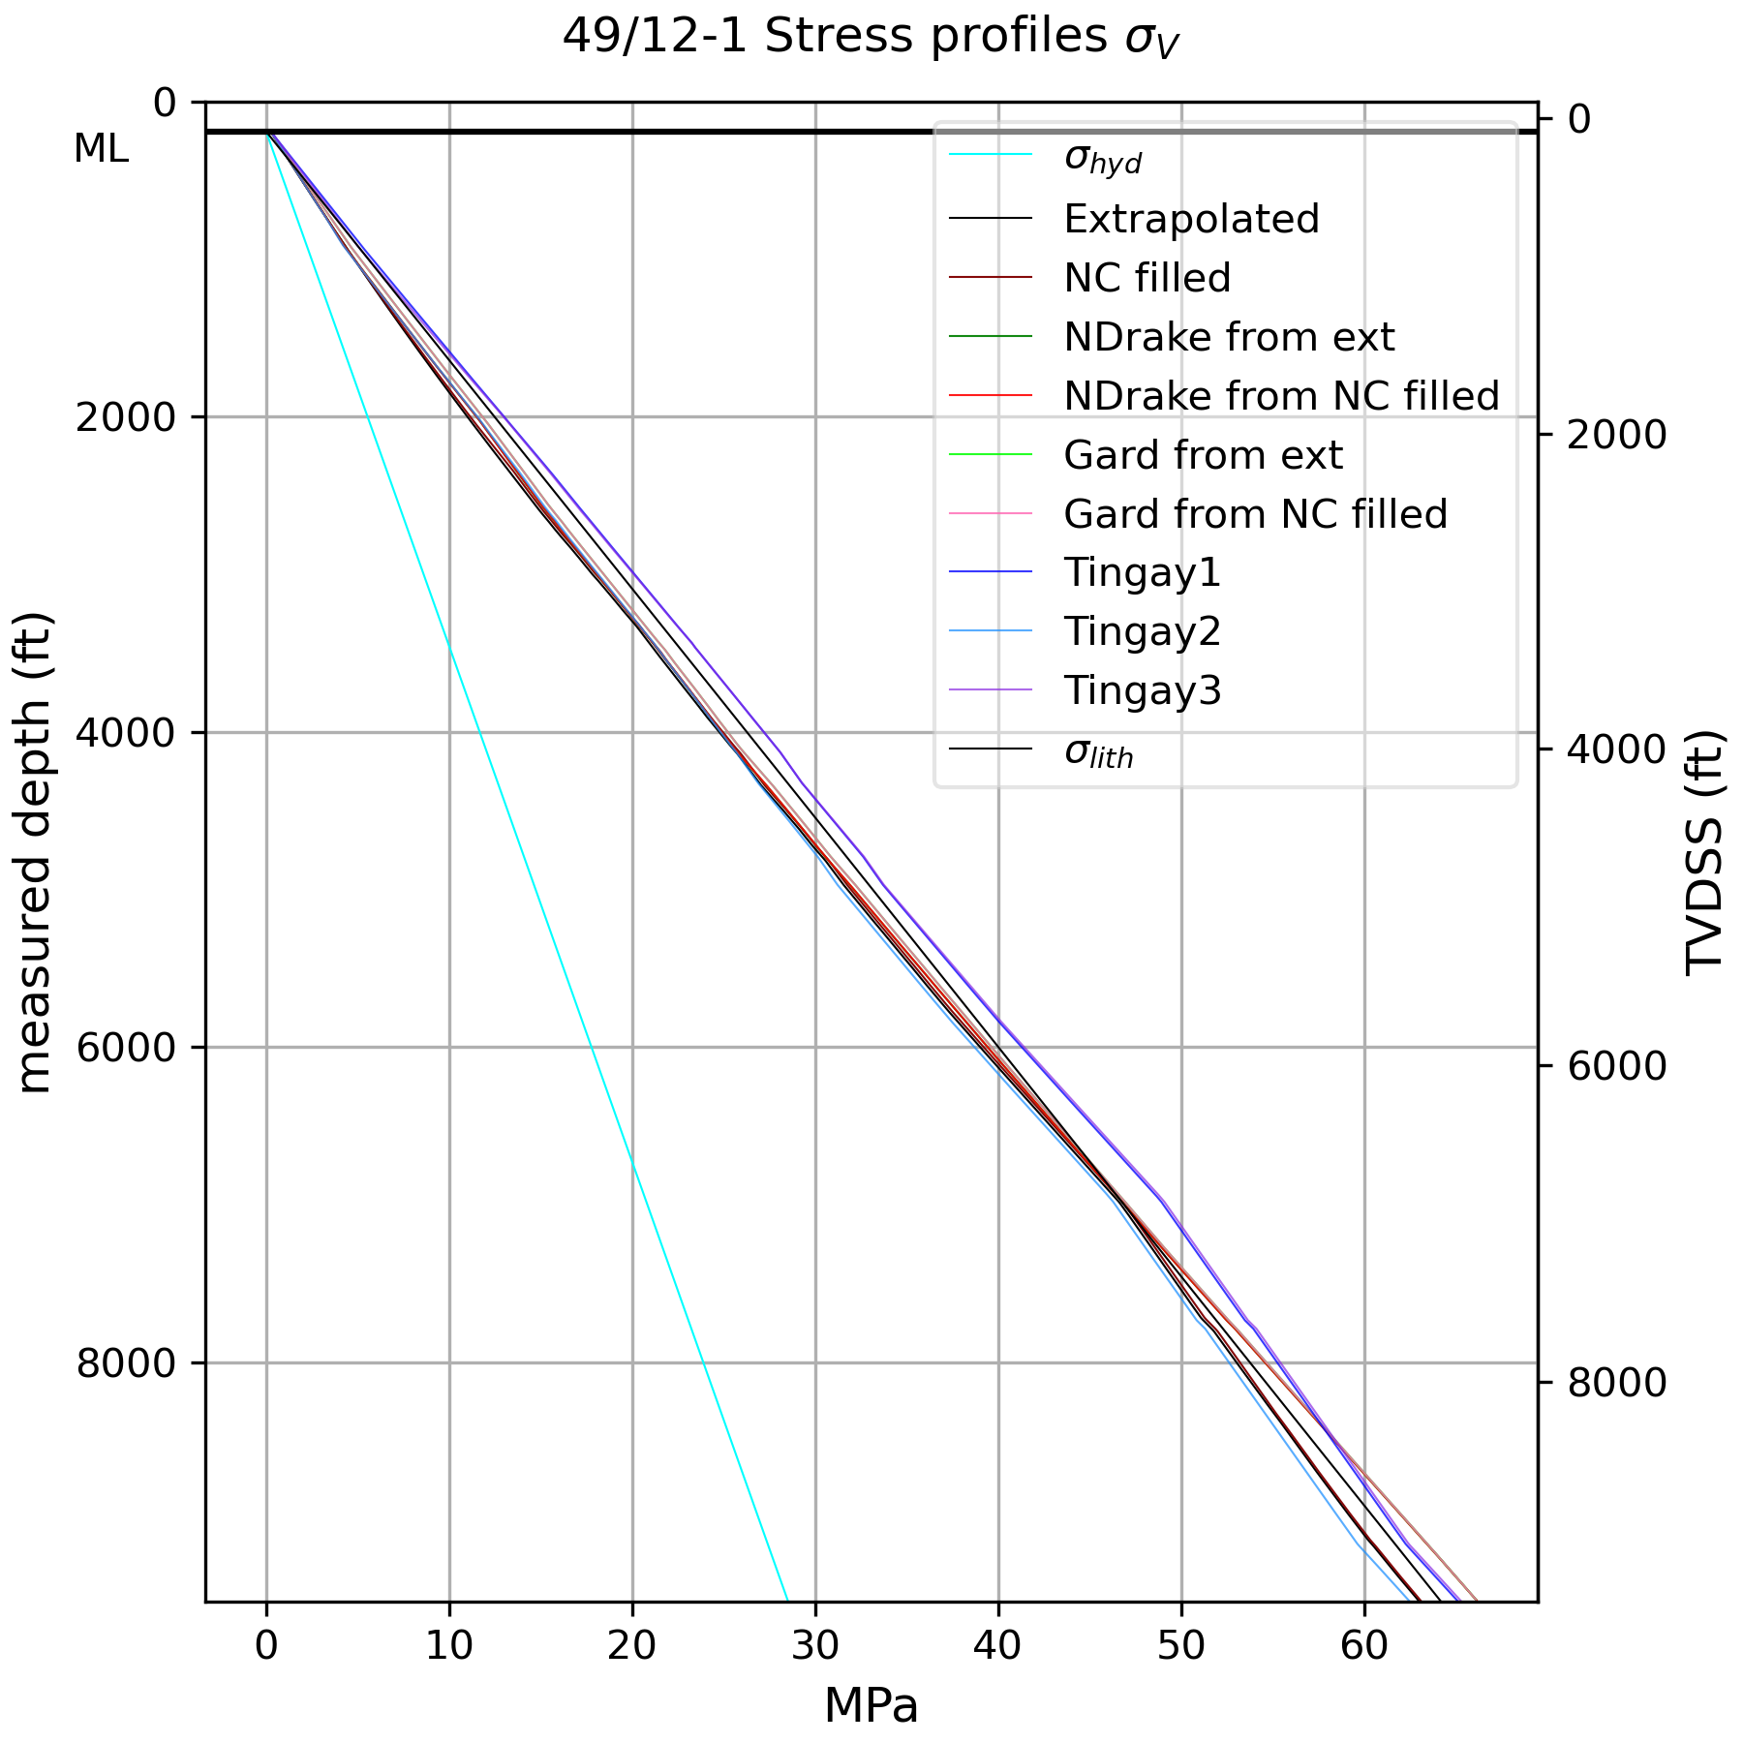
Borehole Processor cont.
Calculate density from sonic (Nafe-Drake, Gardner, Tingay eqs.)
Calculate vertical stress from all different densities

Slide 50
PLEASE RETURN BY 1435
Friday 11th Sept 13:30-15:30
13:30 Introduction
13:35 Keynote from Nick Jefferson
13:55 Lightning talks
14:30 comfort break - use slack channel for questions
14:35 SIG AGM
14:45 Panel discussion
15:30 Close

Slide 51
Agenda
Friday 11th Sept 13:30-15:30
13:30 Introduction
13:35 Keynote from Nick Jefferson
13:55 Lightning talks
14:30 comfort break
14:35 SIG AGM
14:45 Panel discussion
15:30 Close

Slide 52


RSE Geosciences SIG Updates
Quick mentimeter (if time)
https://bit.ly/geomenti

Slide 53
What’s happened so far
Highlights so far:
Sept 2024: RSECon BoF weather and climate session
Feb 2025: Geoscience SIG officially set up under SocRSE
May / June 2025: Elections and appointment of Chair / Deputy
Sept 2025: RSECon BoF Inaugural Geoscience SIG meeting
May 2026: Geoscience SIG virtual seminar
Now: Geoscience@RSECon 2026

Slide 54
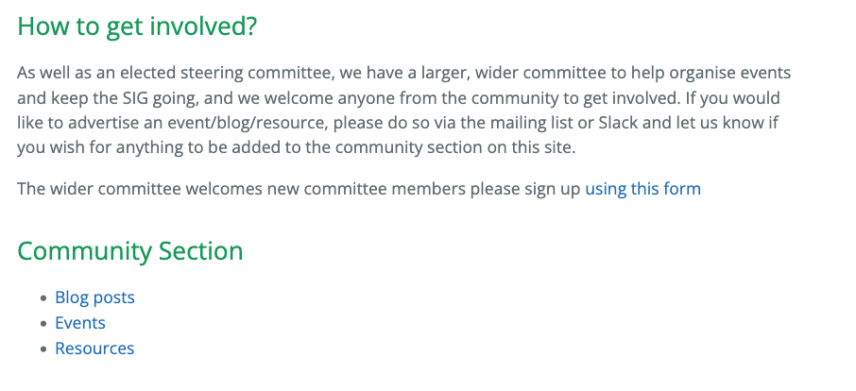



UPDATES from the SIG
Shared resources, community blogs and events.
Needs input from the community
Get in touch to add stuff!

Slide 55

UPDATES from the SIG - What next?
Website shared resources
Plans for another virtual seminar(s) 26/27
Plans for virtual invited speakers
  Get in touch if there’s anyone you’d love to hear from
Possibility of in person event
Expand/replace steering committee
Expand existing committee

Slide 56

Get Involved
https://bit.ly/geoscience26
Sign up in person here to join wider committee
- just a few meetings a year and voluntary
New steering committee open for elections
for the coming year (sign up open for a month)
Chair
Deputy
Events
Comms
Other involvement - Website help etc, sharing news items,
blogs, suggesting speakers you’d like to hear from.

Slide 57
Agenda
Friday 11th Sept 13:30-15:30
13:30 Introduction
13:35 Keynote from Nick Jefferson
13:55 Lightning talks
14:30 comfort break
14:35 SIG AGM
14:45 Panel discussion
15:30 Close

Slide 58
Panel Discussion
https://bit.ly/geoscience26
Discussion topics via slido.
Mark Richardson - CEMAC, University of Leeds
industry --> academia → Industry -> Academia → RSE team leader
Emma Hogan - MetOffice
Astronomy --> industry (in hindsight as an RSE) --> Senior SSE at MO --> SSE Career Family Lead
Jack Atkinson - ICCS, University of Cambridge
Engineering/Fluids --> Geoscience Research --> Geoscience RSE at ICCS --> Principal RSE at ICCS
Tobias Ferreira - NOC
Oceanographer/Engineering → Brazilian Navy Officer/Software Engineer → RSE at NOC

Slide 59
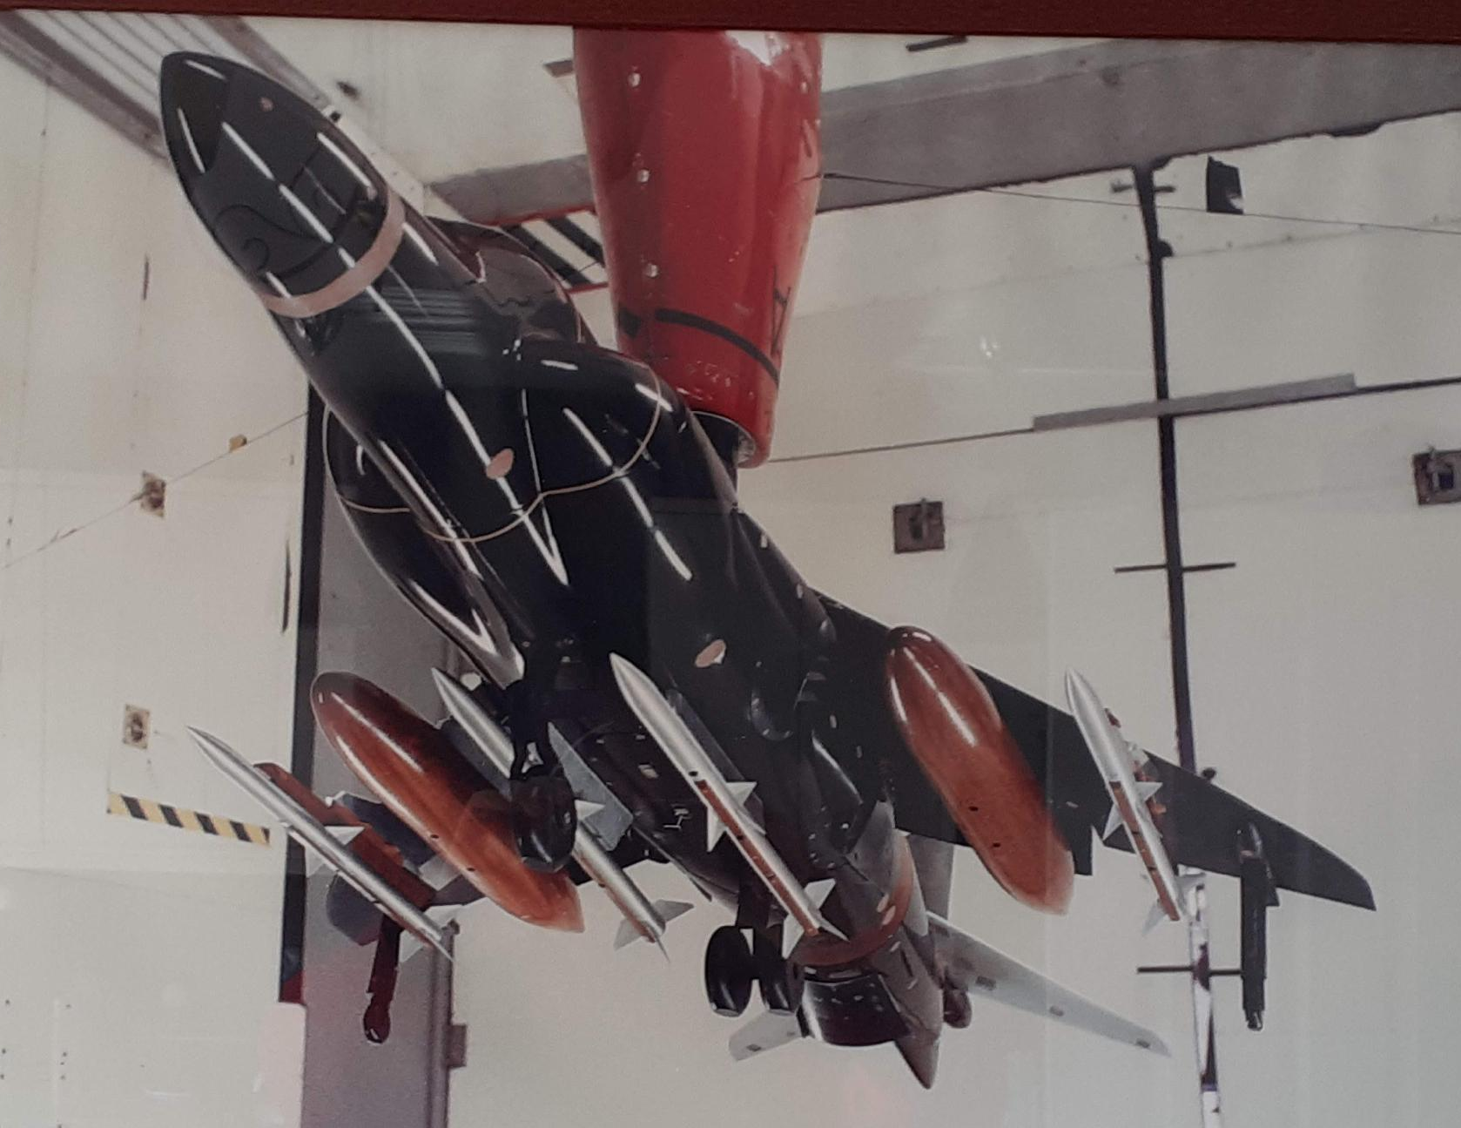
Dr Mark Richardson
From Aeronautical Engineering to Research Software Engineering Leadership
40 years delivering impact across engineering, scientific software, high-performance computing, climate modelling, and research software engineering leadership.
Engineering Foundations
Research & HPC
Scientific Software & HPC
Leadership
Aeronautical Engineering
Computational Science
National Infrastructure
Technical Leadership
➜
➜
➜
• BSc + industrial placement
• Aerodynamicist (6 years)
• Begin to program parallel CFD
• Research Fellow (5 years)
• Parallel computing specialist
• PhD: Multiphase flow simulation
• CFD software build engineer (6 years)
• Supercomputing consultant (6 years)
• HPC software deployment &
optimization
• UKCA/GLOMAP optimisation
Technical Head, CEMAC, 10 years
Personnel management
Funding continuity
Researcher relationships
Domain knowledge
15/10/1987
Career Highlights
• Aerospace Engineering
• Scientific Computing
• High-Performance Computing
• Research Software Engineering
• Climate Modelling
• Technical Leadership

Slide 60
Panel Discussion
https://bit.ly/geoscience26
Discussion topics via slido.
Mark Richardson - CEMAC, University of Leeds
industry --> academia → Industry -> Academia → RSE team leader
Emma Hogan - MetOffice
Astronomy --> industry (in hindsight as an RSE) --> Senior SSE at MO --> SSE Career Family Lead
Jack Atkinson - ICCS, University of Cambridge
Engineering/Fluids --> Geoscience Research --> Geoscience RSE at ICCS --> Principal RSE at ICCS
Tobias Ferreira - NOC
Oceanographer/Engineering → Brazilian Navy Officer/Software Engineer → RSE at NOC

Slide 61

THANK YOU
Notes:
Thank Speakers, panel, committee

Slide 62
Links
https://bit.ly/geoscience26
Slack channels:
Channel for this conference #geosciencesig:
https://rsecon26.slack.com/archives/C0BTZBY4NP9
GeoSIG channel: #geoscience: https://ukrse.slack.com/archives/C07L01M9F29
Website: https://socrse.github.io/geoscience-sig/
Mailing list: https://www.jiscmail.ac.uk/cgi-bin/wa-jisc.exe?SUBED1=GEOSCIENCE-RSE&A=1
Feedback form: https://forms.gle/mGfBw35uJBjeDhmX9

