Slide 1
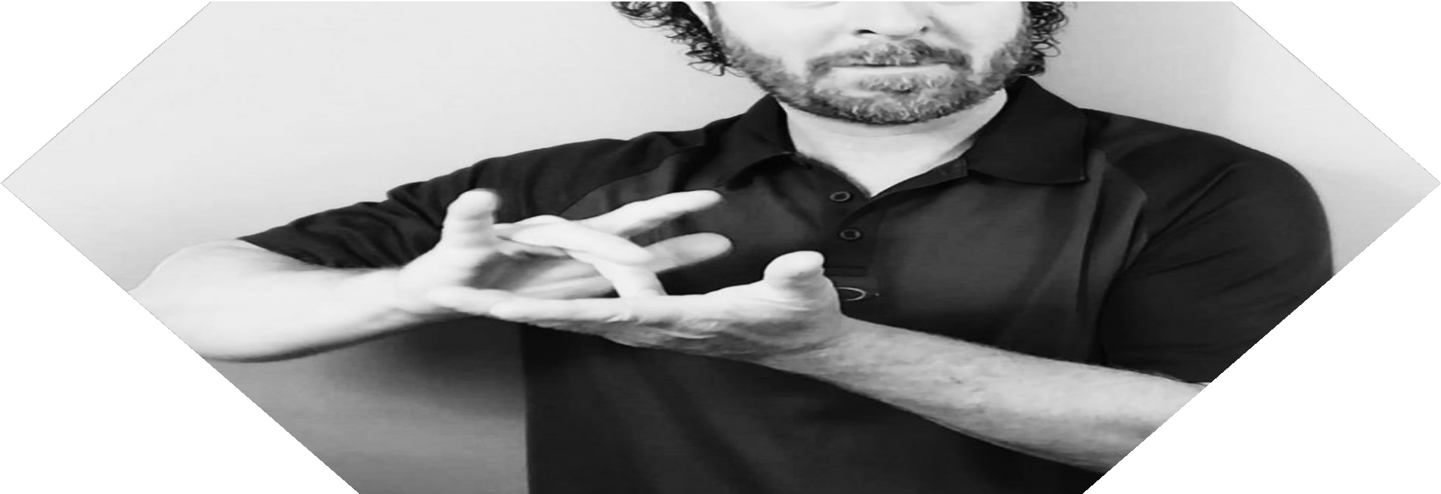

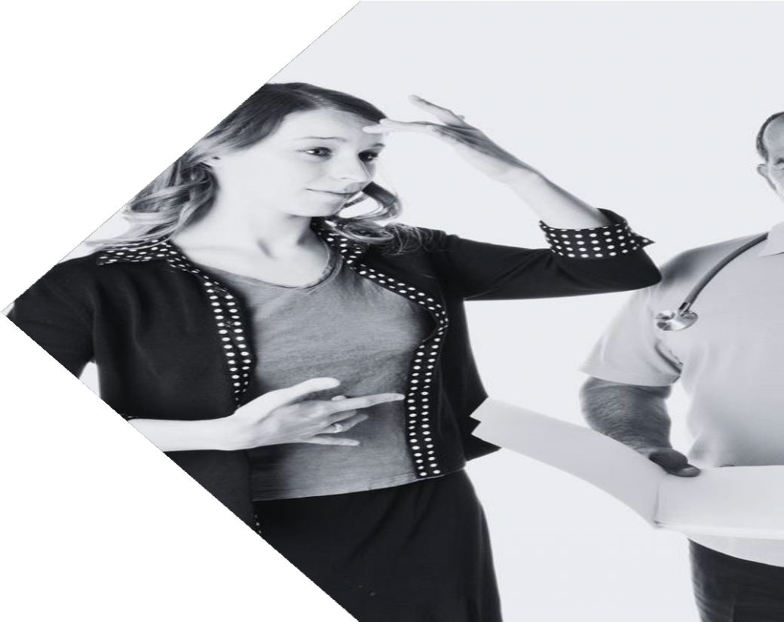

DeafDiabetesCan.org: The First Diabetes Education Website In American Sign Language
Michell e L. Litchman Ph D, FNP- BC Karissa Mirus, MSHA

Slide 2
Americans w/Diabetes
Deaf/Hard of Hearing Americans w/Diabetes
Elmore et al, In Progress

Slide 3

Dinner Table Syndrome
90-95% of Deaf people have hearing parents
70% of hearing parents don’t
learn ASL
Hearing parents = SDOH
Meek et al., 2020; Bhatt et al., 2018; Mitchell et al., 2004; Mitchell et al., 2005; Humphries et al., 2012; Hall et al, 2018

Slide 4
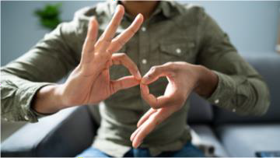
Lack of ASL Interpreters Provided
Dinner Table Syndrome
50% of the time an ASL
interpreter is not present
~ 1/3 of the time they are not medically qualified
Schniedewind et al., 2020; Rinker et al, 2018

Slide 5
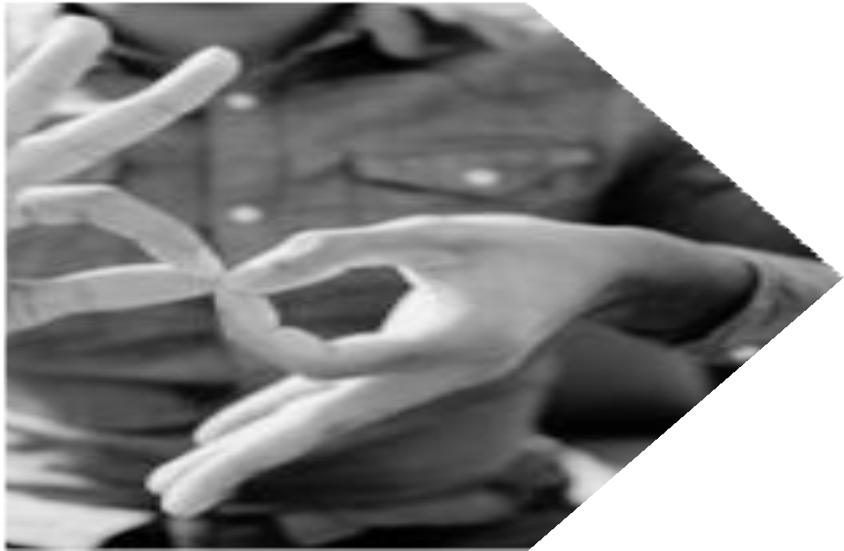
AMERICAN DISABILITIES ACT
By law, health systems are required to
provide an American Sign Language (ASL) interpreter if it is requested
US Department of Justice

Slide 6
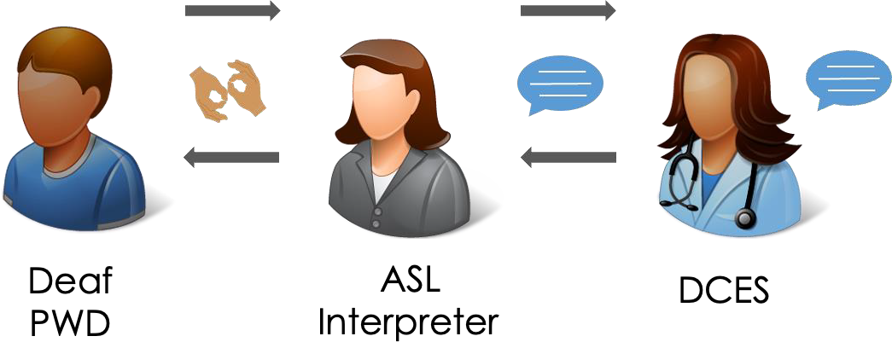
HEARING ASL INTERPRETER
Nurse Practitioner

Slide 7
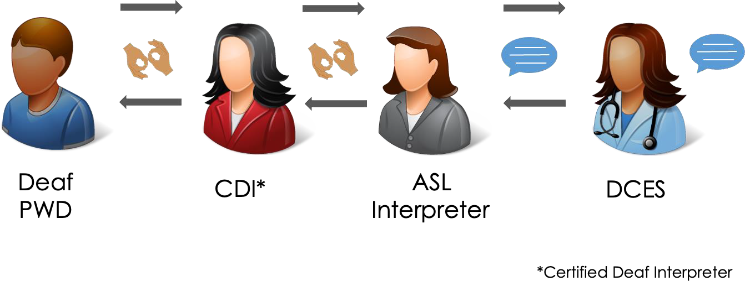
CERTIFIED DEAF INTERPRETER
Nurse Practitioner

Slide 8
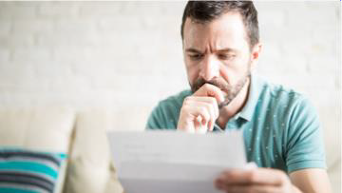
ASL is Not Visual English
Dinner Table Syndrome
ASL is a different language from English
Not all DHH are bilingual
ASL is Not Visual English
Holcomb, 2012

Slide 9

Lack of Video-Based Education in ASL
Dinner Table Syndrome
Lack of ASL Interpreters Provided
Litchman et al., 2022
ASL is Not Visual English

Slide 10

Program of Research
Develop
Intensive Diabetes
Education and Support (IDEAS) Program
Utah Diabetes and
Endocrinology Center
One-Day Program, In-person
NP, Dietitian, Social Worker
Litchman et al., 2019; Litchman et al., 2021

Slide 11

Program of Research
Develop
Adapt
Intensive Diabetes
Education and Support (IDEAS) Program
Utah Diabetes and
Endocrinology Center
One-Day Program, In-person
NP, Dietitian, Social Worker
Rural Diabetes
Education Program
English/Spanish
Telehealth to Primary Care Clinics in Rural Colorado
One-Day Program
NP, Dietitian, Social Worker, Pharmacist
Litchman et al., 2022; Oser et al., 2022

Slide 12
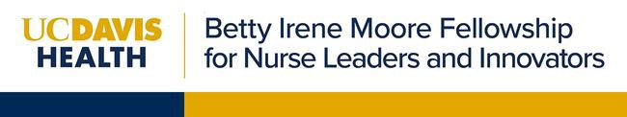
Program of Research
Develop
Adapt
Adapt
Intensive Diabetes
Education and Support (IDEAS) Program
Utah Diabetes and
Endocrinology Center
One-Day Program, In-person
NP, Dietitian, Social Worker
Rural Diabetes
Education Program
English/Spanish
Telehealth to Primary Care Clinics in Rural Colorado
One-Day Program
NP, Dietitian, Social Worker, Pharmacist
Deaf Diabetes
Education Program
American Sign
Language (ASL)

Slide 13




ADAPTATION
Design
Participatory Trial Results

Slide 14
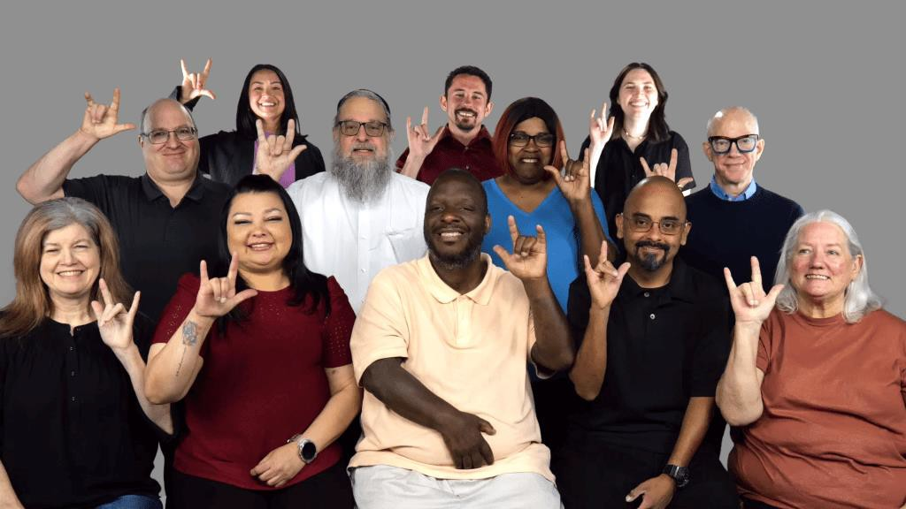
Community Advisory Board
Established in 2022
50% with T1D
50% racially/ethnically diverse
Living across the U.S.
8 initial meetings
Litchman et al., Under Review

Slide 15


METHODS
DHH-PWD National Community
Advisory Board (N=10)
Design
Interventionists - DHH
Virtual sessions to reach DHH across US
10-12 sessions (2 hrs) to fill the education gap
Unify diabetes terms in ASL
Data collection in ASL
ASL “handouts”
Cover ADCES7 behaviors
  Expand nutrition/meds
  Add advocacy for ASL interpreters
Litchman et al., under review

Slide 16
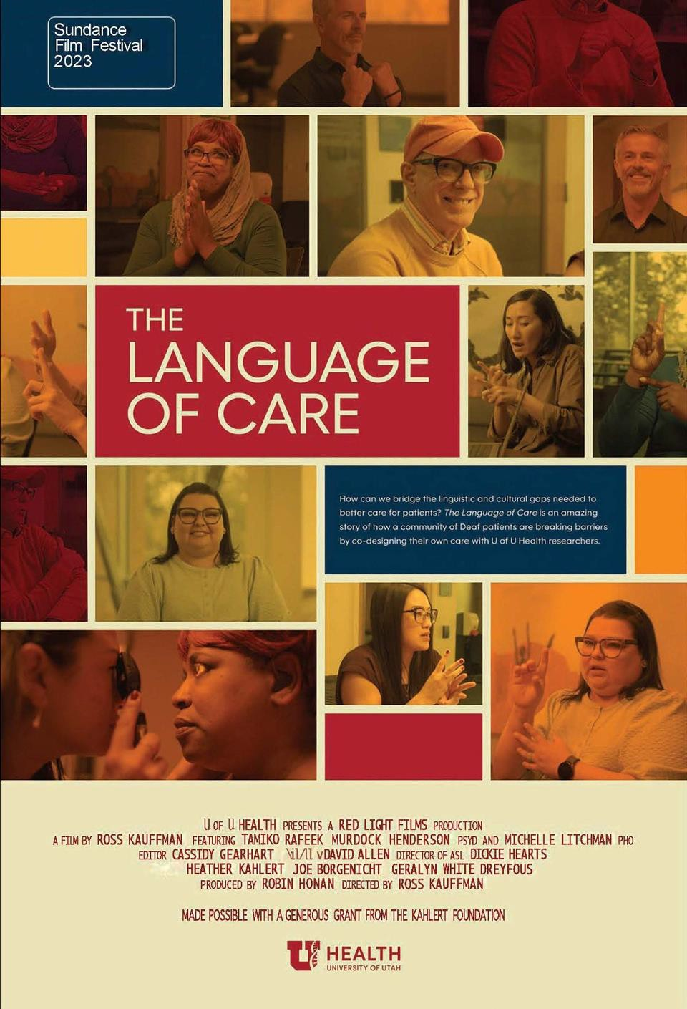
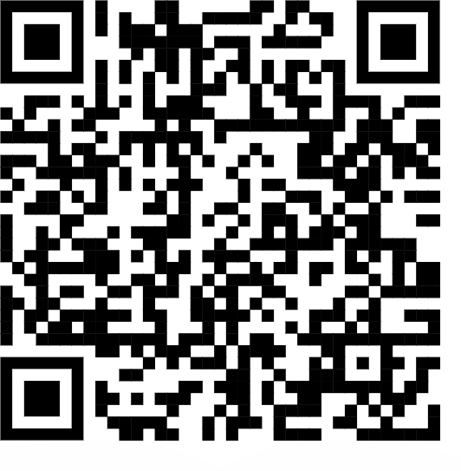
DOCUMENTARY
uofuhealth.utah.edu/languageofcare

Slide 17
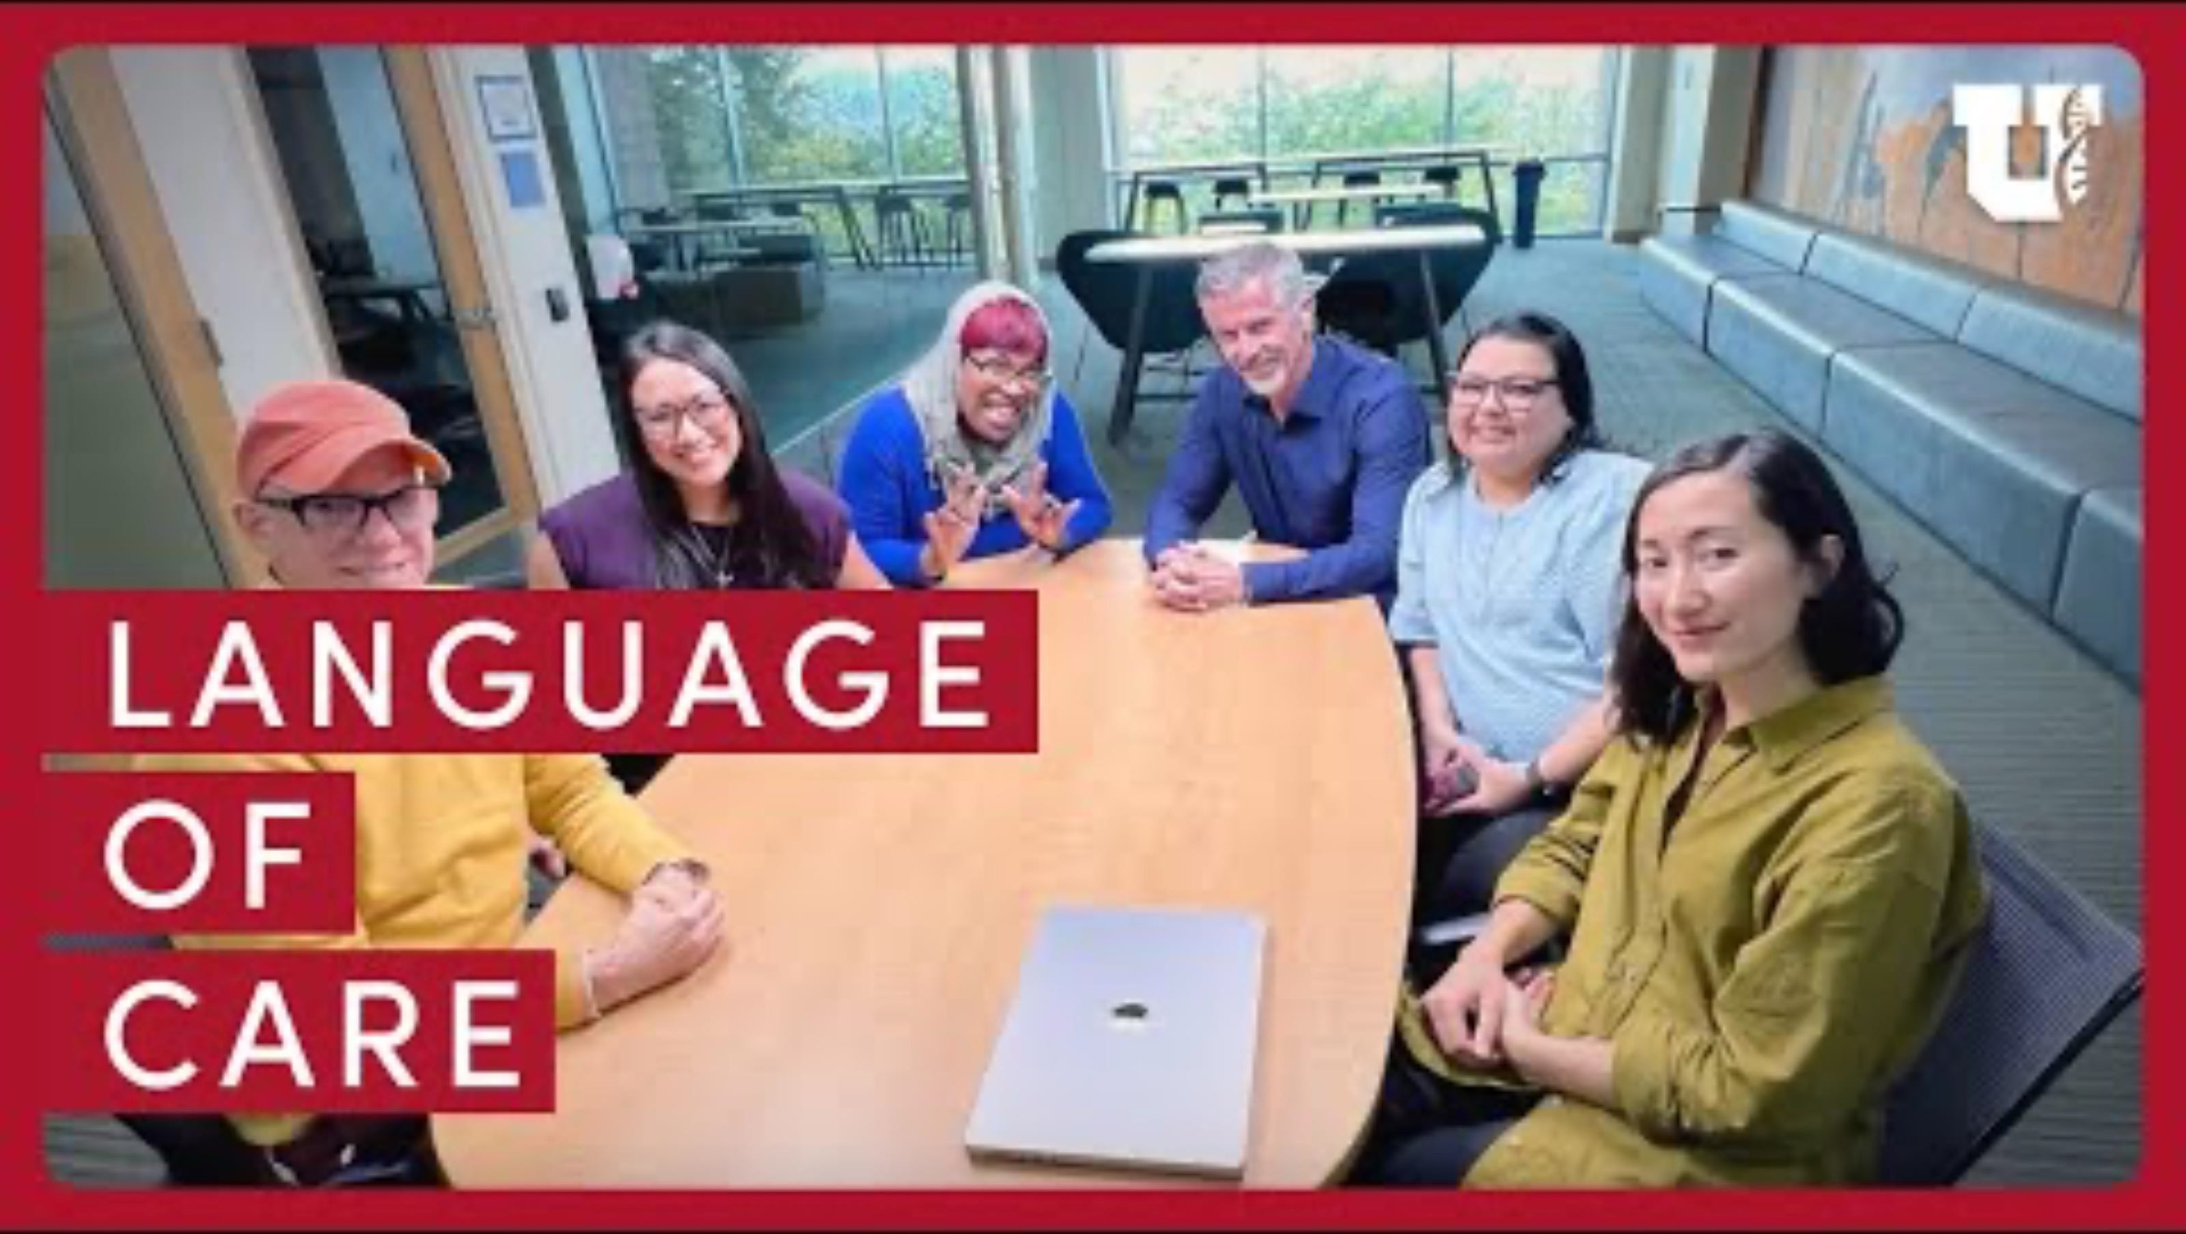
Language of Care

Slide 18
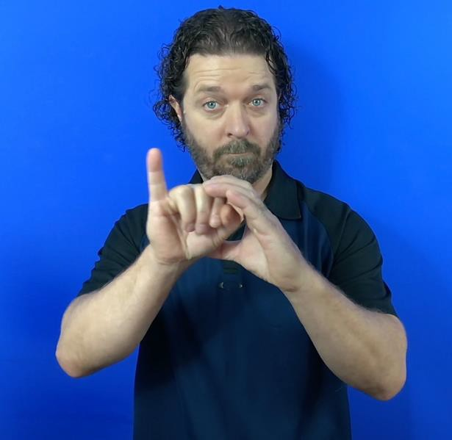
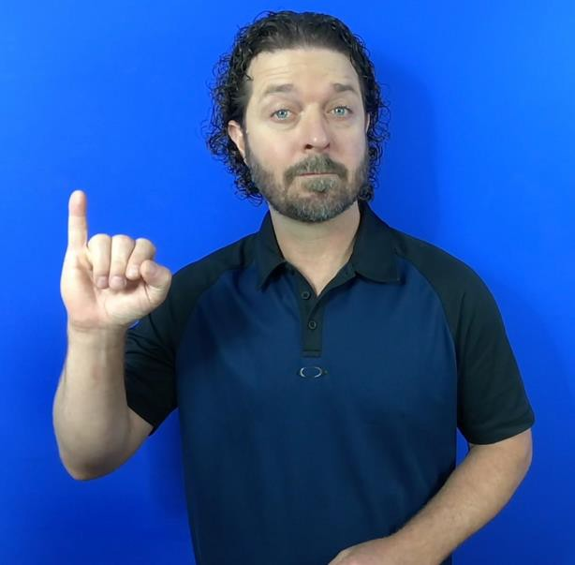
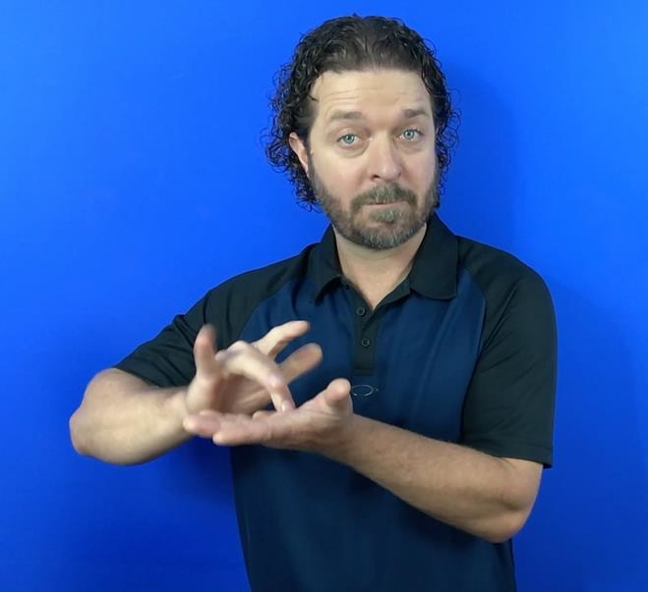
ASL GLOSSARY OF DIABETES TERMS
A
B
Insulin by pancreas
Insulin medicine
Mirus et al., under review

Slide 19
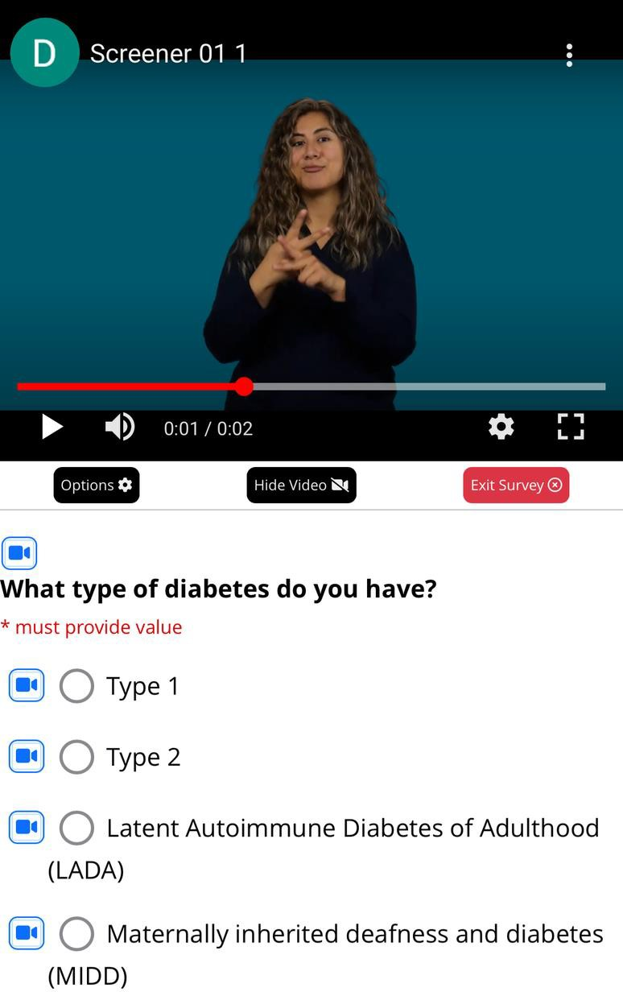
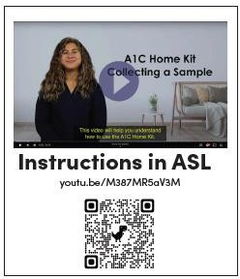
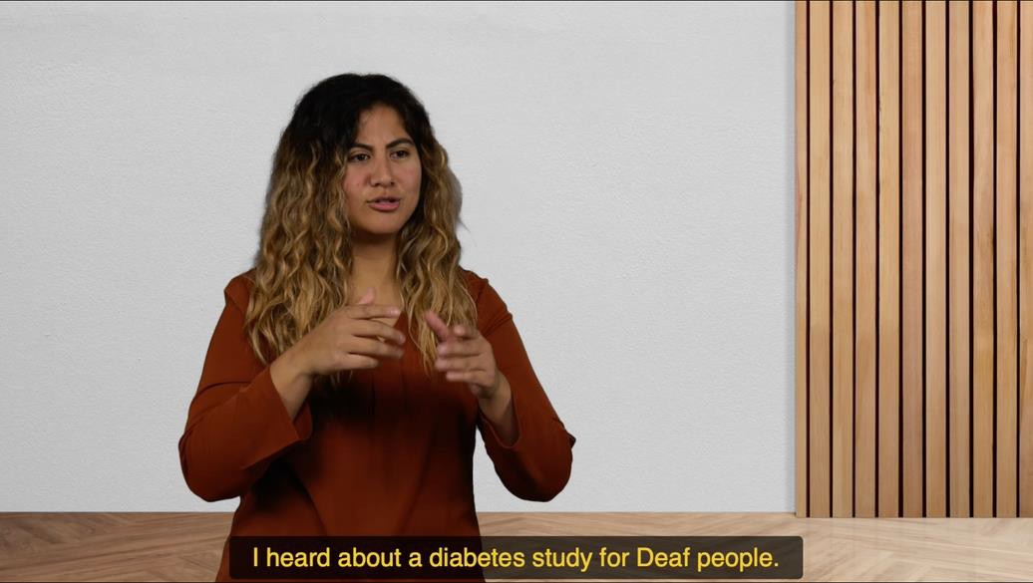
DATA COLLECTION
Novella Consent Video
A1C Home Kit
REDCap

Slide 20
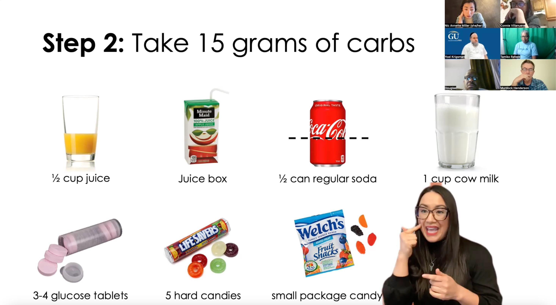
ASL DIABETES EDUCATION VIDEOS
Litchman et al., 2025

Slide 21
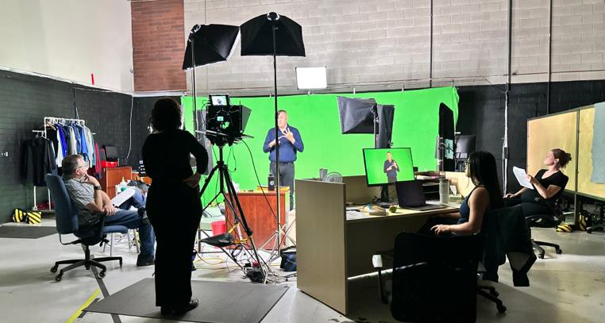
ASL DIABETES EDUCATION VIDEOS
Litchman et al., 2025

Slide 22
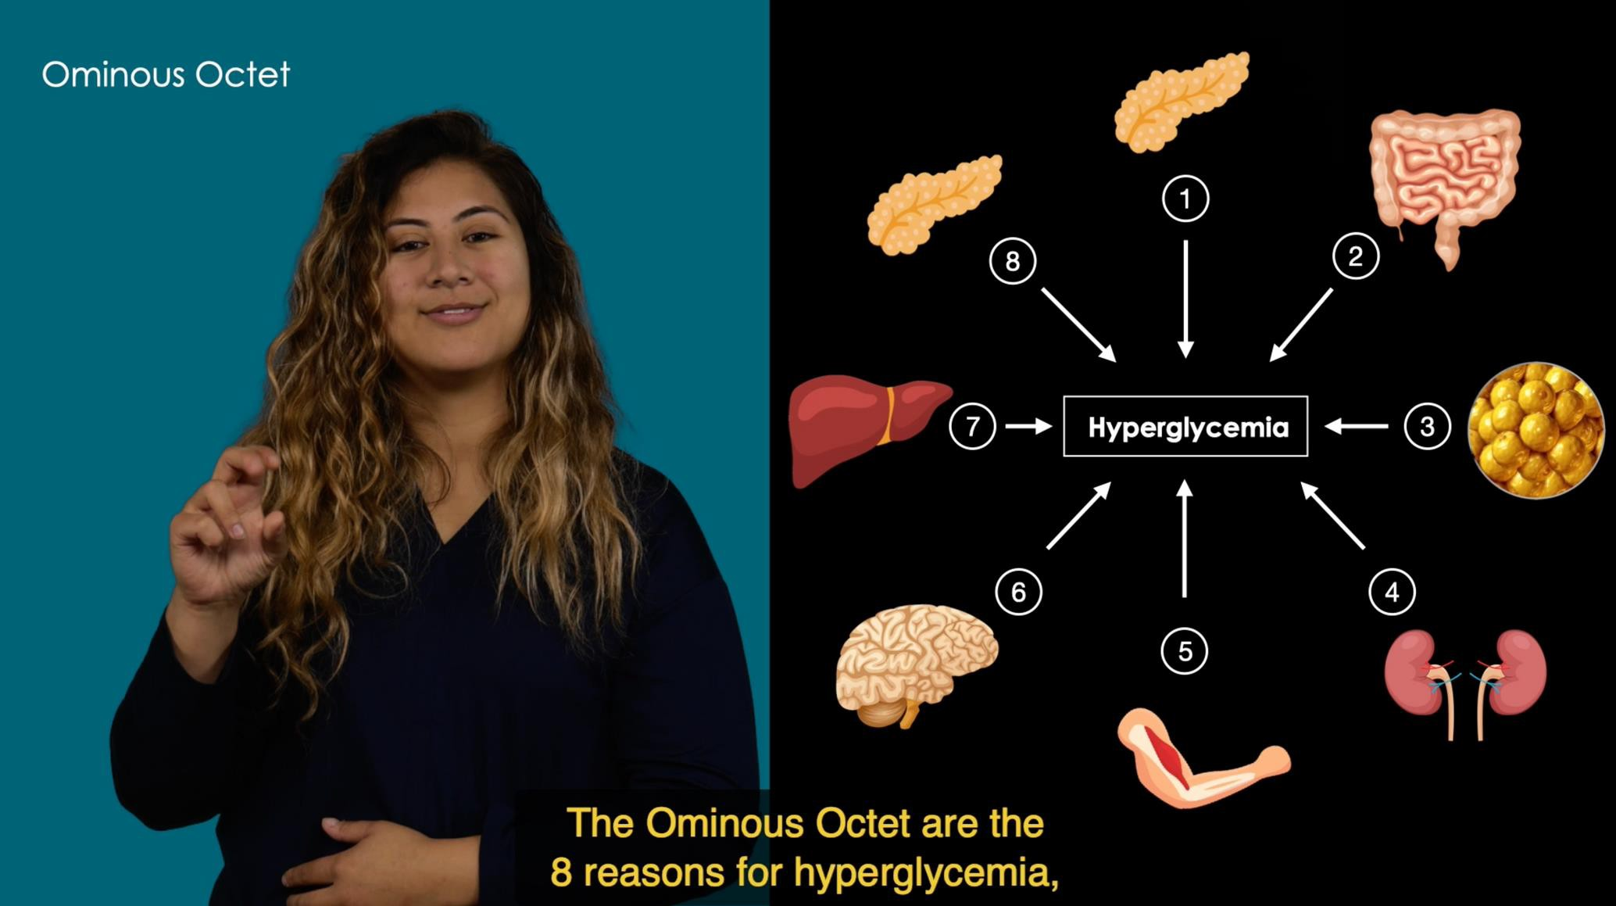
ASL DIABETES EDUCATION VIDEOS
Litchman et al., 2025

Slide 23
ASL DIABETES EDUCATION VIDEOS
HEALTHY COPING
Coping
Long-Term Success
HEALTHY EATING
Healthy Plate
Carbohydrate Recommendations Reading Food Labels
BEING ACTIVE
Physical activity and exercise
TAKING MEDICATION
General Medication
Pills and Non-Inulin Medications
General Insulin Basal Insulin Bolus Insulin
MONITORING
Checking glucose
PROBLEM SOLVING
Goal-setting
Troubleshooting hypoglycemia
Troubleshooting hyperglycemia
REDUCING RISKS
Diabetes Basics
Diabetes Complications/Labs
ADVOCACY
Self-Advocacy (ASL Interpreters)
FAMILY/FRIEND SUPPORT
Support person
Communicating about Diabetes at Home
Litchman et al., 2025

Slide 24

G08
Goal: Develop a diabetes education website in ASL

Slide 25

METHODS
Design
User Testing Dissemination

Slide 26
METHODS
DHH-PWD National Community
Advisory Board (N=10)
Design
4 sessions
Use previously developed content
Add FAQ in ASL
Add research repository

Slide 27
METHODS
Design
UX Testing (N=10)
Navigation was clear
High satisfaction
Some preferred video closed captioning in
white vs yellow
User Testing

Slide 28
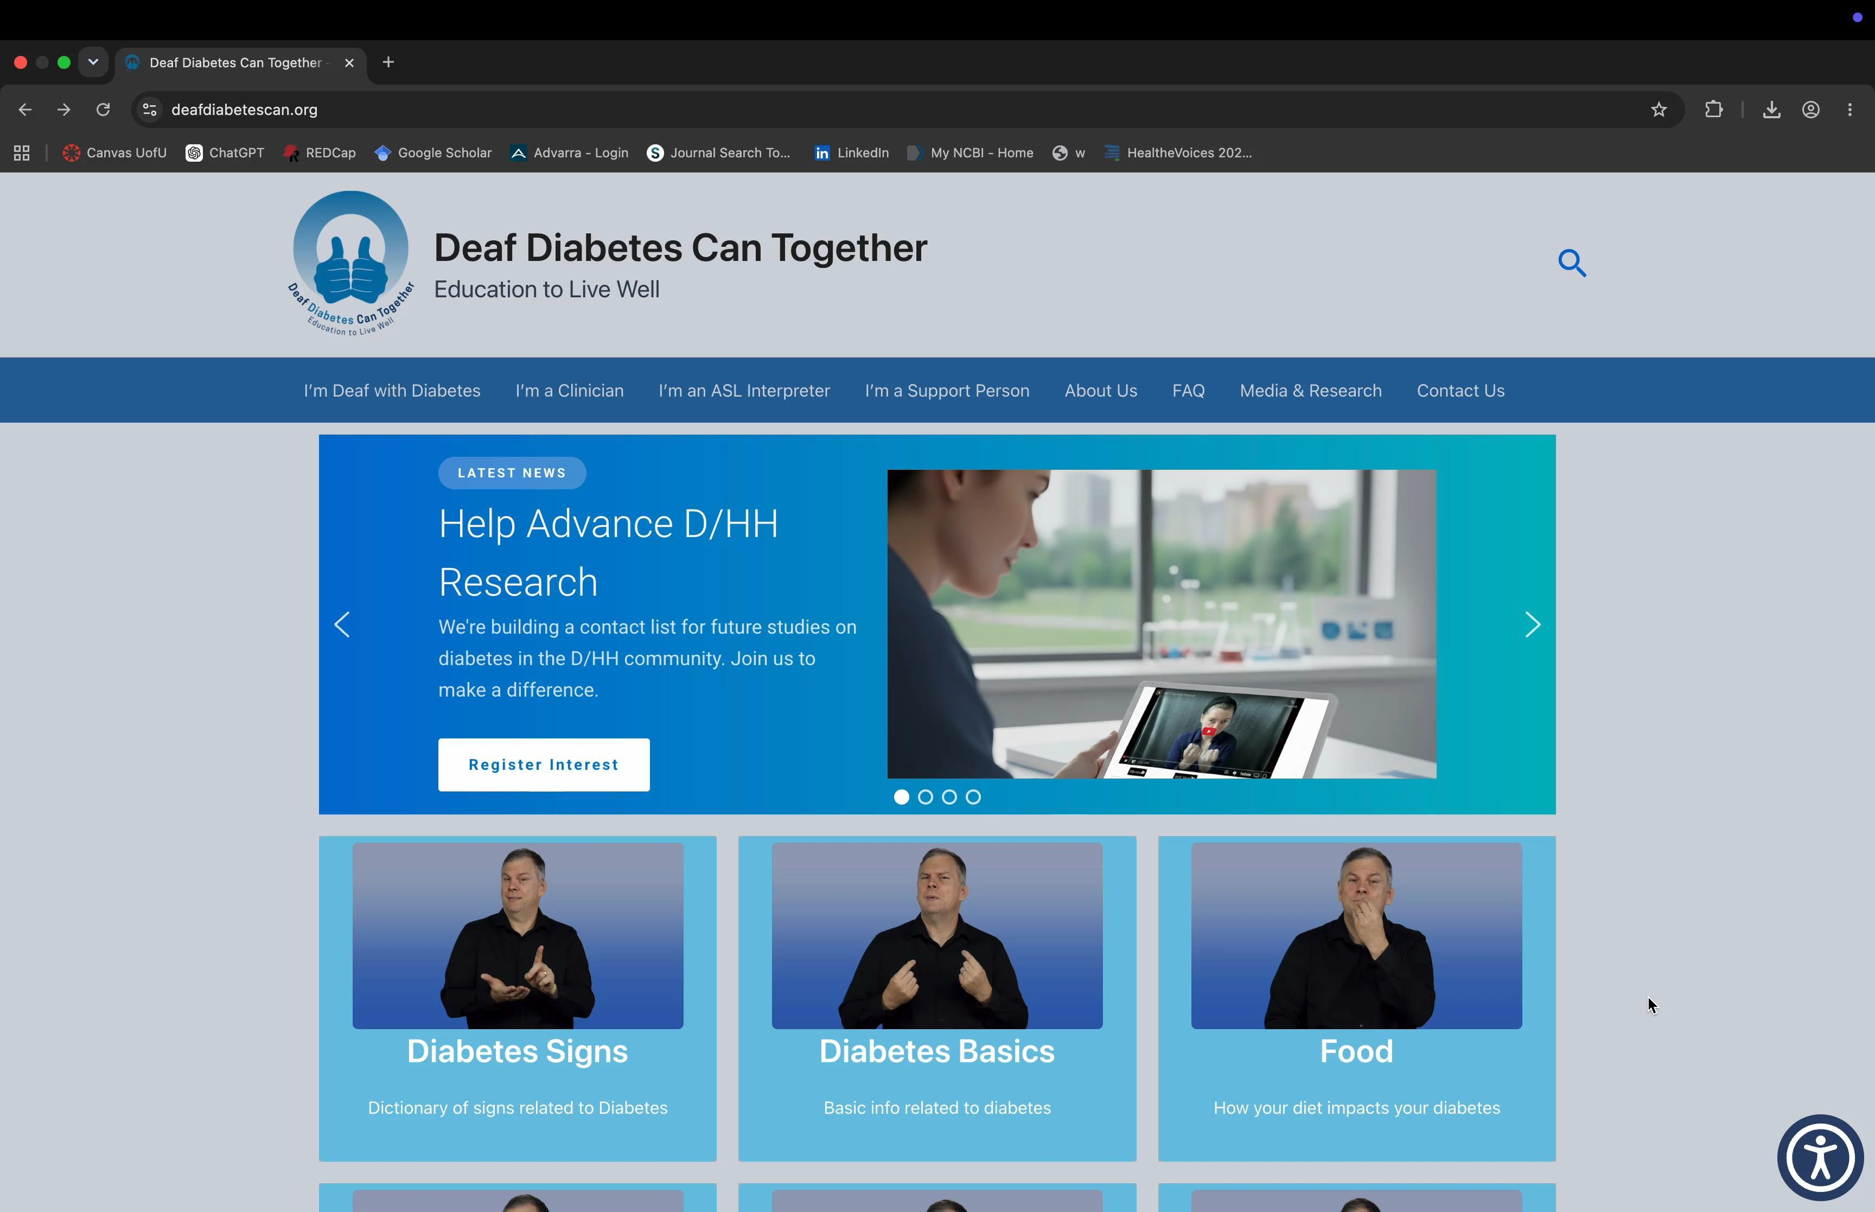
Deaf Diabetes Can Together

Slide 29
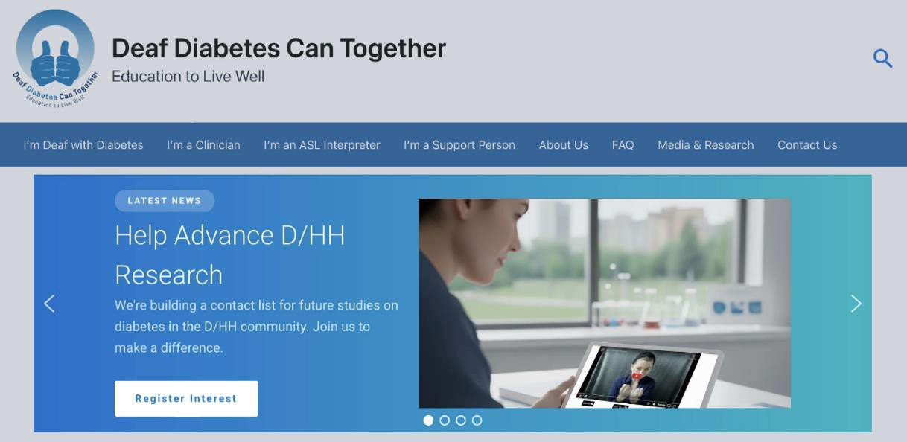
Research Repository
Data is collection in ASL using
REDCap

Slide 30
METHODS
Design
User Testing
Reach
Dissemination
Deaf/HH
Clinicians
Medical Librarians

Slide 31
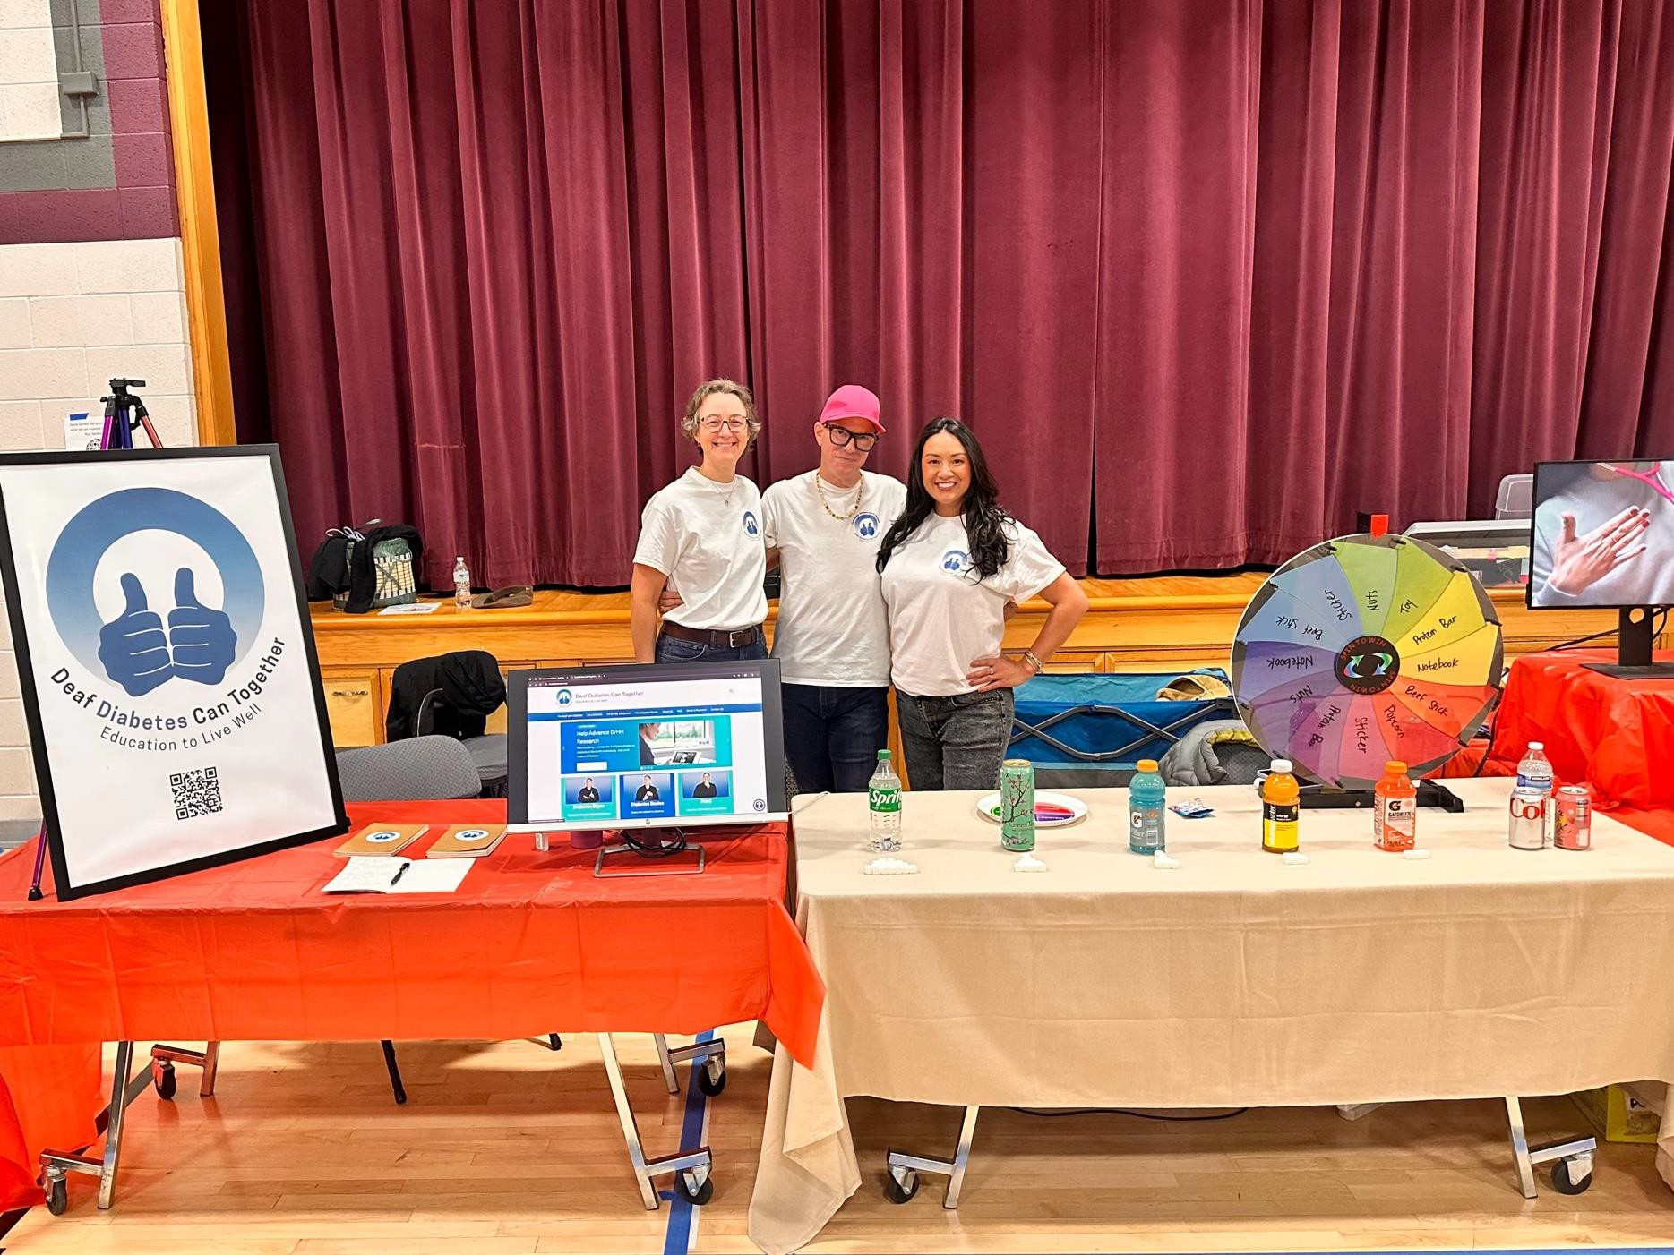
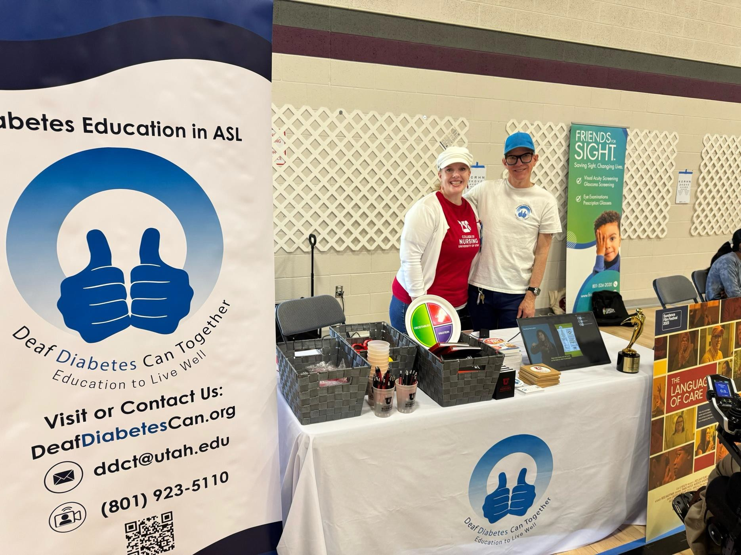
Local Deaf Events
Salt Lake City, UT November 2025
Salt Lake City, UT April 2026

Slide 32
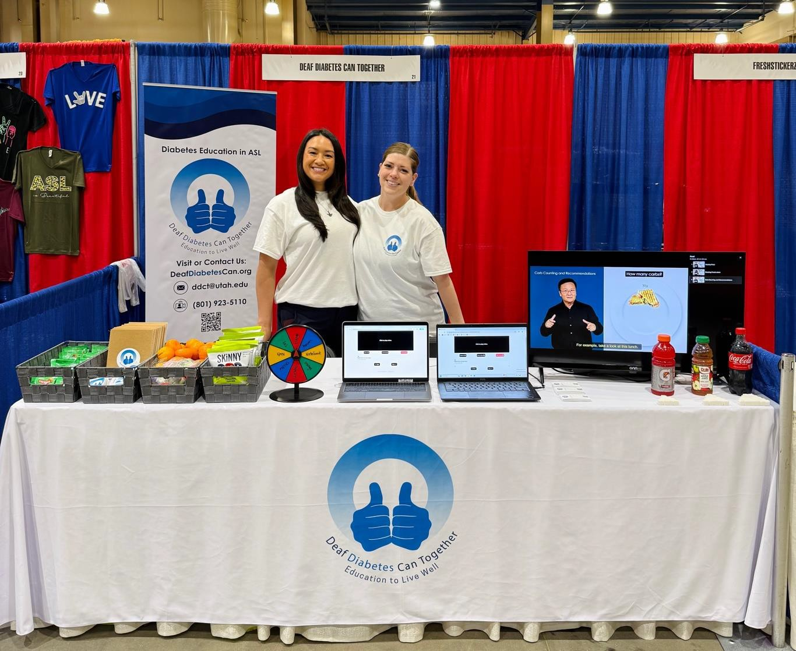
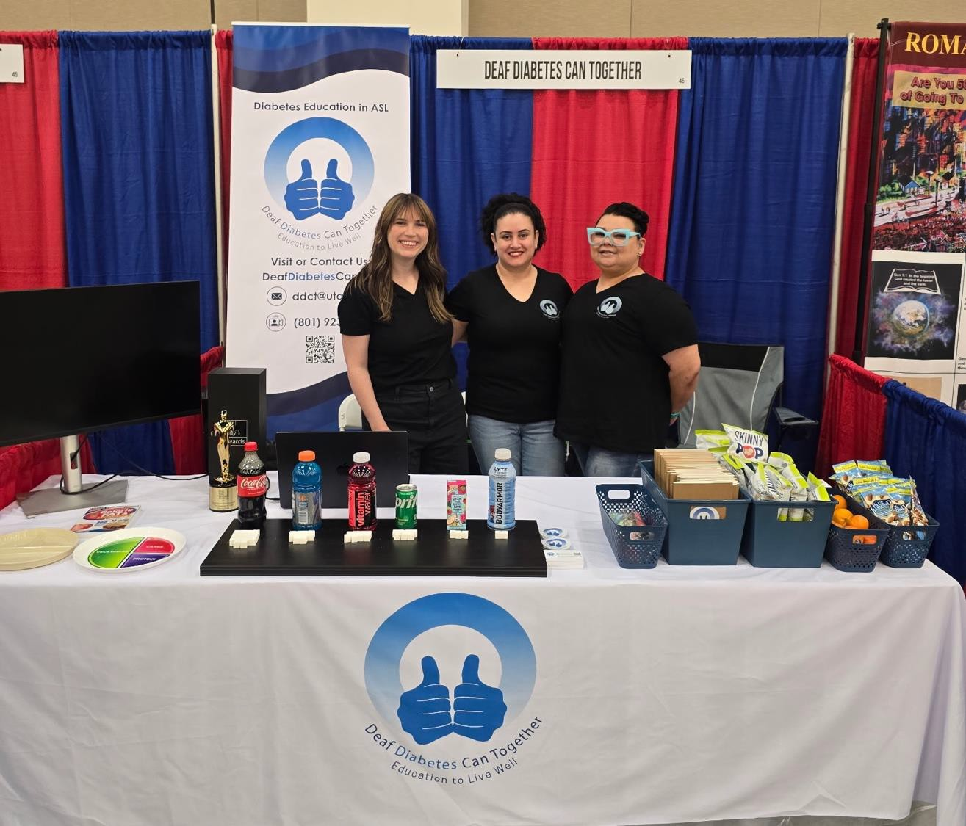
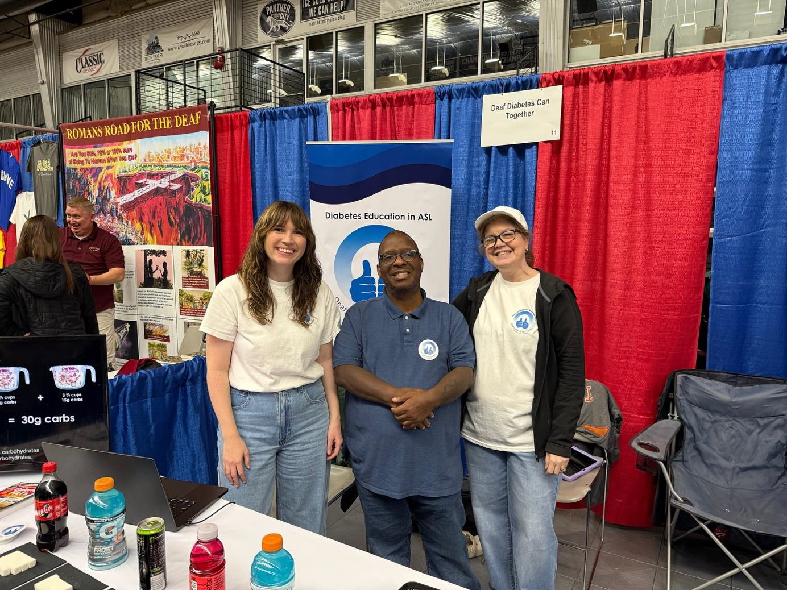
DEAF EXPO
Kissimmee, FL March 2026
Pasadena, CA April 2026
Austin, TX April 2026

Slide 33


CLINICIANS

Slide 34
MEDICAL LIBRARIANS

Slide 35
METHODS
Design
User Testing
Reach
Dissemination
Deaf/HH N= 6,325
Clinicians = 2,353
Website usage
Ever user = 1395
Repeat user = 937
Medical Librarians = 379

Slide 36
CONCLUSION
DeafDiabetesCan.org is the first diabetes education website in ASL
The website was designed with the DHH community All videos are signed by DHH individuals
Usability testing with the DHH community was acceptable
Dissemination to the DHH population, clinicians and medical librarians is ongoing

Slide 37
Next Steps
Continue to disseminate the website to the DHH population, clinicians and medical librarians
Deaf Expo, Seattle (Oct 2026)
International Deaf Expo, Las Vegas (July 2027)
Abstracts submitted to clinician conferences
Submit Medline article
Focus groups to examine the usability and additional content needs from other perspectives
ASL interpreters
Clinicians
Expand the website for other health topics

Slide 38
Visions for Deaf Health

Slide 39
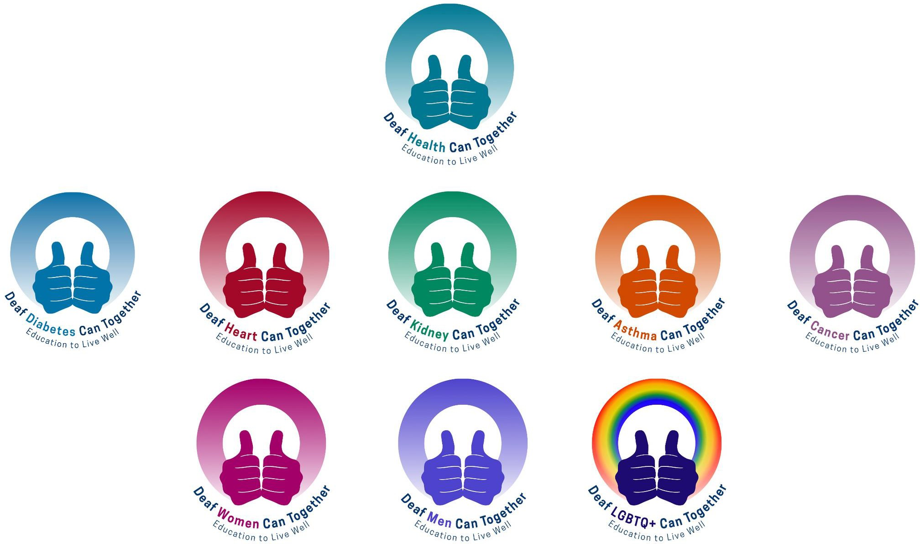
Deaf Diabetes

Slide 40

ONGOING PROJECTS
Comparative Effectiveness Trial (N=60) ASL Videos vs 12-week intervention + CHW Active through Nov 2026
Website of ASL Videos
Active through July 2027
Sustainability of Deaf Diabetes Can Together
Active through Dec 2027

Slide 41
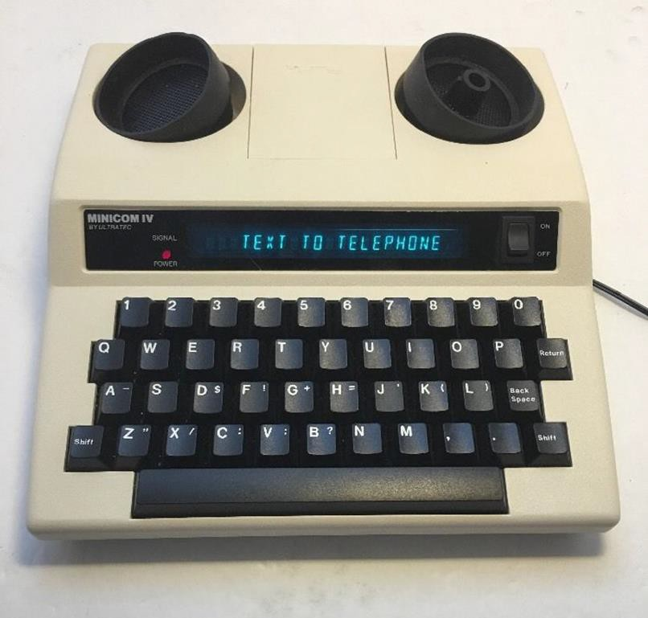
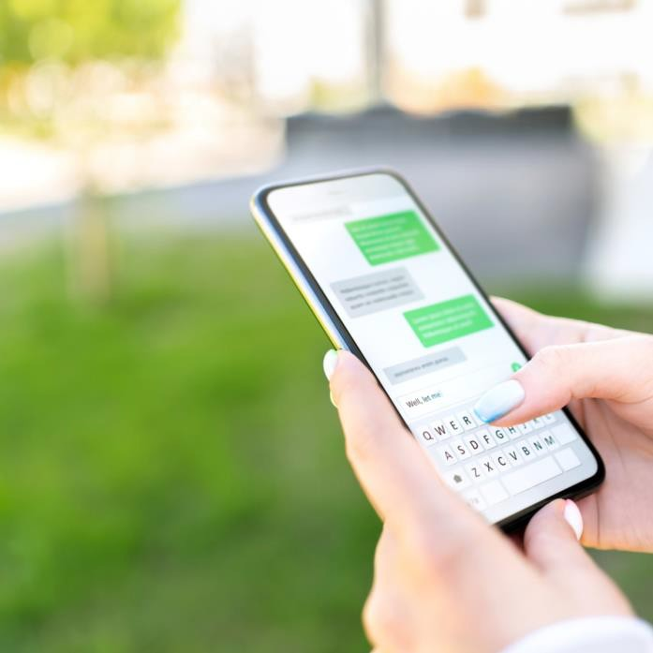
DEAF GAIN
Teletypewriters (TTY) in 1964
Text Messaging

Slide 42
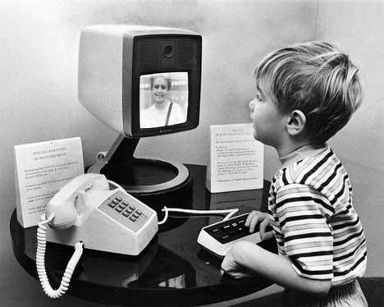
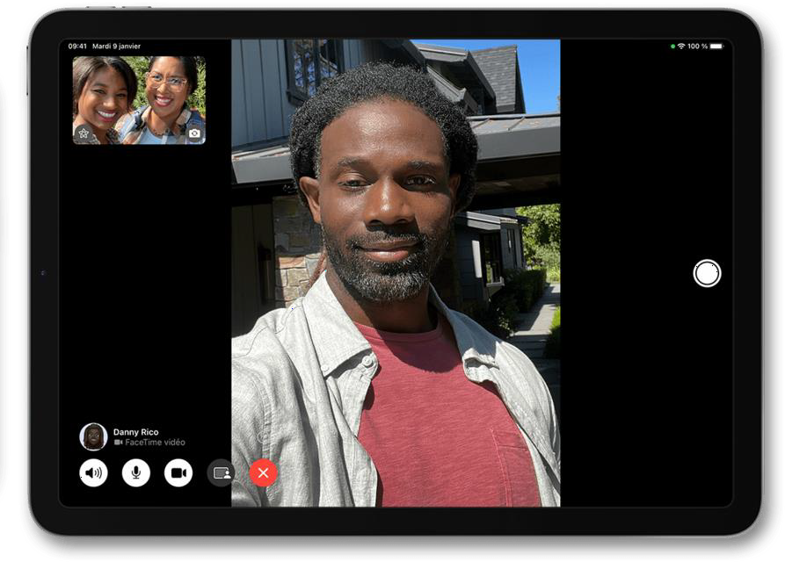
DEAF GAIN
Teletypewriters (TTY) in 1964
Text Messaging
Picturephone in 1964

Slide 43
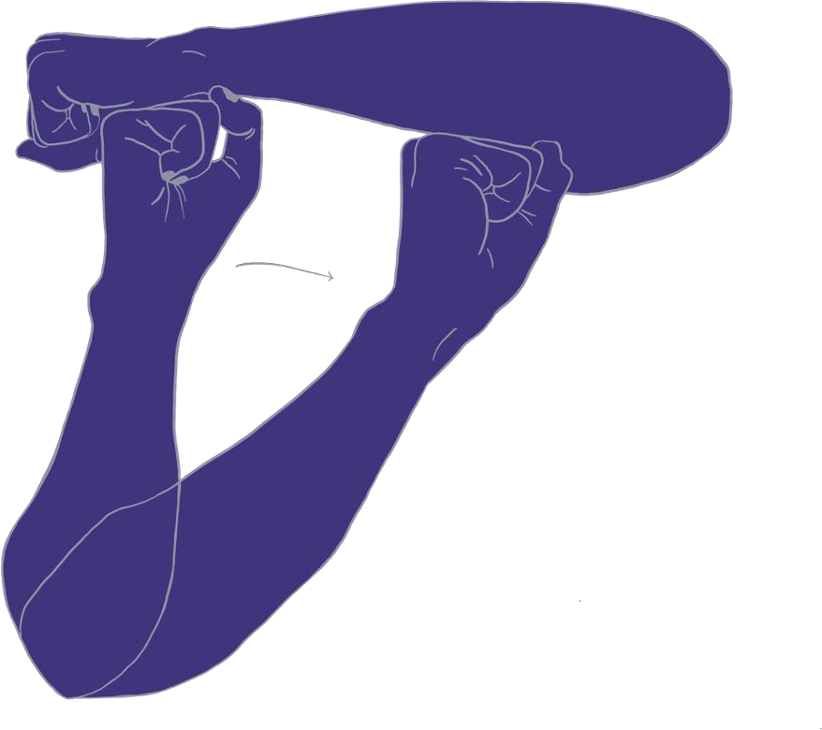


Improve
Deaf Health Outcomes

Slide 44


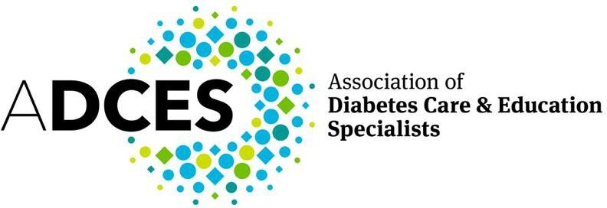



Funding Sources
EXTRAMURAL
FUNDING
STATE APPROPRIATIONS
PHILANTHROPIC SUPPORT
FRANKLIN S.
RACHAEL C.
Next Steps Grant

Slide 45
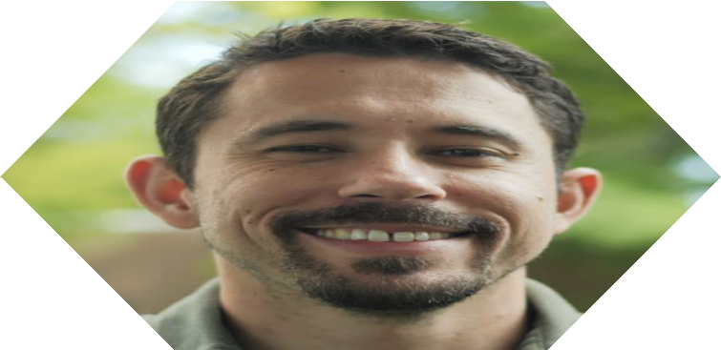
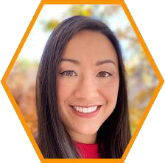
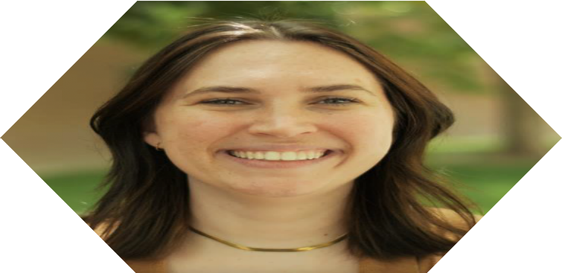
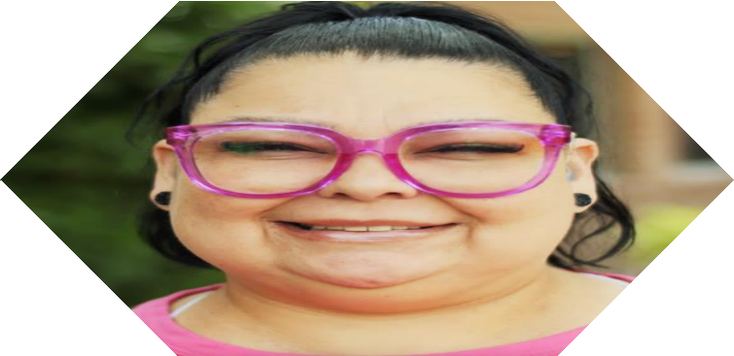
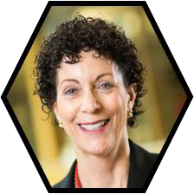
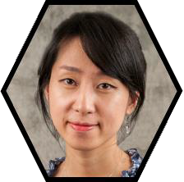
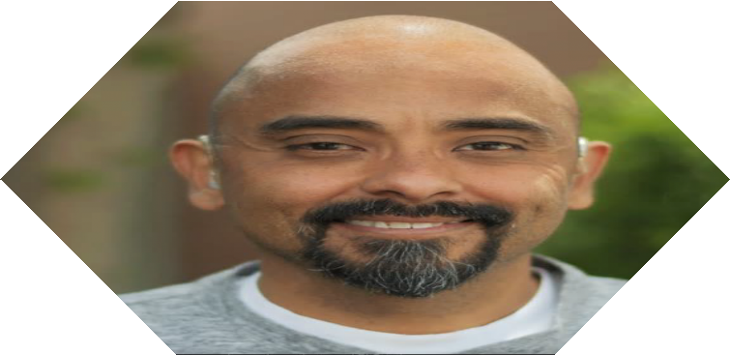
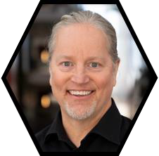
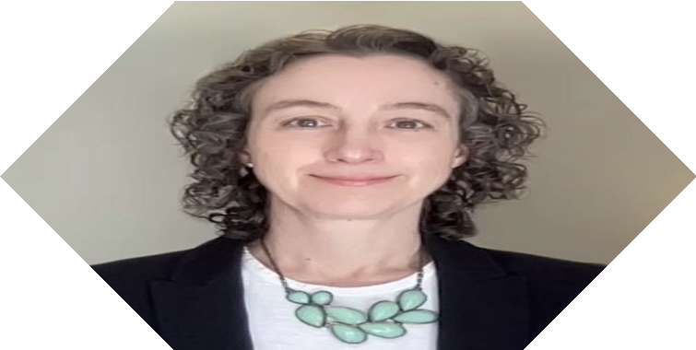
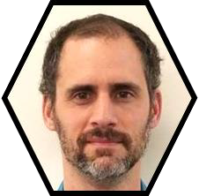
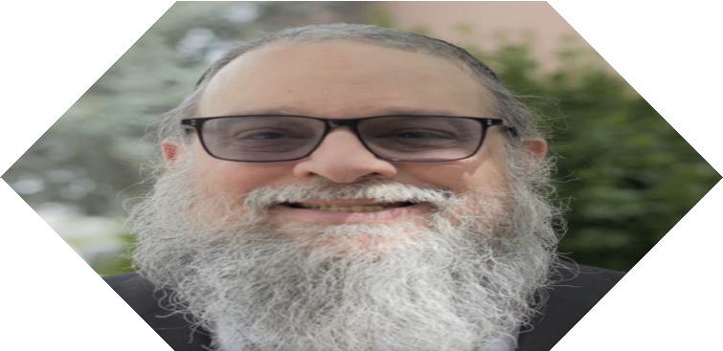
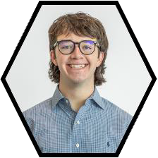
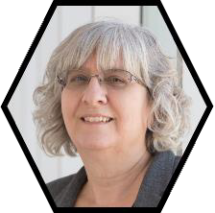
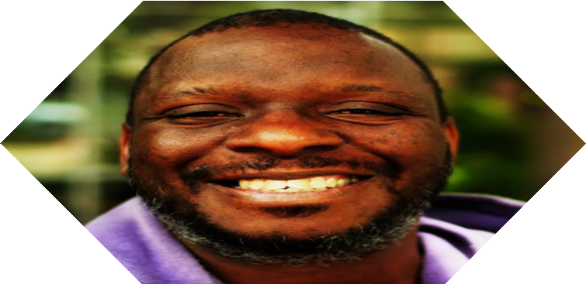
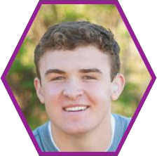










T H E
T E A M

Slide 46
REFERENCES
Bainbridge KE, Hoffman HJ, Cowie CC. Diabetes and hearing impairment in the United States: audiometric evidence from the National Health and Nutrition Examination Survey, 1999
to 2004. Annals of internal medicine. 2008;149(1):1–10.
Meek DR. Dinner table syndrome: A phenomenological study of deaf Individuals' experiences with inaccessible communication. The Qualitative Report. 2020;25(6):1676A-94.
Bhatt J, Bathija P. Ensuring Access to Quality Health Care in Vulnerable Communities. Acad Med. 2018;93(9):1271 -5.
Hall WC, Smith SR, Sutter EJ, DeWindt LA, Dye TDV. Considering parental hearing status as a social determinant of deaf population health: Insights from experiences of the "dinner
table syndrome". PLoS One. 2018;13(9):e0202169.
Mitchell RE, Karchmer M. Chasing the mythical ten percent: Parental hearing status of deaf and hard of hearing students in the United States. Sign language studies. 2004;4(2):138-
63.
Humphries T, Kushalnagar P, Mathur G, Napoli DJ, Padden C, Rathmann C, et al. Language acquisition for deaf children: Reducing the harms of zero tolerance to the use of alternative
approaches. Harm Reduct J. 2012;9:16.
Mitchell RE, Karchmer MA. Parental hearing status and signing among deaf and hard of hearing students. Sign Language Studies. 2005;5(2):231-44.
Schniedewind E, Lindsay R, Snow S. Ask and ye shall not receive: Interpreter-related access barriers reported by Deaf users of American sign language. Disabil Health J.
2020;13(4):100932.
Rinker J, Dickinson JK, Litchman ML, Williams AS, Kolb LE, Cox C, et al. The 2017 Diabetes Educator and the Diabetes Self-Management Education National Practice Survey. The
Diabetes educator. 2018;44(3):260-8.
U.S. Department of Justice. Guide to Disability Rights Laws ADA.gov [Available from: https://www.ada.gov/resources/disability-rights-guide/#americans-with-disabilities-act-ada.
Holcomb TK. Introduction to American deaf culture: Oxford University Press; 2012.
Litchman ML, Moreland C, Fagerlin A, Kushalnagar P. Limited Diabetes Education and Resources in American Sign Language. Diabetes Spectrum. 2022;35(2):134-5.
Litchman, M.L., Delaney, R.K., Neuberger, J., Wang, X., Fagerlin, A., & Fisher, S. (2019). An interdisciplinary Diabetes One-Day Education and Care Intervention Improves Diabetes
Distress and A1C. Annals of Behavioral Medicine, 53, S572-S572.
Litchman, M.L., Wang, X., Delaney, R., Neuberger, J., Reeder, A., Jones, S., Simonetti, J., Wahl, M., Fagerlin, A., and Fisher, S.J. (2021). Durable Reductions in A1C and Diabetes Distress
with a One-Day Hybrid DSMES Intervention. Diabetes, 70(Supplement 1). 474-P. doi: 10.2337/db21-474-P
Oser, T.K., Zittleman, L, Curcija, K., Kwan, B.M., Burke, S., Gonzalez, S., Huss, K., Johnson, M., Sanchez, N., Neuberger, J., Iacob, E., Simonetti, J., Litchman, M.L. (2022). Adaptation of a
Diabetes Self-Management Education and Support Intervention to Inform a Randomized Control Trial in Rural Populations. JMIR Diabetes, 7(2):e35664 doi: 10.2196/35664
PMID: 35687385 PMCID: 9233250
Litchman, M.L. Kwan, B.M., Zittleman, L., Simonetti, J., Iacob, E., Curcija, K., Neuberger, J., Latendresse, G., Oser, T.K. (2022). A Telehealth Diabetes Interve ntion for Rural Populations:
Protocol for a Randomized Control Trial. JMIR Protocols, 11(6):e34255. PMID: 35700026
Litchman, M.L., Miller, N.A., Mirus, K., Lee, S., Rafeek, T., Rivas, D., Iacob, E., Allen, N.A. (Under Review). Engaging a De af Community Advisory Board to Address Diabetes Education
Disparities. Health Equity.
Mirus, K., Miller, N., Farovitch, L., Allen, N.A., Lee, S., Quiroga, J., Litchman, M.L. (Under Review). Developing an American Sign Language Glossary for Diabetes Terms. Disability and
Health Journal.
Litchman, M.L., Miller, N.A., Lee, S., Kauwe Tuitama, A.I., Mirus, K., Layton, R., Layton, S., Farovitch, L., Allen, N.A. (epub ahead of print, 2025). Development of a Diabetes Education
Video Series in American Sign Language for Deaf and Hard of Hearing Populations. The Science of Diabetes Self-Management and Care,51(2). PMID: 40119772
doi: 10.1177/26350106251315676
Litchman, M.L., Iacob, E., Lee, S., Mirus, K., Farovitch, L., Elmore, C., Krigsman, J.P., Wertley, A.M., Allen, N.A. (Under Review). Feasibility of Deaf Diabetes Can Together: A Telehealth
DSMES Program in American Sign Language. Diabetes Research and Clinical Practice.

Slide 47

Contact Info
Michelle Litchman, PhD, FNP-BC
michelle.Litchman@nurs.utah.edu Karissa Mirus, MSHA Karissa.mirus@nurs.utah.edu

