Slide 1

A People’s History of MDLS
Dani Kirsch, Oklahoma State University
Summer Mengarelli, University of Notre Dame
Nicole Scholtz, University of Michigan
Notes:
Summer

Slide 2

Session Outline
Self-reflection and table discussion (15-20 min)
Overview & preliminary results of our project (15-20 min)
Group reflection and discussion (5-10 min)
Notes:
Summer

Slide 3
Rules of the Road
Much of this session will incorporate group- and self-reflection on experiences and perceptions of MDLS
  Remember that your feelings and experiences may be quite different than others around you, and we want this to be a safe space for everyone to express themselves
  We welcome everyone to engage with the reflections to the extent that they are comfortable, and we will provide an option for anonymous sharing toward the end of the session
During group discussions and reflection, please make space and time for each group member to share so that everyone’s voice can be heard
  Please also respect individuals’ decisions not to engage with the broader discussion
Notes:
Summer

Slide 4
Table Reflections & Discussion

Slide 5

Self-reflection (5-7 min)
Draw, doodle, brainstorm, or just think quietly about…
something that represents MDLS to you
It can be specific to this MDLS, to your MDLS experiences overall, or something else entirely.
Notes:
Dani

Slide 6
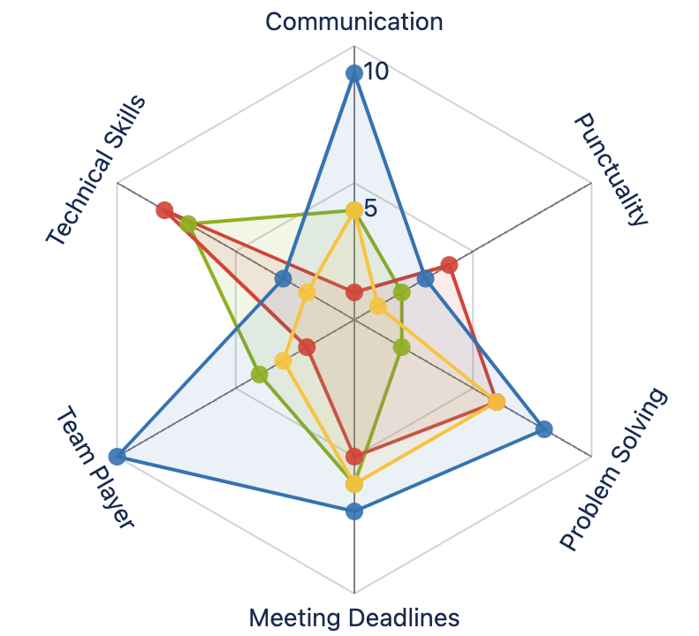
Table Discussion & Spider Chart (10 min)
Distill your self-reflection into 1 or 2 words or short phrases that represent it
  Share/discuss with your table!
Work with your table to fit everyone’s words on the blank spider chart
  Each word should go at a node
Each person at the table takes a few dot stickers and marks how relevant each word is to their MDLS experience
Then connect your dots with marker lines and compare with your group
Image from Stiltsoft User Guide on Radar (Spider) charts
Notes:
Nicole

Slide 7
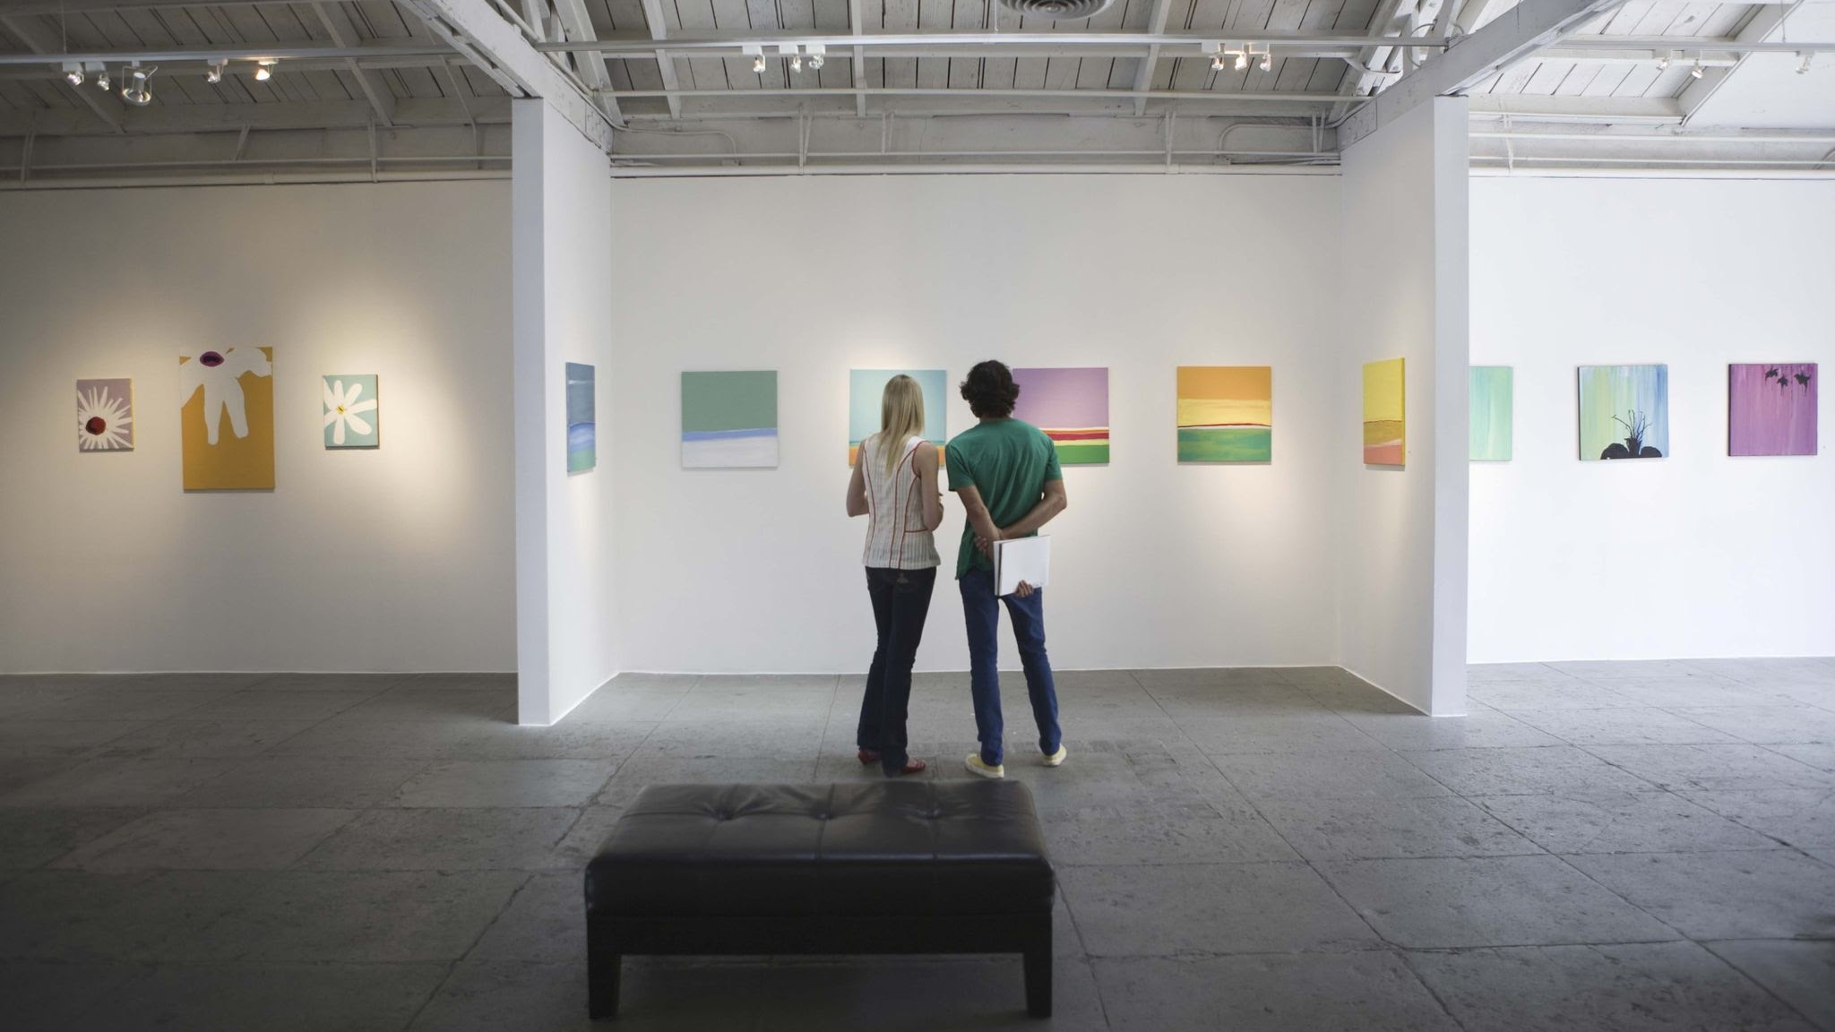
Gallery Walk! MDLS Participatory Data Viz
(3-5 min)

Slide 8
The Project
A People’s History of MDLS:
Reflections and Aspirations for a Regional Data Librarian Symposium
This research project has been reviewed and approved by the Oklahoma State University IRB (Study IRB-26-317)
Notes:
Nicole

Slide 9
Context: Why Are We Doing This?
MDLS 2025
  Tracing Our Data Lineage (E.M. Durham)
  Discussions about disconnect between newer & established attendees
  (e.g., shared vocabulary, lineage of MDLS)
Create shared history
  Reflections (will be deposited in Deep Blue Data Repository at UM)
  Oral History Interviews (Oklahoma Oral History Research Program archive)
What are we interested in?
  How has MDLS contributed to individual professional development?
  How can perceptions and experiences be classified (e.g., positive/negative, professional/affective)?
  In what ways do participants describe or use the language of community when reflecting on their MDLS experience?
Notes:
Nicole

Slide 10
IRB Journey
Who has submitted an IRB application before?
Why did we submit an IRB application?
  Err on the side of caution
  Avoid prematurely limiting the context(s) in which we could use/share data
  Potential for broadening scope to other data librarian symposia/conferences
Experiences throughout the process
  Committing to lots of things early on
  Felt constrained in some ways (e.g., messaging), but modifications possible
  OSU was main IRB (expedited review)
    Notre Dame did not require any IRB oversight
    UM required a ceding application, which was handled with SMART IRB
  Took longer than expected (~ 7 weeks from initial submission to final approval)
Notes:
Dani (+ add-ins from others)

Slide 11

Reflection Survey
Survey had 2 demographic questions and several optional, open-ended reflection questions
Distributed survey to MDLS listserv, datacure Slack, and RDAP Discuss listserv
  Separately emailed MDLS 2026 registrants who had previously attended MDLS
Started recruitment August 18 and closed survey September 25 (38 days)
  10 responses as of 9/22/2026
Notes:
Summer

Slide 12

Text Mining
Tools
  R (tidyverse, tidytext, etc)
  Text Mining with R
Methods
  Sentiment analysis🟨
  Bigrams/relationships between words🟨
  LDA topic modeling❌
Limitations
  Relatively little data
“Text Mining with R: A Tidy Approach" was written by Julia Silge and David Robinson. It was last built on 2025-04-07.
Notes:
Summer

Slide 13
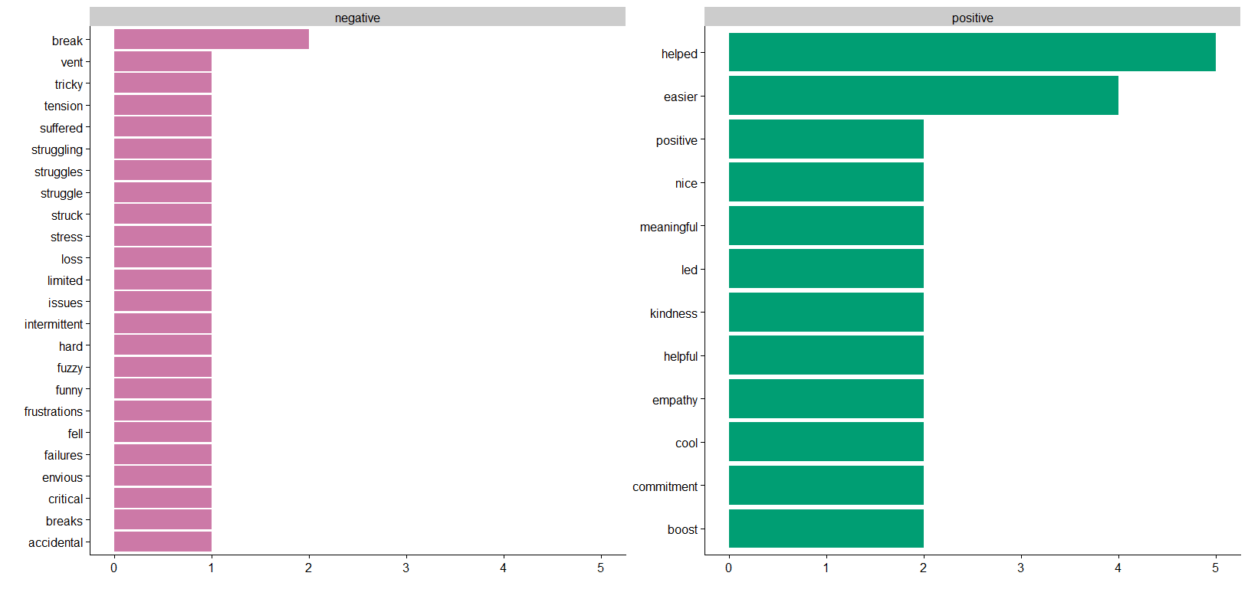
Sentiment Analysis: Preliminary Results
“The Failures/Lessons Learned session is a good mix of catharsis and solutions.”
Notes:
Summer

Slide 14
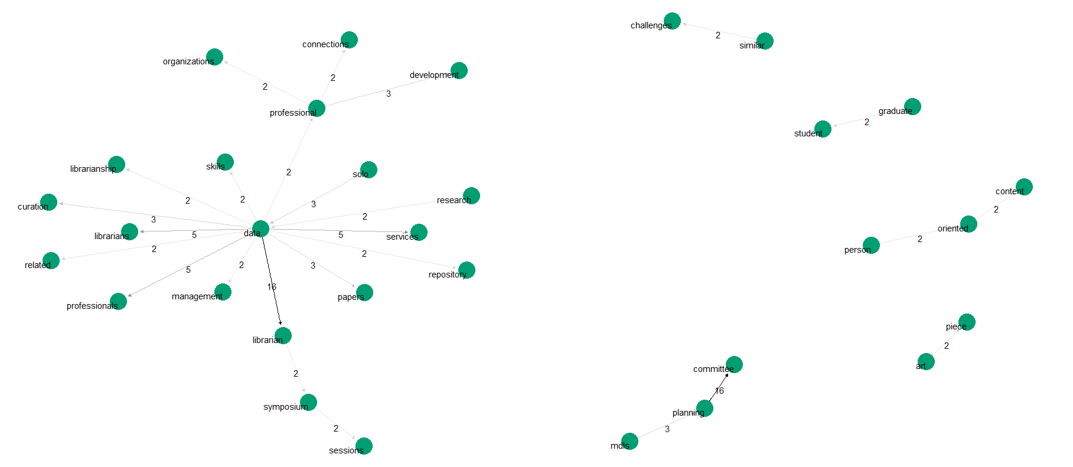
Bigrams Network: Preliminary Results
Notes:
Summer

Slide 15
Thematic Analysis: 6 Steps
Braun, V., & Clarke, V. (2006). Using thematic analysis in psychology. Qualitative Research in Psychology, 3(2), 77–101.
6 steps
  Familiarizing yourself with your data
  Generating initial codes
  Searching for themes
  Reviewing themes
  Defining and naming themes
  Producing the report
Notes:
Nicole

Slide 16
Thematic Analysis: Methods
Values and biases we bring to the process
  Both previous MDLS attendees, but newer to MDLS (<5 times attended)
  Dani newer to data services, Nicole more established
Using an inductive or “bottom up” approach
  Dani & Nicole each separately identified 28 initial categories/codes
  Grouped iteratively into fewer themes & sub-themes
  Coordinated to arrive at 4 major themes
Where we are
  Responses closed last Friday
  Completed steps 1-3, and in the midst of reviewing preliminary themes (step 4)—likely a second round of coding coming soon
  Both coders quite inexperienced with thematic analysis, so a fun learning opportunity
Notes:
Nicole

Slide 17
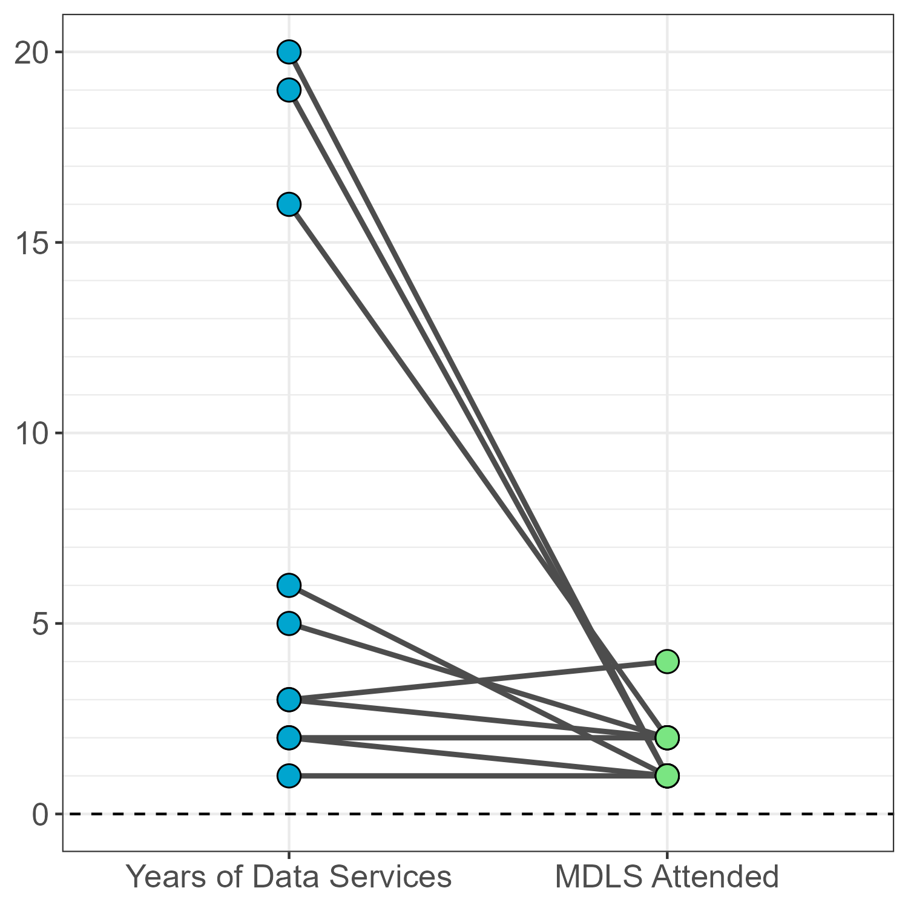
Preliminary Results: Thematic Analysis
Coded 10 survey responses
Also coded content from a published piece from MDLS 2023
  Koshoffer, A., Badger, K., Adams, K., & Munandar, A. (2024). Midwest Data Librarian Symposium: A Model for Regional Communities. College & Research Libraries News, 85(8), 332.
Survey demographic questions
  How many years has data services been a part of your work?
  How many times have you attended MDLS?
Notes:
Dani

Slide 18
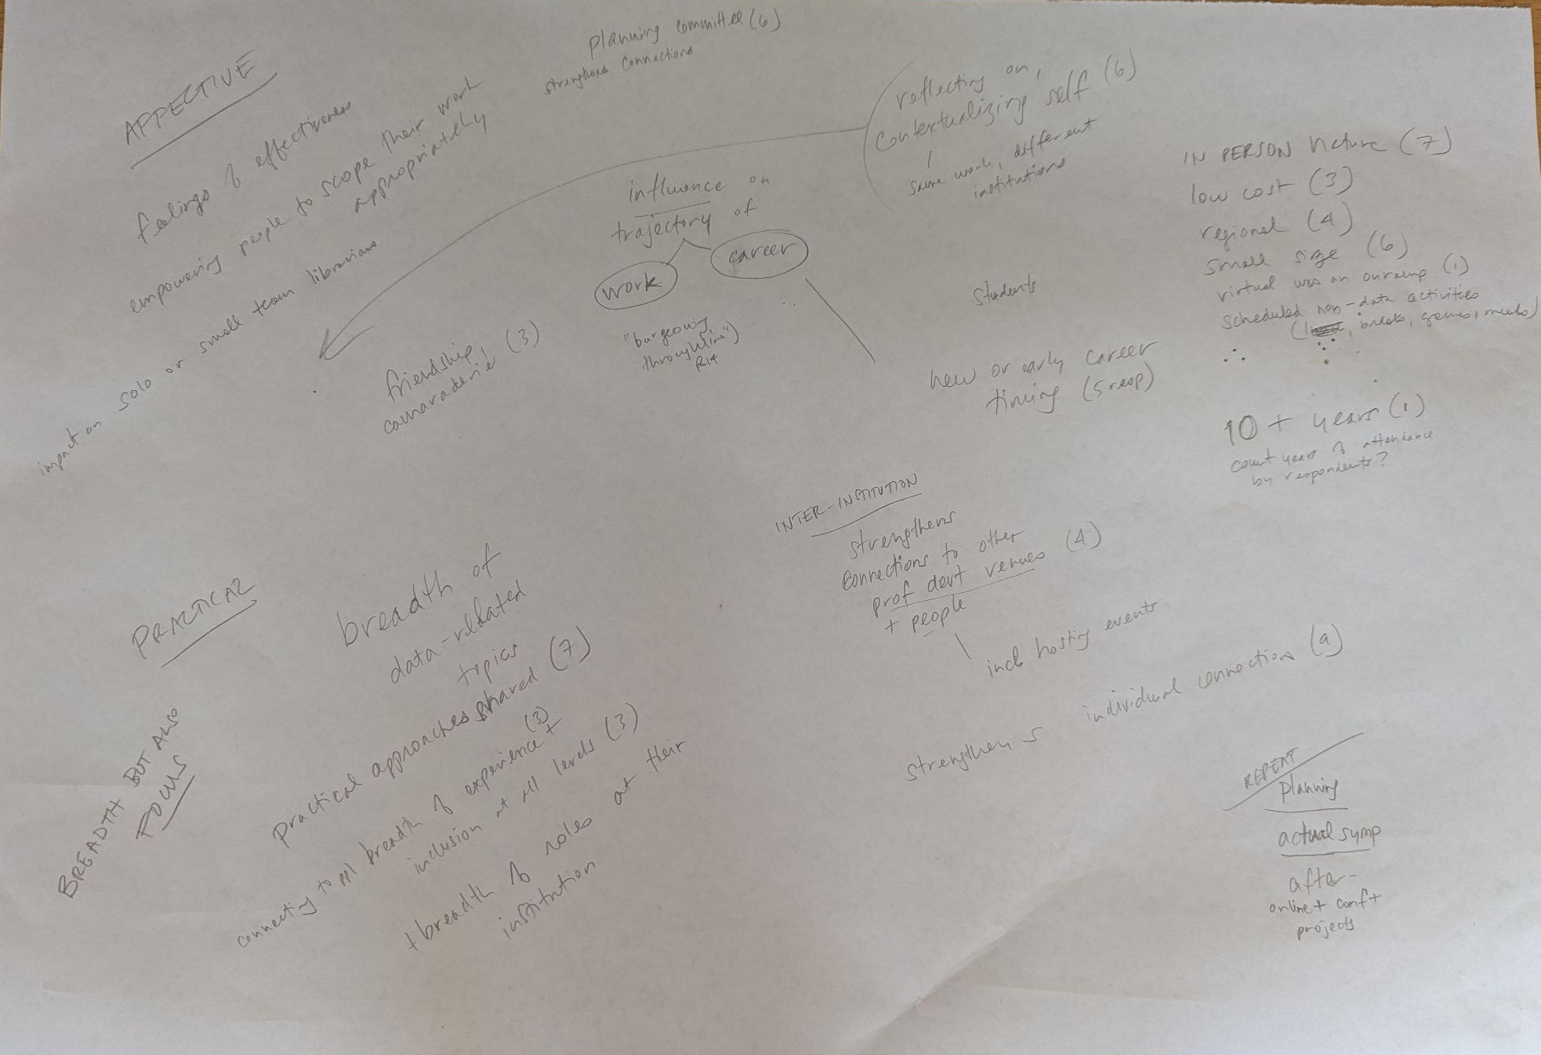
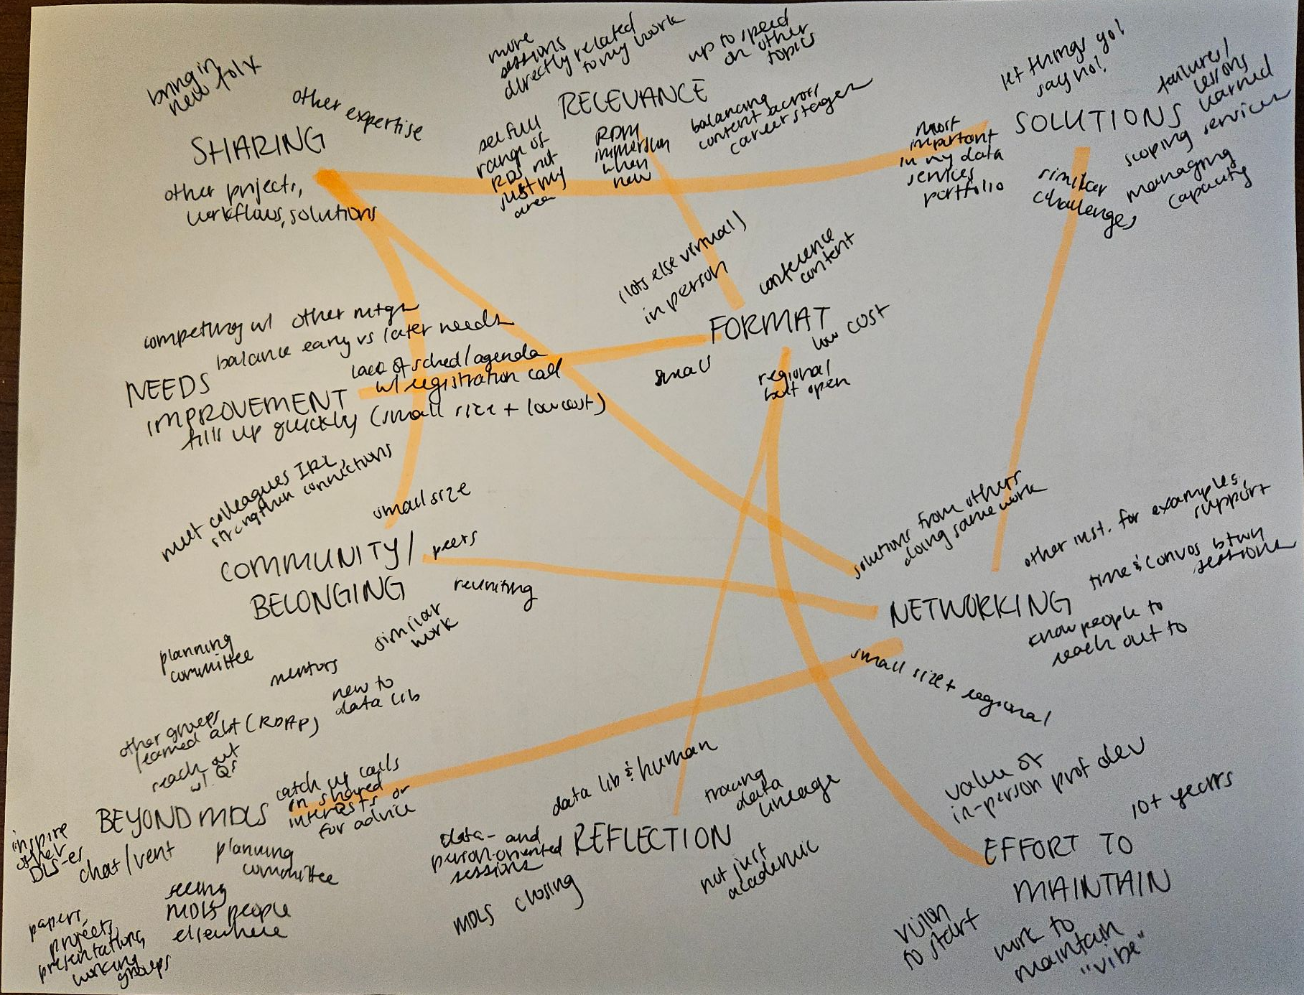
Searching for themes involved several iterations
(and lots of thinking about and reconfiguring codes)
but we eventually arrived on 4 major themes
Notes:
Dani

Slide 19
Theme 1: Symposium Topical Programming
MDLS programming is relevant for many data professionals who attend
  Breadth of data-related topics & sharing of practical approaches
  Keeping up to speed with topics not present in day-to-day work
  Impactful for early career folks and students
Attendees come from a variety of roles and bring many different levels of experience in data services and librarianship
“While I am a data services professional, very little of my work pertains to some major areas of data services…so MDLS has been a good avenue to stay more up-to-date on those aspects of the field.”
“The conference was shortly after starting my new position so it was a good chance for me to immerse myself into the RDM space.”
Notes:
Dani

Slide 20
Theme 2: Symposium Affective Experiences
Attendees benefit from reflecting on their work
  Contextualizing self as both a professional and a human
  Supported in scoping work appropriately (e.g., letting things go, saying no)
Able to bring one’s whole self to the symposium
“Like any professional conference, MDLS gives me new ideas and opportunities to learn. But it also allows me the rare opportunity to think deeply and critically about what is most important in my data services portfolio. Sometimes that even means learning to say no.”
“I appreciate that MDLS ends with a reflective closing session and has a more casual, introspective business meeting/feedback session on the last day. This conference helps me realize my role as a data librarian and as a human in the professional world and does not just focus on the structured, academic sessions like other data adjacent conferences do.”
Notes:
Dani

Slide 21
Theme 3: Symposium Logistics & Practical Features
Attendees appreciate the time built into the schedule for building camaraderie and friendships
Symposium logistics identified as important
  In-person format
  Small size
  Regional location
  Low cost
One downside is that small size and low cost means registration fills quickly
“Colleagues I’d seen on listservs, or perhaps chatted with on DataCure, were in the flesh! And it was easier to get to know them, which made it easier to follow up with them later.”
“The small size and being able to connect with colleagues regionally has helped me in my position where I am on a small team and often feel silo-ed in my work.”
Notes:
Nicole

Slide 22
Theme 4: We Take the Symposium with Us
Nearly all respondents mentioned strengthening new or existing connections through MDLS attendance
MDLS experiences influence attendees’ work and career trajectories
  Some attendees learn about and connect with other groups and conferences
  Symposium had led to inter-institutional projects and collaborations
Planning committee identified as another way of strengthening connections
“I have also served on the MDLS planning committee and that in itself has been a great way to meet people in similar roles and get service experience, which is a factor in my promotion and reappointment processes.”
“Papers, projects, and conference presentations have been born directly out of connections made at MDLS.”
Notes:
Nicole

Slide 23
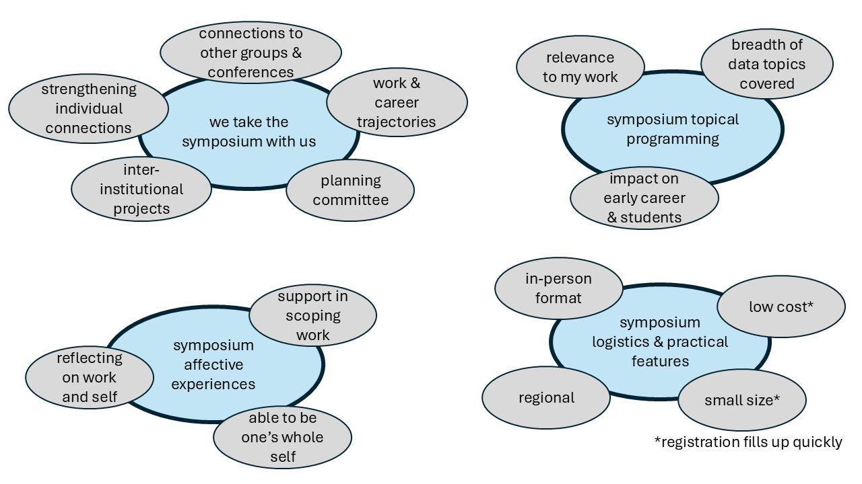
Side-by-side NLP & Thematic Analysis Summaries

Slide 24
Final Reflections

Slide 25
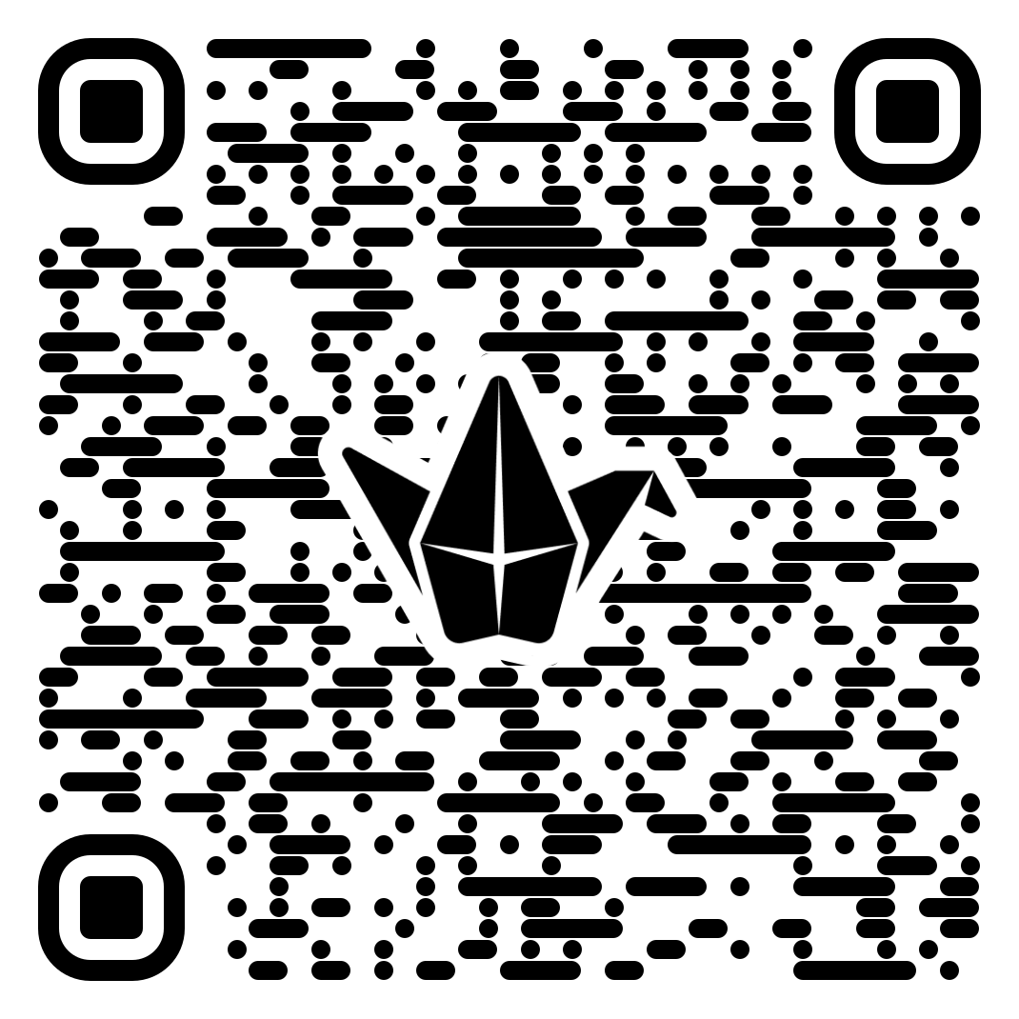

Consider your initial table discussions, the shared visualizations, and our preliminary results
What are your thoughts and insights?
  What differences and/or similarities do you see between our results and your table discussions?
  What themes stood out to you and why?
  What elements are missing?
What actionable steps can we take?
  If you were a first-time attendee next year, what information/resources would you want in advance?
  What activities outside of MDLS do you do or could you do to strengthen the connections you’ve made here?
Provide anonymous responses through our Padlet!
tinyurl.com/mdls-reflections-padlet
or share out loud!
Notes:
Summer

Slide 26
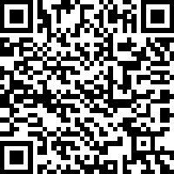
We want your nominations!
The next phase of this project involves recording oral history interviews with community-nominated individuals.
Interview focus is on preserving history, impact, and trajectory of MDLS from multiple narrators’ perspectives
This oral history collection will be publicly available online through the Oklahoma Oral History Research Program’s archive
Nominate one or more people using this link!
Self-nominations are welcome and responses are anonymous.
tinyurl.com/mdls-nominations
Contact us: danielle.kirsch@okstate.edu | smengare@nd.edu | nscholtz@umich.edu
Notes:
Dani

