Slide 1

MDLS 2026
Business Meeting

Slide 2
Thank you to the 2026 Planning Committee!
Co-chairs: Kelly Denny, Summer Mengarelli, Mikala Narlock
Committee members:
  Marianne Bracke (2025 co-chair)
  Jonathan Barber (2025 co-chair)
  Jennifer Moore (2027 chair and host)
  Nicole Scholtz
  Roger Justus
  Dani Kirsch
  Isaac Wink
  Sandi Bates
  Ben Ingall
  Megan Sapp-Nelson
  Ethan Fridmanski
  Sara Hansen

Slide 3
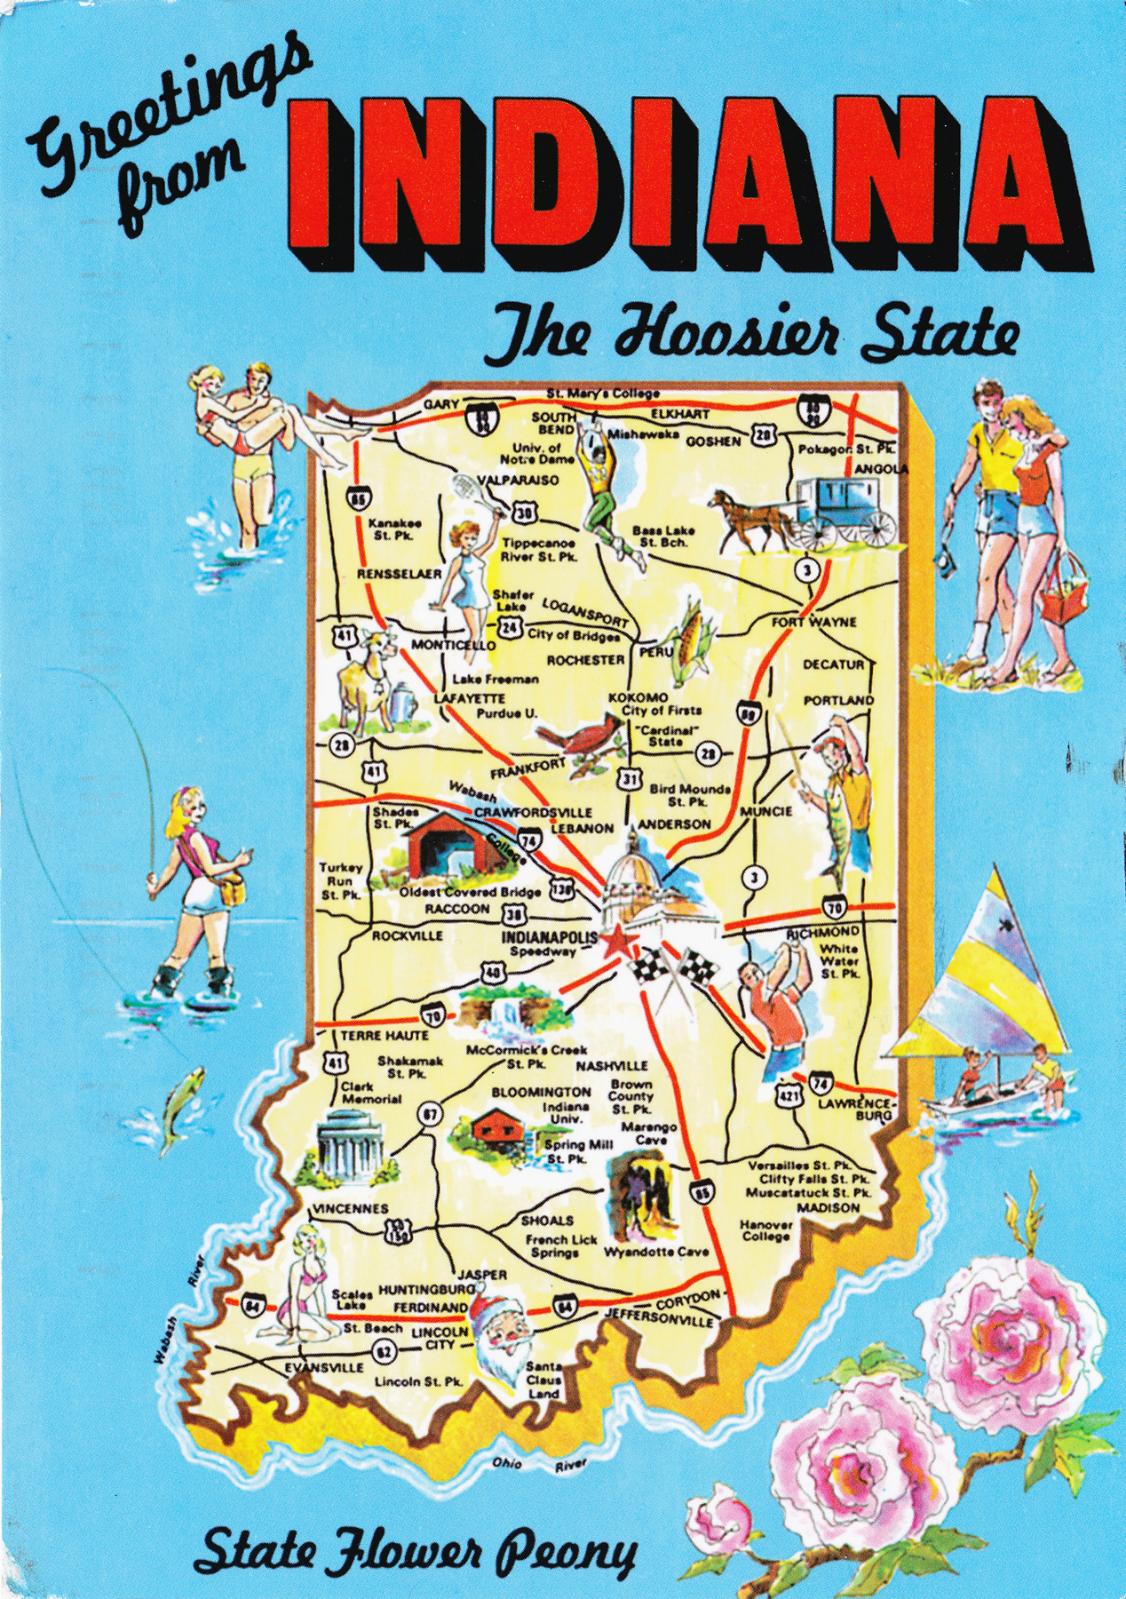
MDLS 2026 Statistics
New and returning attendees
  59 total attendees: 23 first time, 13 second time, 23 more than once
We welcomed 1 student and 58 non-students
  Thank you, Brittney!!
Geographic breakdown
  20 U.S. States; 2 countries (U.S. and Yemen)
    Midwest – 44 (18 IN)
    Northeast – 4
    South – 3
    West – 3

Slide 4
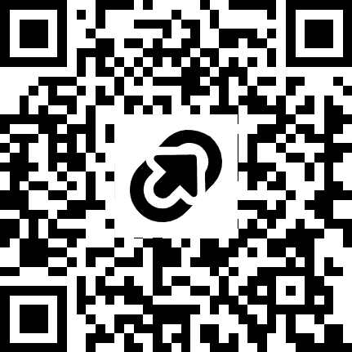
How are we feeling?
Comments from 2025
Looking forward to 2027
Networking element is great
Variety of presentation formats
Interactive sessions
Small size
Divide between levels of experience
Do you have any general comments?
What should change?
What should stay the same?
Share your comments anonymously via the Post-conference assessment (QR code)
  https://tinyurl.com/MDLS2026feedback

Slide 5
Continued Support
How do we support each other throughout the year?
  What are some new ways to connect?
  Current resources:
    MDLS Listserv
    DataCure Slack channel
    RDAP community events (e.g. Kaffee Klastch)
    Solo Data Librarians monthly call (Nina Exner & Daria Orlowski)

Slide 6
MDLS 2027
We’re going to St. Louis!
  Host site: WashU, St. Louis, Missouri
  Chair: Jennifer Moore
  Save the date: ?

Slide 7
Call for 2027 Planning Committee
Month Kick-off meeting
Great way to make connections and network!
Opportunity to hang out with some fun data lib folks
Automatic spot reserved for 2027 symposium
Contact to serve on committee:
  Jennifer Moore (j.moore@wustl.edu)

Slide 8
Committee Obligations
Lots of documentation
MDLS conference website maintenance
Monthly meetings (more as we near symposium date)
Emails sent out for save the date, proposals, registering, etc.
Proposal evaluations
Schedule of events
Hotel, food, logistics
Splitting up of tasks for flexibility

Slide 9
Seeking 2028 Host!
Talk to current and past hosts to see what would be involved
MDLS Planning Committee manual details past host commitments and responsibilities for hosts/chairs and committee members
Where in the Midwest will we end up next..?

