Slide 1
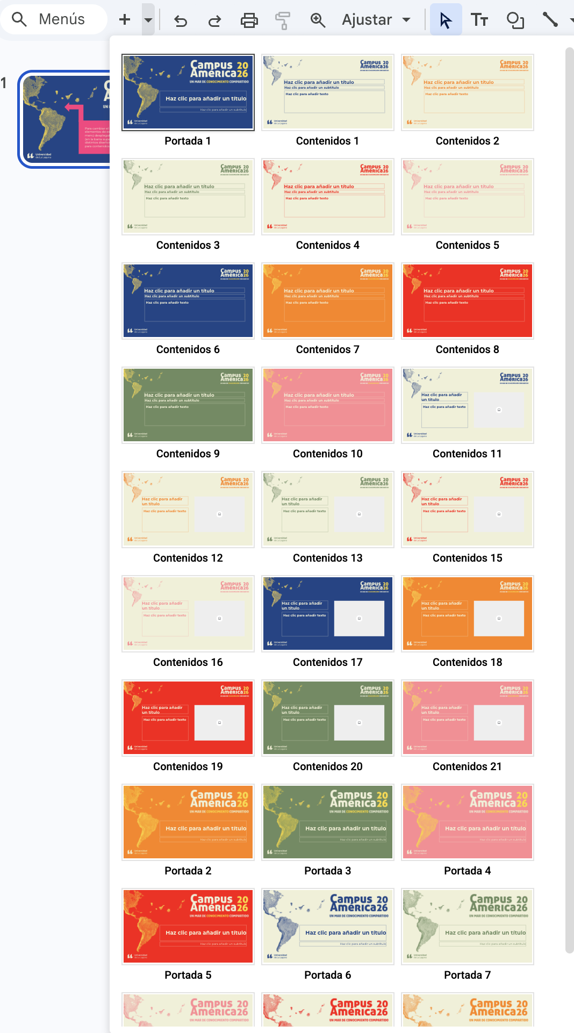
Para cambiar el fondo y la distribución de los elementos de esta plantilla, puedes acceder al menú desplegable que aparece en la imagen (en la barra superior, a la izquierda). Encontrarás distintos diseños de portada y de diapositivas para contenidos.

Slide 2



Culinary Traditions as an Endangered Heritage
Piotr Stec

Slide 3
Endangered Culinary Traditions
Safeguarding the knowledge, skills and communities behind food
Culinary traditions are living heritage: knowledge, skills and social practices, not merely dishes
Like languages, they can lose their speakers — the practitioners who keep them alive
This presentation: why foodways become endangered, and how law and policy respond

Slide 4
More Than What We Eat
The Complexities of Culinary Heritage
Culinary heritage spans the whole food chain: growing and gathering, preserving, cooking, and sharing meals
It includes embodied skills (kneading, fermenting), oral traditions (songs, proverbs) and ritual occasions
Transmission typically happens informally — children cooking alongside elders in family kitchens

Slide 5
When Does a Tradition Become Endangered?
Stop eating this, it’s unhealthy! And other warning signs
Fewer practitioners; masters without apprentices
Interrupted intergenerational transmission
Loss of ingredients, farmland or communal spaces
Disappearance of the social occasions the food anchors (festivals, weddings, family meals)

Slide 6
Pressure on culinary traditions
Destruction – change - desuetudo
Armed conflict and the displacement of bearer communities
Destruction of agricultural environments and of access to local ingredients
Loss of the everyday contexts of practice — including traditional food festivals and events
Undermining of the social and cultural well-being of communities of practice
Exporting, migrating, changing…

Slide 7
The Intangible Cultural Heritage Framework
Giving Culinary Traditions a Michelin Star, or making a glorified cookbook?
UNESCO's 2003 Convention defines intangible cultural heritage (ICH) as practices, skills and knowledge that communities recognize as their heritage
"Safeguarding" means measures ensuring viability — especially transmission through formal and non-formal education
Two key lists: the Representative List (visibility) and the List of ICH in Need of Urgent Safeguarding (for heritage whose viability is at risk despite the efforts of the community and State concerned)
Culinary practices appear in several domains: social practices and rituals, knowledge concerning nature, traditional craftsmanship

Slide 8
Intellectual Property and Culinary Arts
Let’s patent tereré ruso
Sybaris – ancien culinary „patent”
Geographical Indications of Provenance (traditional arts)
Copyright in food?
Trademarks
Licensing culinary heritage

Slide 9
Recognition Is Not Enough
A culinary practice in four phases of dough preparation and wood-fired baking; about 3,000 pizzaiuoli practice in Naples
Knowledge is transmitted master-to-apprentice in the bottega, supported by courses and academies
Inscription raises visibility and pride, but viability depends on continued transmission
Inscription confers no exclusivity or ownership — the Committee expressly recalled this for borscht, shared across the region

